Slide 2
Benevolence

Slide 3
Objectivism is a science

Slide 4
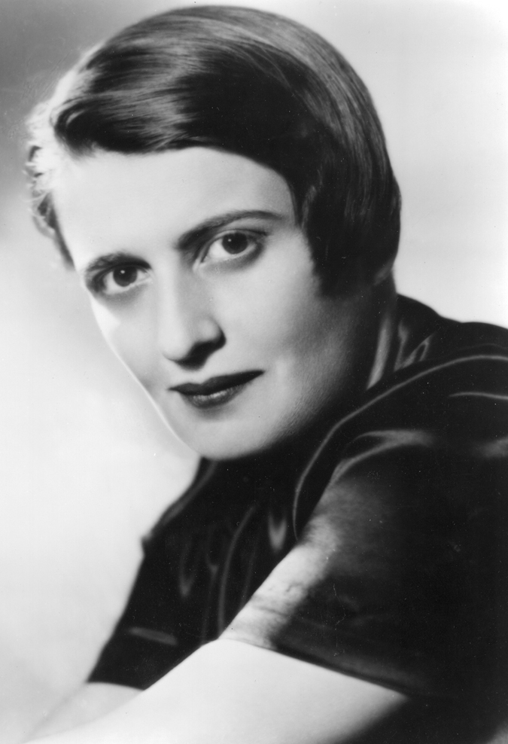
“Epistemology is a science devoted to the discovery of the proper methods of acquiring and validating knowledge. Ethics is a science devoted to the discovery of the proper methods of living one’s life. Medicine is a science devoted to the discovery of the proper methods of curing disease. …
Source: Ayn Rand, “Concepts of Consciousness,” Introduction to Objectivist Epistemology

Slide 5
How should philosophers think and act as scientists?

Slide 6
Objectivism is a science contrasted to Ayn Rand’s fiction as art.

Slide 7
“It is important to note, in this connection, that a discovery cannot be patented, only an invention. A scientific or philosophical discovery, which identifies a law of nature, a principle or a fact of reality not previously known, cannot be the exclusive property of the discoverer because (a) he did not create it, and …”

Slide 8
“… (b) if he cares to make his discovery public, claiming it to be true, he cannot demand that men continue to pursue or practice falsehoods except by his permission. He can copyright the book in which he presents his discovery and he can demand that his authorship of the discovery be acknowledged, that no other man appropriate or plagiarize the credit for it—but he cannot copyright theoretical knowledge.”
Source: Ayn Rand, “Patents and Copyrights,” Capitalism: The Unknown Ideal, p. 130

Slide 9
Scientists | Artists
Newton | Michelangelo
Darwin | Beethoven
Einstein | Monet
Rand | Rand
Ayn Rand’s nonfiction as science
contrasted to
Ayn Rand’s fiction as art.

Slide 10
“Open” and “Closed”: They are metaphors

Slide 11
The “Open” and “Closed” metaphors:
Is it complete?

Slide 12
On completeness:

Slide 13
The “Open” and “Closed” metaphors:
Is it complete?
Is it perfect?

Slide 14
On perfection:

Slide 15
3. Individual thinking in a social context:
Is one open to discussion, questioning, challenges, corrections, debate?

Slide 16
Question:
What if your individual thinking differs from that of Objectivist philosophers with Ph.D.s?

Slide 17
Question:
What if your individual thinking differs from that of Objectivist philosophers with Ph.D.s?
Another question:
What if your individual thinking differs from Ayn Rand’s?

Slide 18
“Metaphysically, the only authority is reality; epistemologically—one’s own mind. The first is the ultimate arbiter of the second.
The concept of objectivity contains the reason why the question ‘Who decides what is right or wrong?’ is wrong. …”

Slide 19
“The answer, here as in all other moral-intellectual problems, is that nobody ‘decides.’ Reason and reality are the only valid criteria … . Who determines which theory is true? Any man who can prove it.”
“This prevents the formation of any coercive ‘elite’ in any profession.”
Source: Ayn Rand, “Who Is the Final Authority in Ethics?” The Objectivist Newsletter, February 1965, pp. 7-8.

Slide 20
How best to protect and advance Objectivism.
How best to revere Ayn Rand.

Slide 21
Suggestion:
A moratorium on past ‘schismology,’ and a fresh start.
“Anyone who fights for the future, lives in it today.”
(Ayn Rand, The Romantic Manifesto)

Slide 24
Schisms: Common to virtually all intellectual and activist movements.

Slide 25
“He repays a teacher badly who always remains a student.”
—Nietzsche

Slide 26
“Question with boldness even the existence of a God; because, if there be one, he must more approve of the homage of reason, than that of blindfolded fear.”
—Jefferson

Slide 27
“You have to have a culture that is explicitly tolerant of the crazy idea, the criticism of it, and then its renewal.”
—Eric Schmidt, former Google CEO

Slide 28
“This institution will be based on the illimitable freedom of the human mind. For here, we are not afraid to follow truth where it may lead, nor to tolerate error so long as reason is free to combat it.”
—Jefferson, in founding the University of Virginia

Slide 29
“He .”
—Pope Francis

Slide 30
Dis co Cs.

