Slide 1
Wealth and Health Indicators

Slide 2
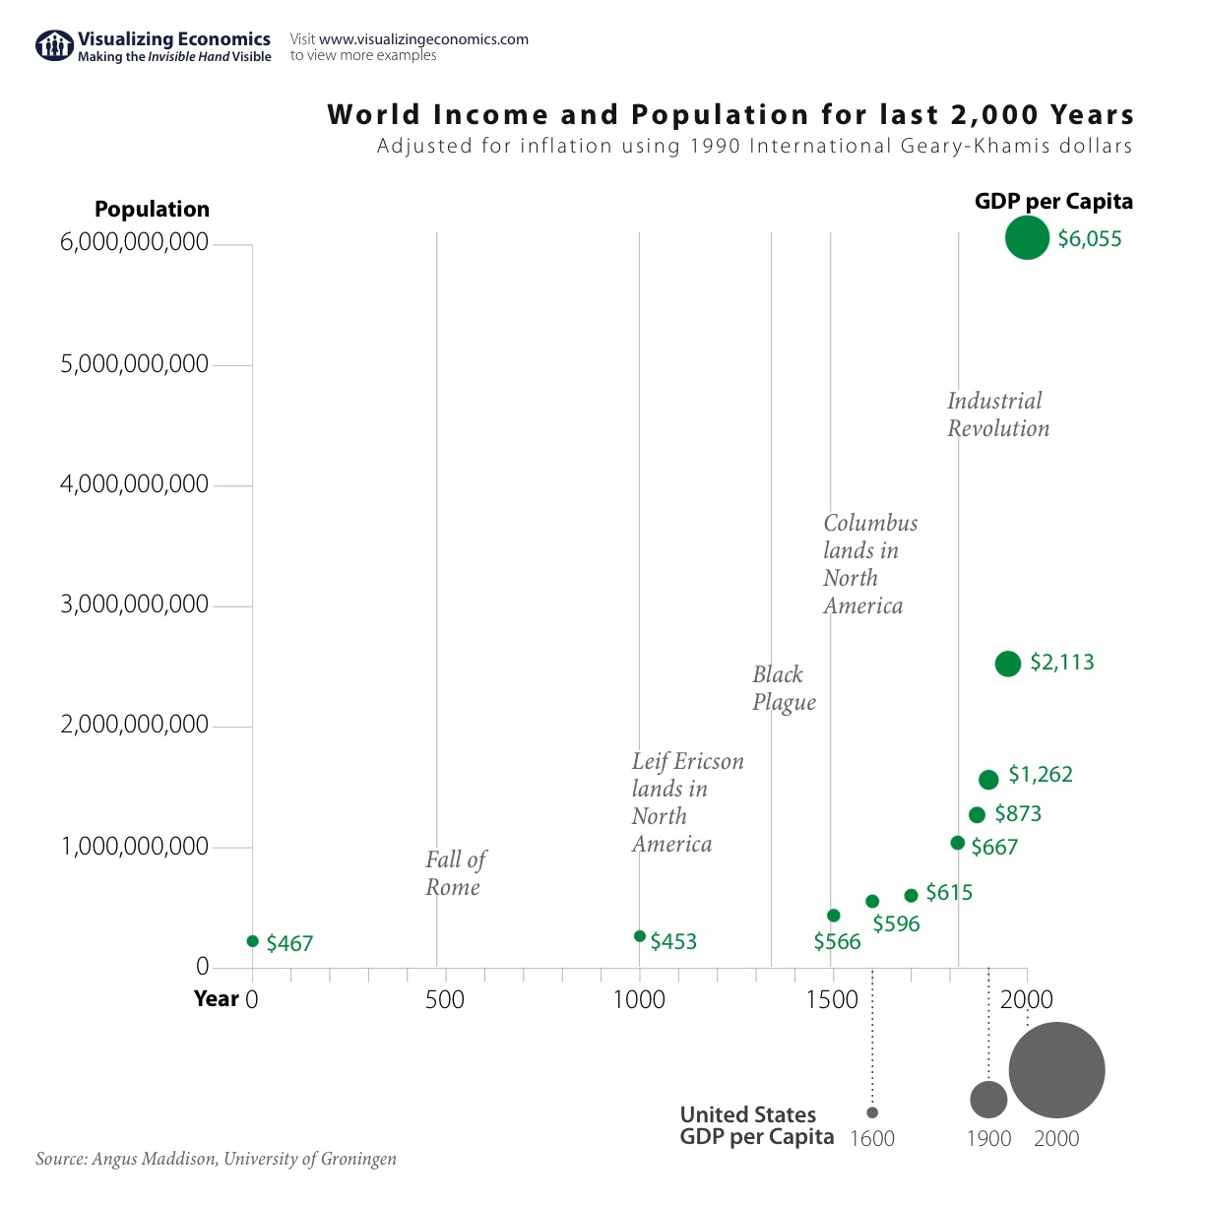

Slide 3
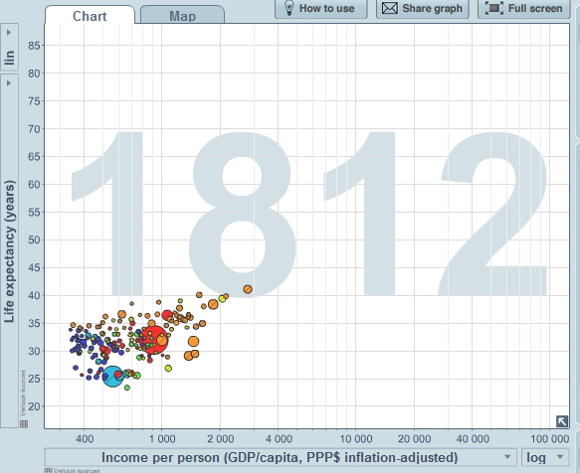

Slide 4
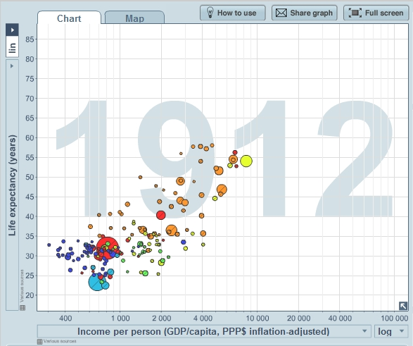

Slide 5
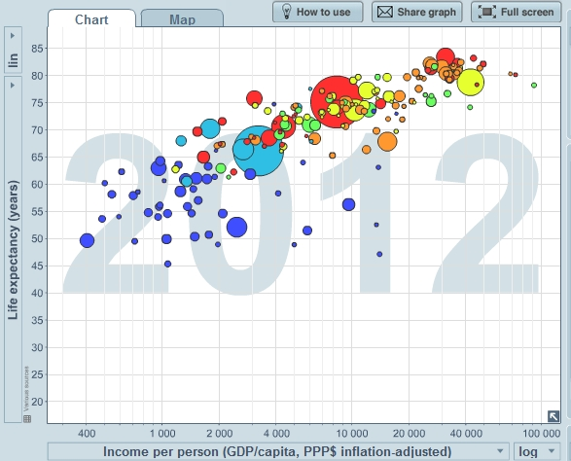

Slide 6
Source: Gapminder
http://www.gapminder.org/world/

