Slide 1
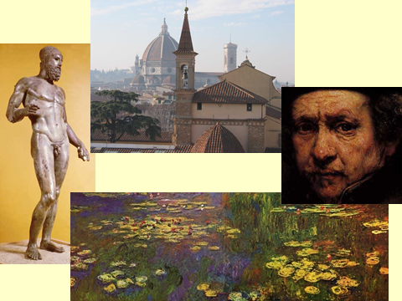
The Next Revolution in Art
Stephen Hicks, Ph.D. Department of Philosophy Rockford University
Illinois, USA Hong Kong / Kowloon July 2015

Slide 2
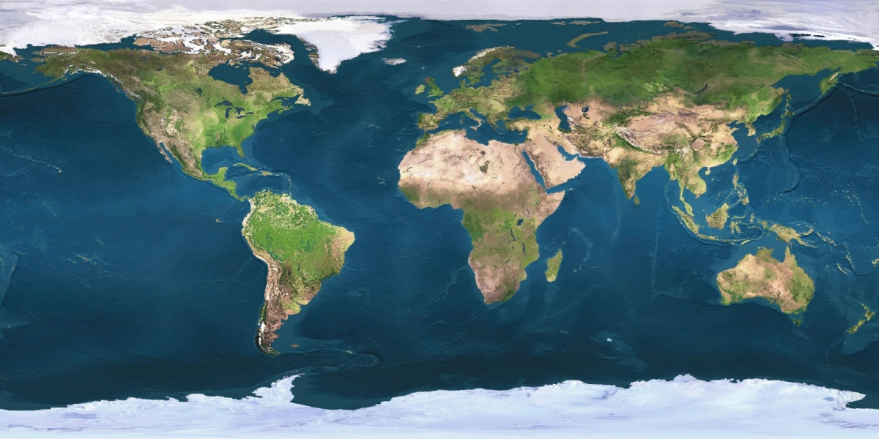

Slide 3
The Archaic Era

Slide 4
The Classical Era

Slide 5
The Dark Ages

Slide 6
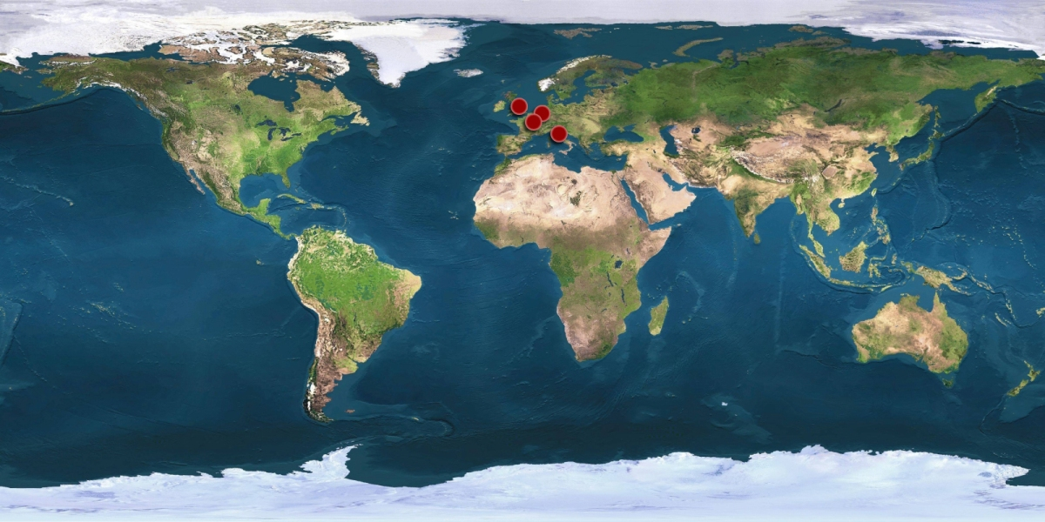
The Renaissance and Early Modern Eras

Slide 7
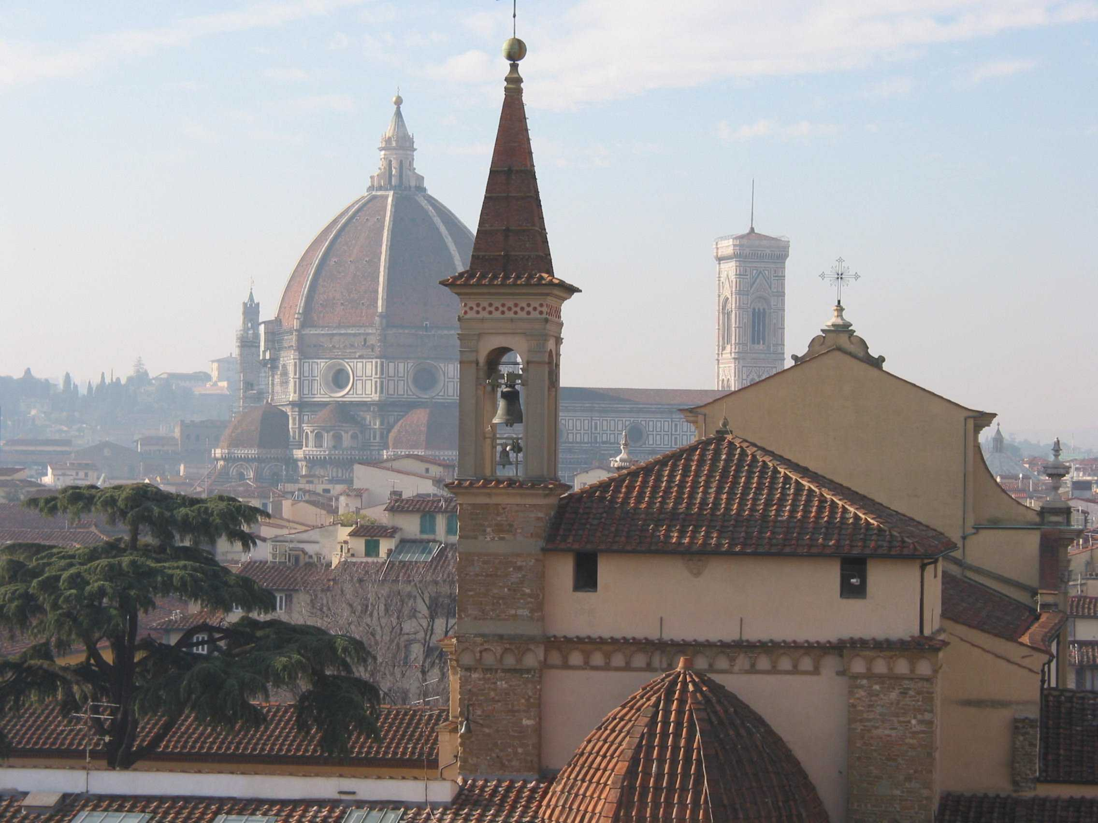
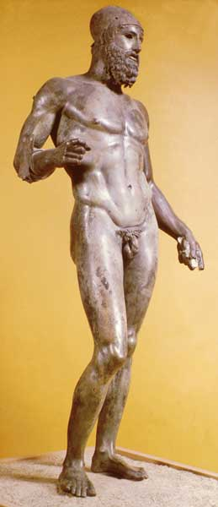
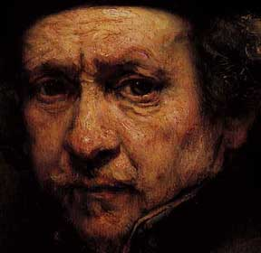
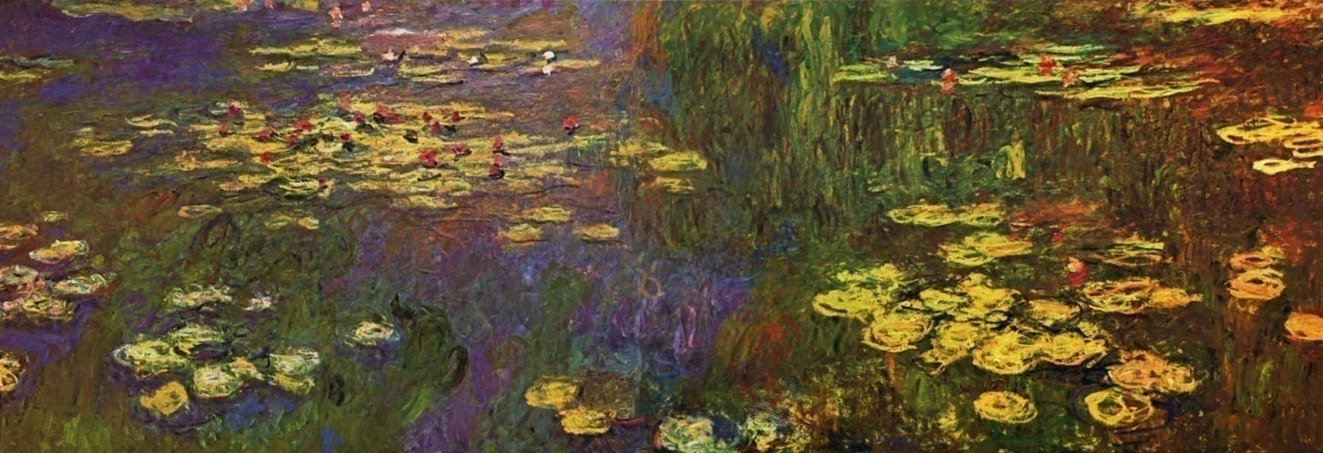

Slide 8
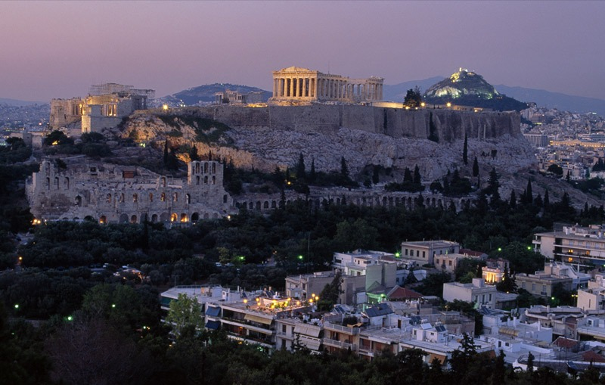

Slide 9
Innovation

Slide 10
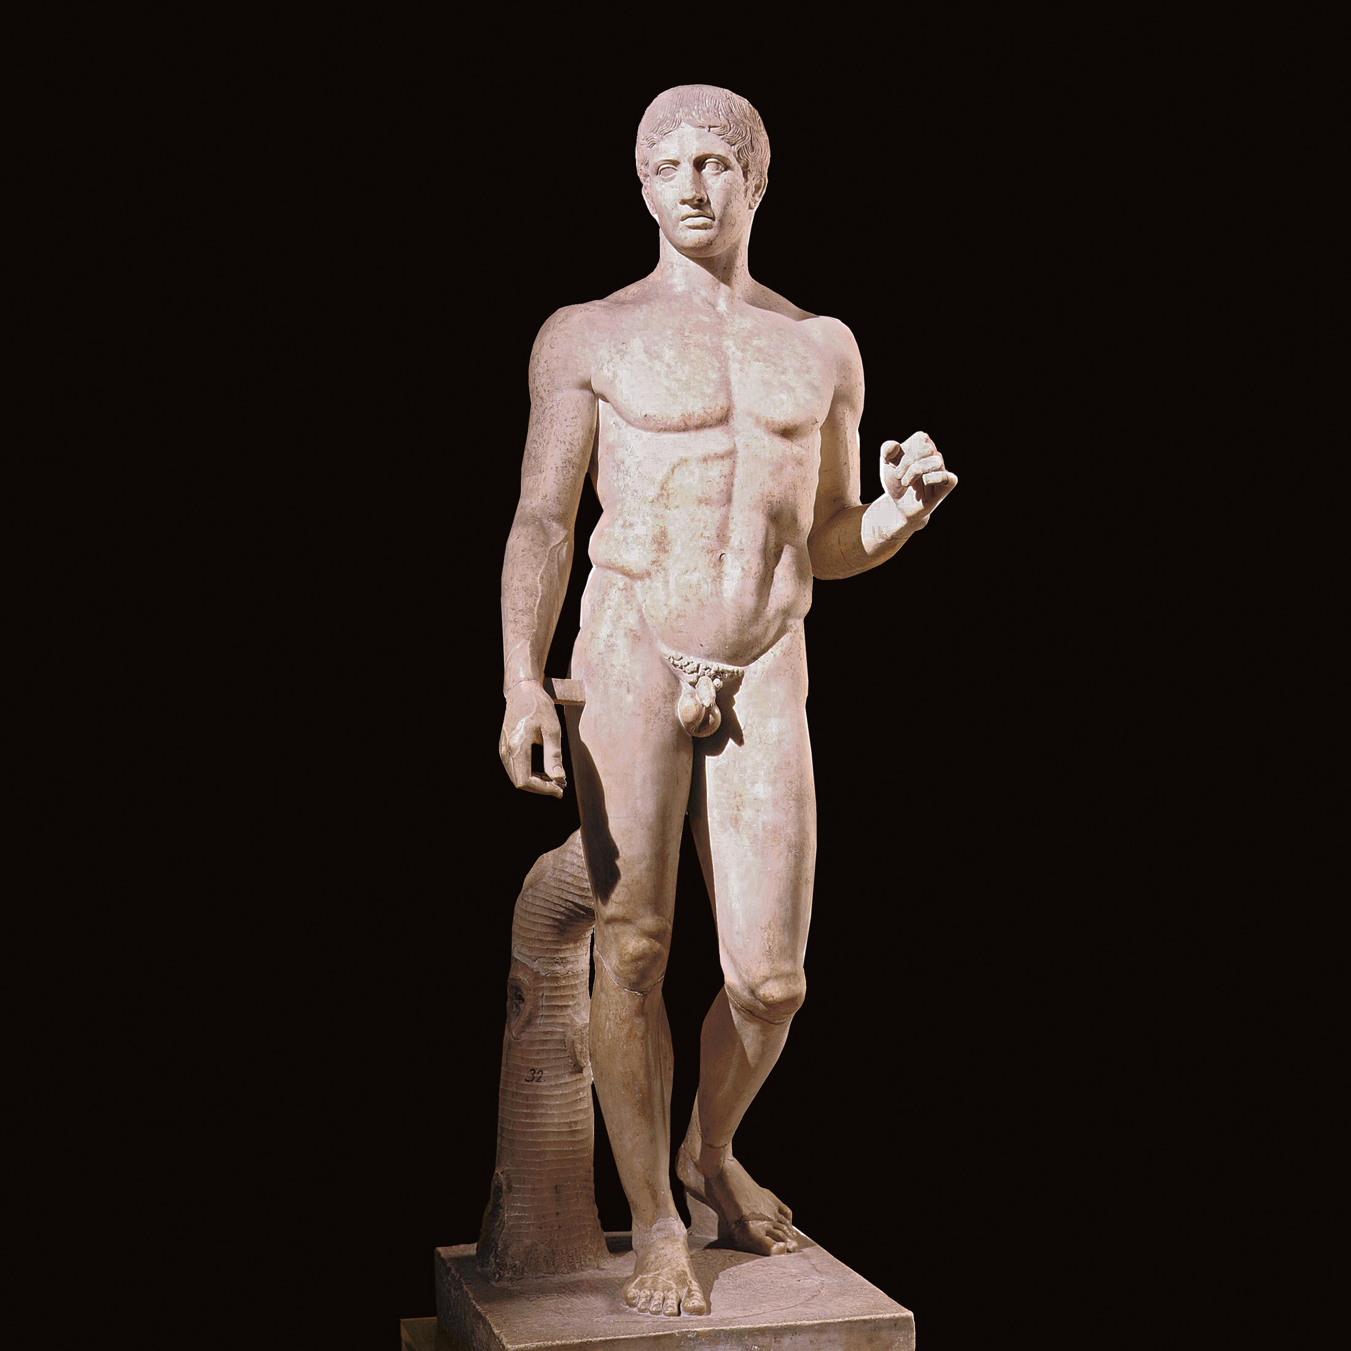
Spear
Bearer

Slide 11
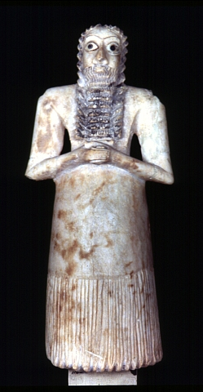
Sumerian

Slide 12
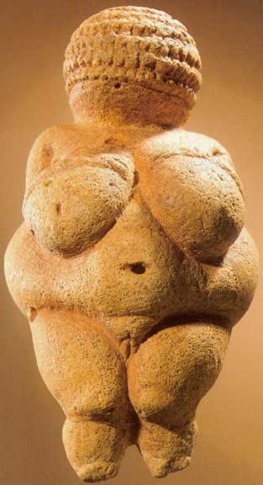
Willendorf Venus, fertility statue

Slide 13
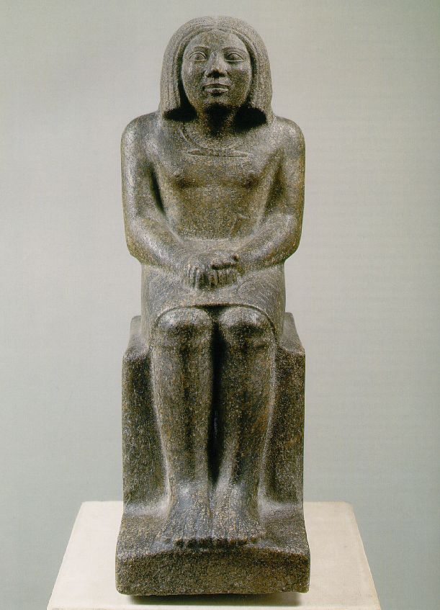
Ankh, Egyptian

Slide 14
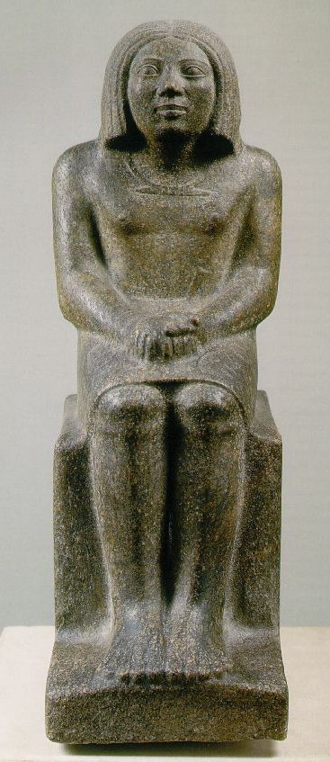
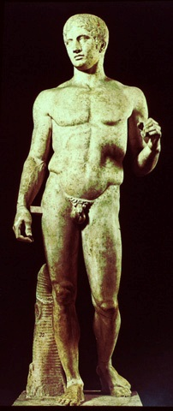

Slide 15
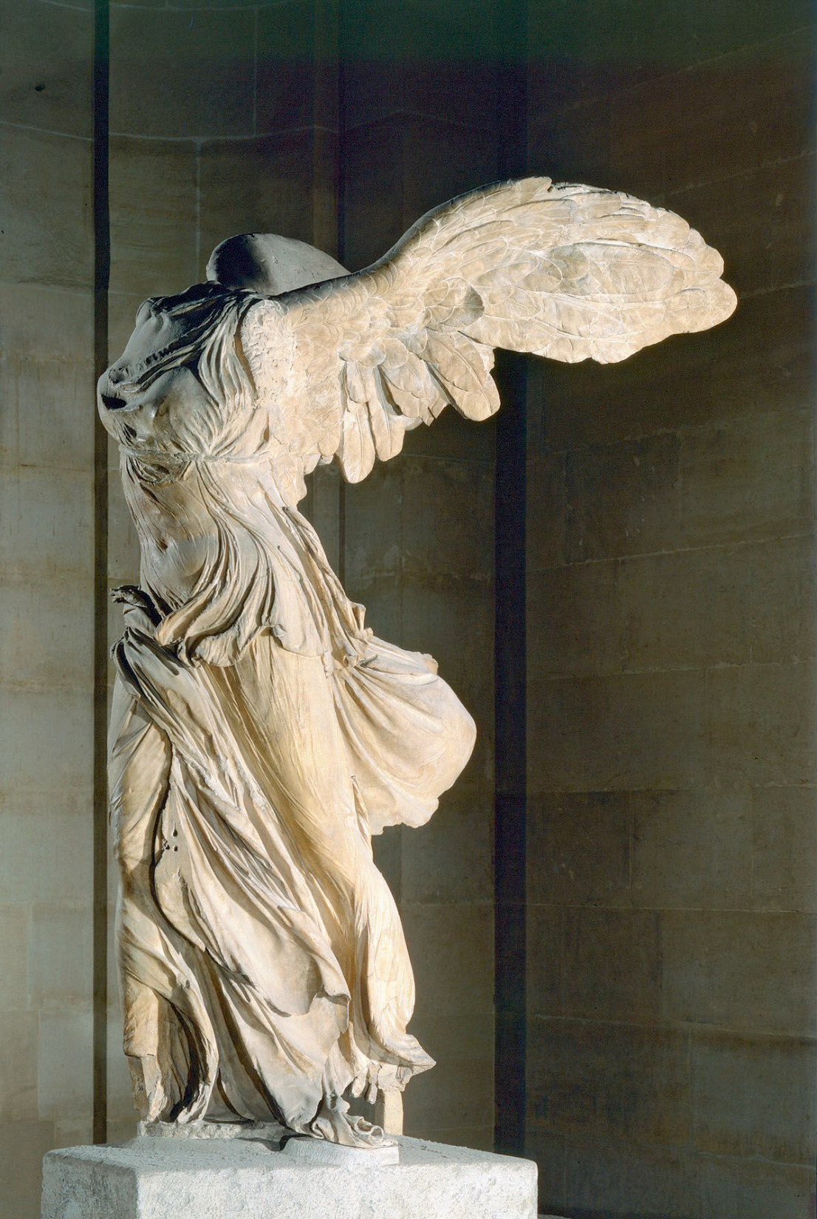
Nike of Samothrace

Slide 16
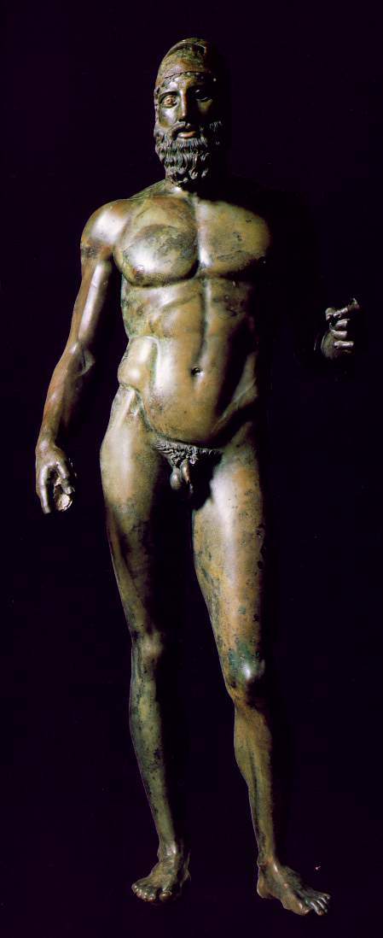
Riace warrior, front

Slide 17
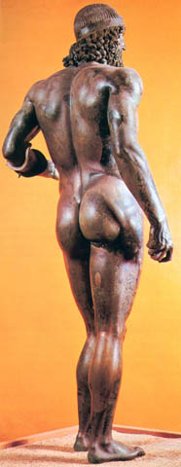
Riace warrior, rear

Slide 18
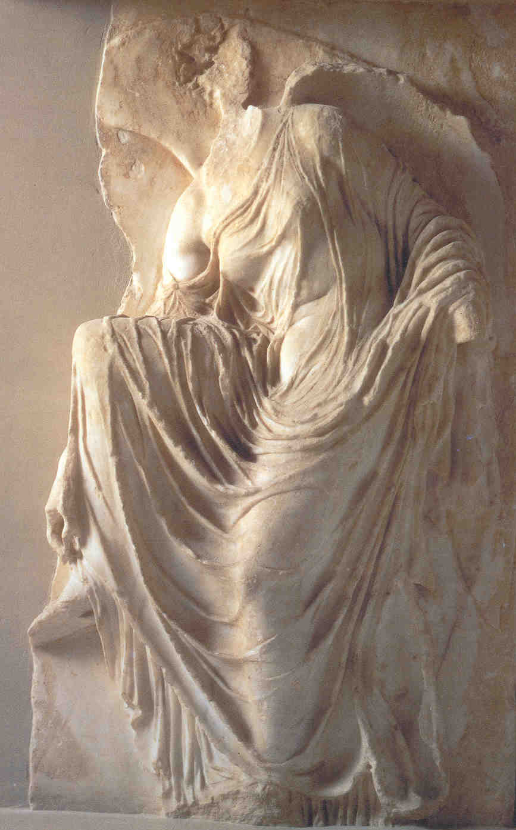
Nike Adjusting Her Sandal

Slide 19
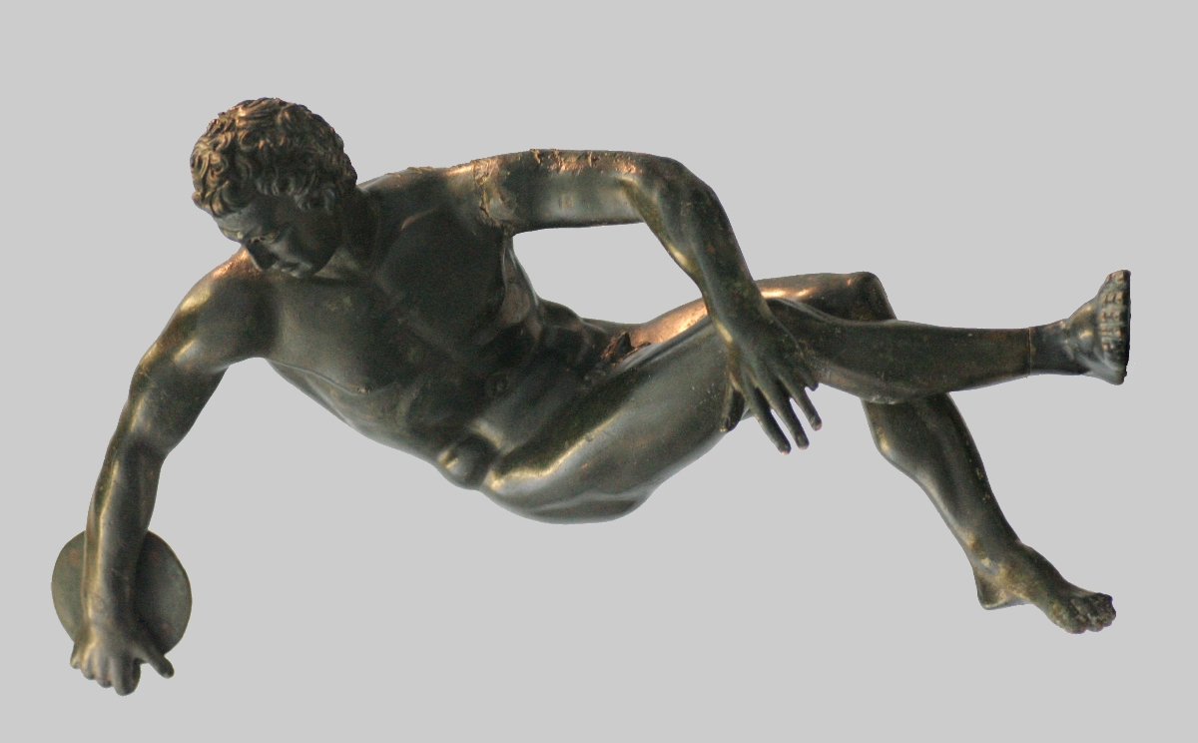
Discobulus
Myron

Slide 20
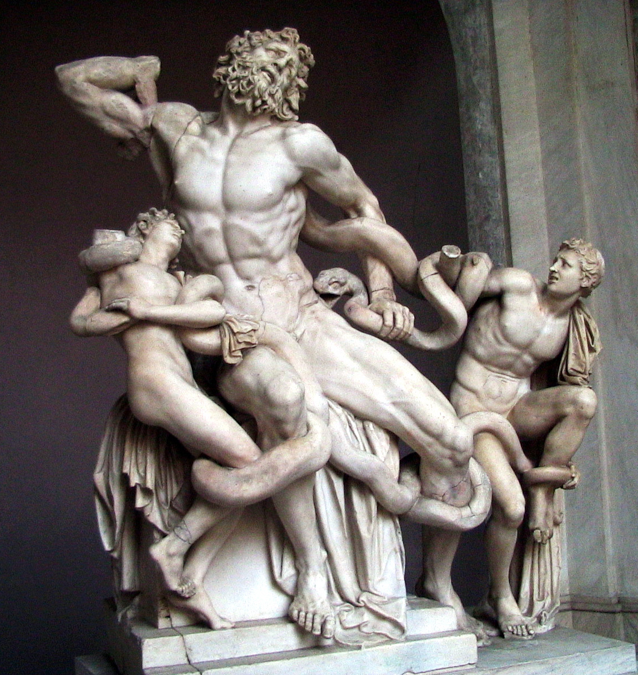
Laocoön and his Sons, c. 50 CE

Slide 21
Why Athens?

Slide 22
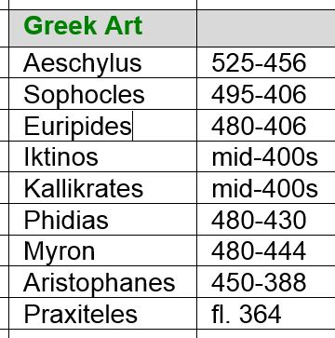

Slide 23
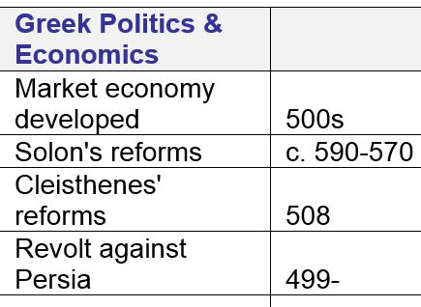

Slide 24
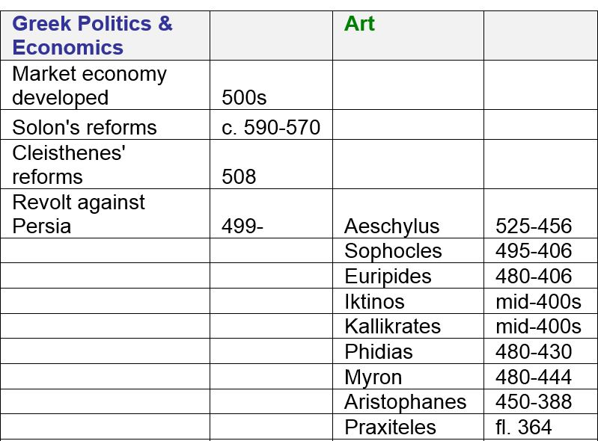

Slide 25
Why Athens?
Economics:
Free-market economy
Cosmopolitan – visitors, immigrants
Politics:
Democracy
Tension with authoritarianism
Foreign tension with Persia, Sparta
Religion and Philosophy:
Worldly
Diversity

Slide 27
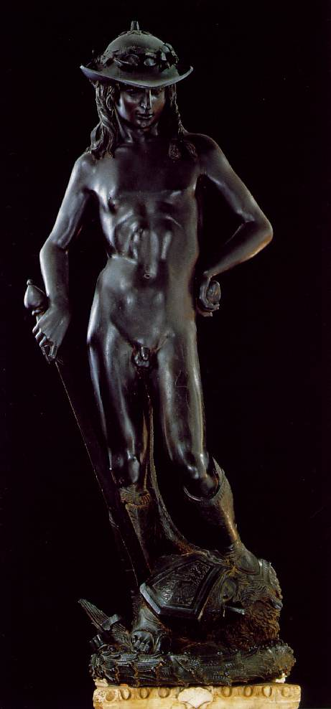
David
Donatello

Slide 28
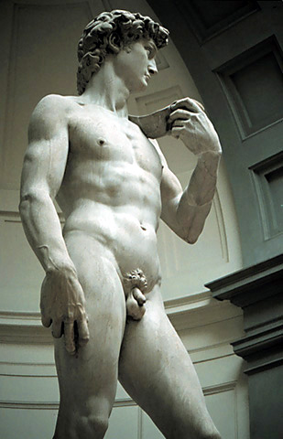
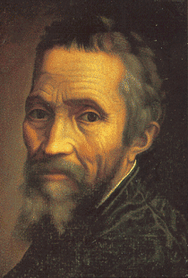
David
Michelangelo

Slide 29
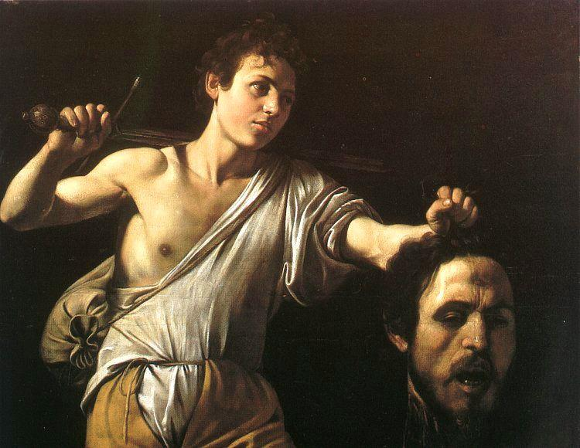
David with the head of Goliath, Caravaggio

Slide 30
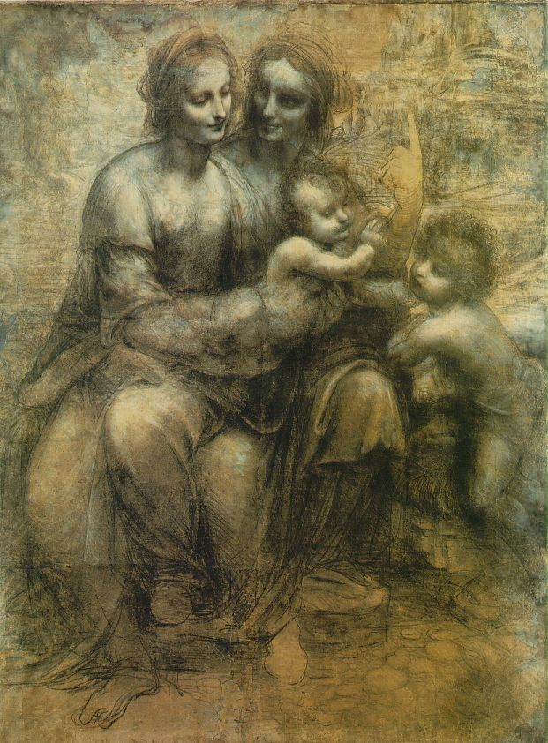
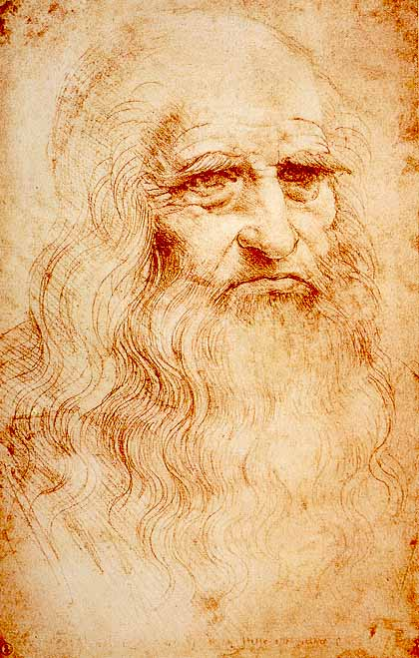
The Virgin and Child … Leonardo

Slide 31
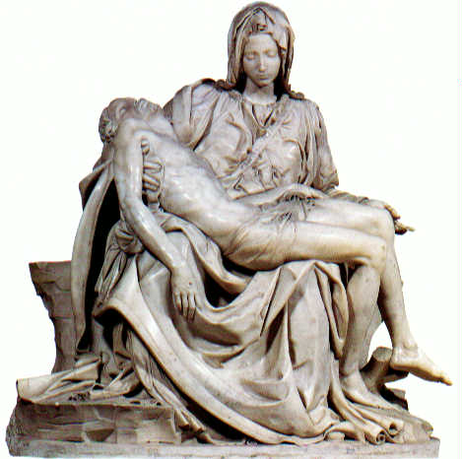
Pietà
Michelangelo

Slide 32
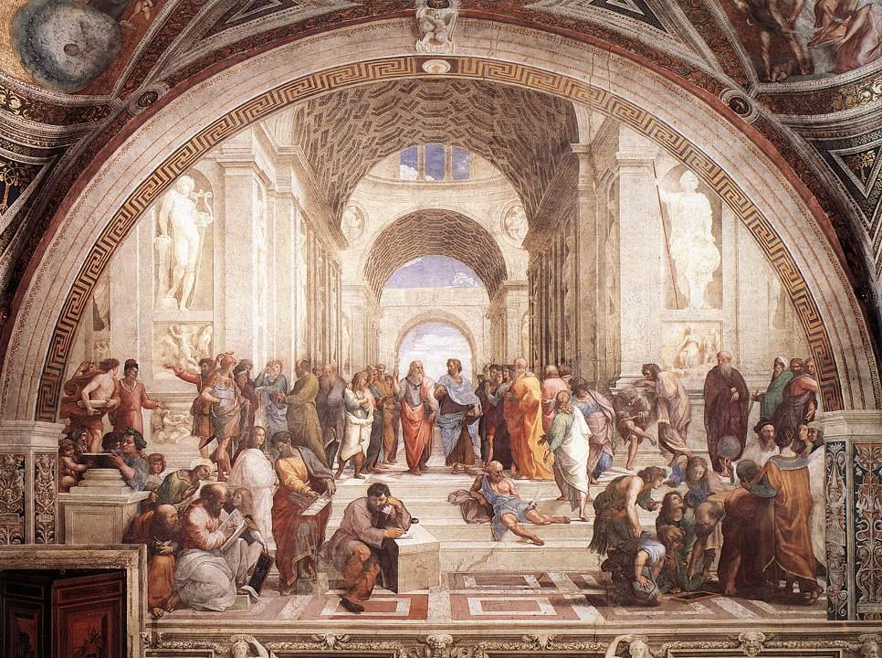
The School of Athens, Raphael

Slide 33
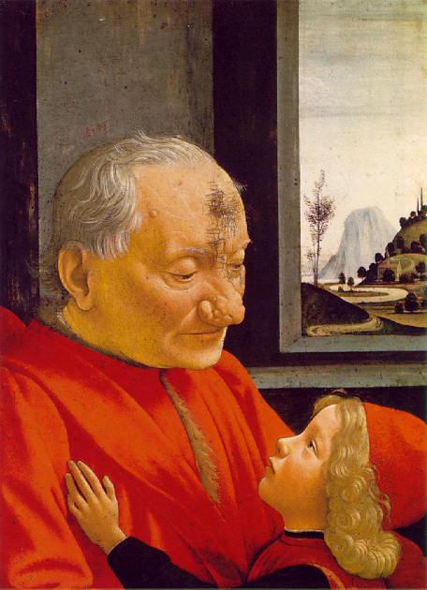
Old Man with Boy, Ghirlandaio

Slide 34
Why Florence?

Slide 35
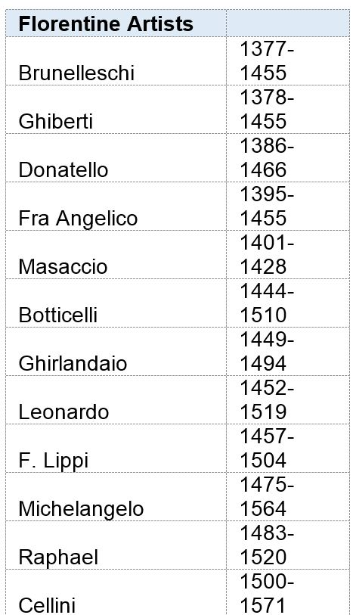

Slide 36
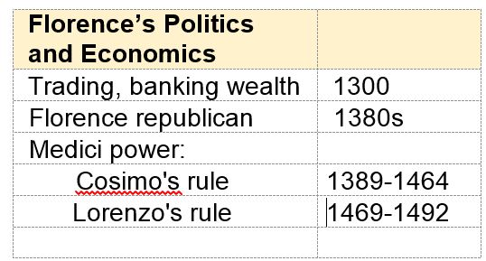

Slide 37
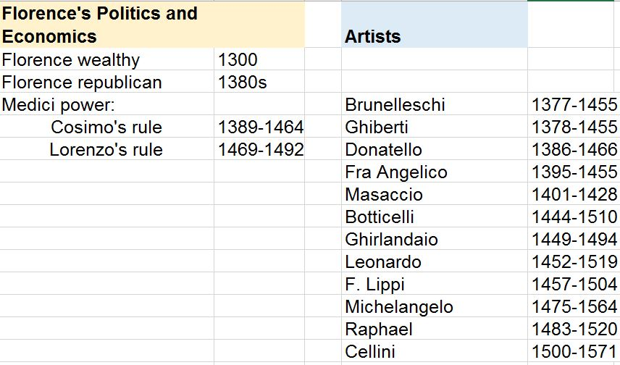

Slide 38
Why Florence?
Economics:
Free-market economy
Cosmopolitan – visitors, immigrants
Politics:
Republican
Tension with authoritarianism
Foreign tension with France, Milan, Naples, Vatican
Religion and Philosophy:
Worldly: relaxed Catholicism, Humanism
Diversity

Slide 39
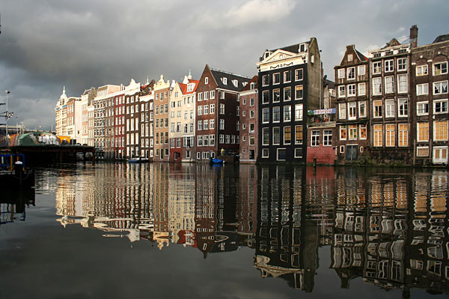

Slide 40
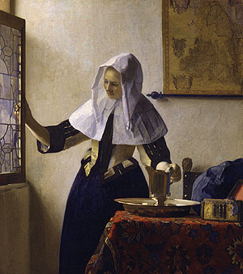
Young Woman with Water Jug
c. 1662
Vermeer

Slide 41
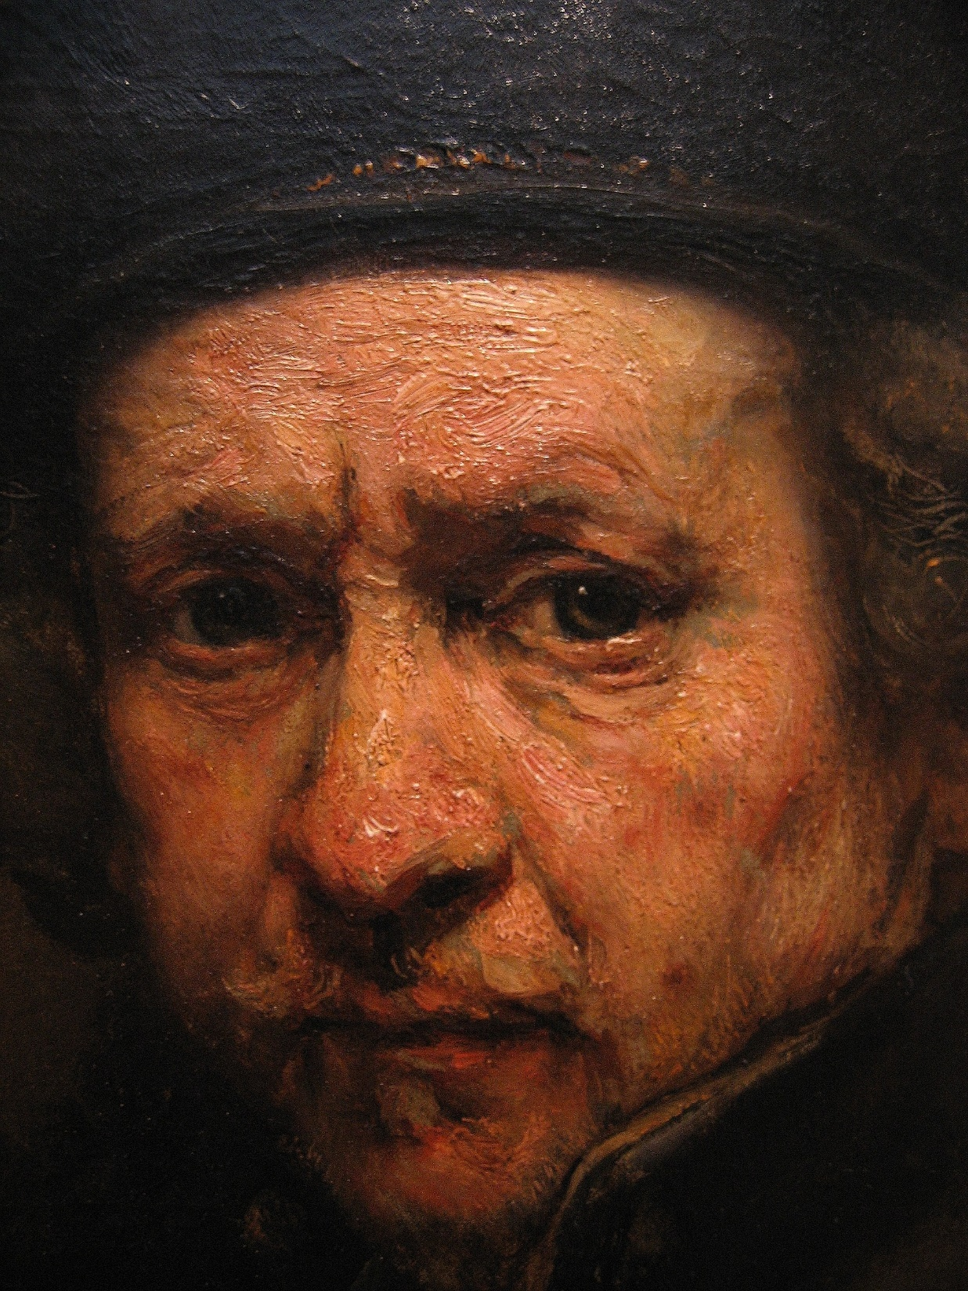
Self-Portrait
1659
Rembrandt

Slide 42
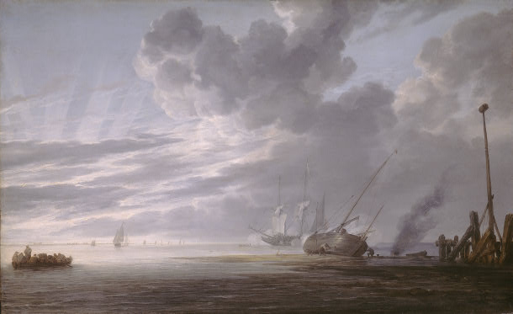
Estuary at Dawn, Simon Vlieger

Slide 43
Why Holland?

Slide 44
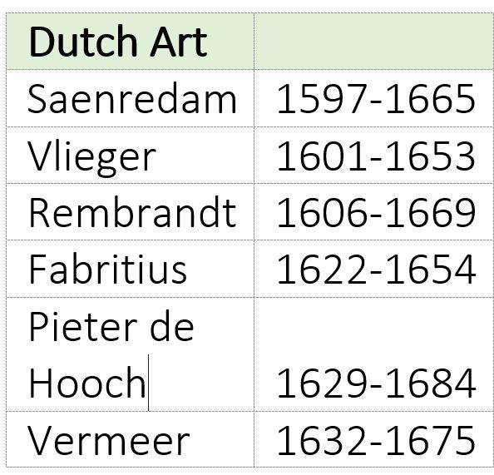

Slide 45
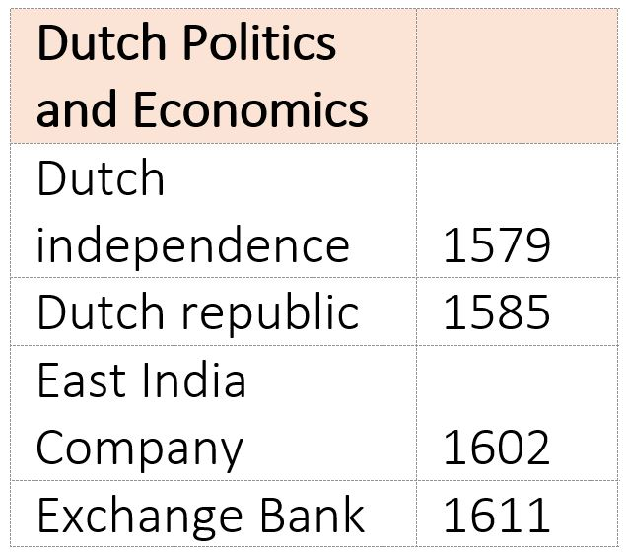

Slide 46
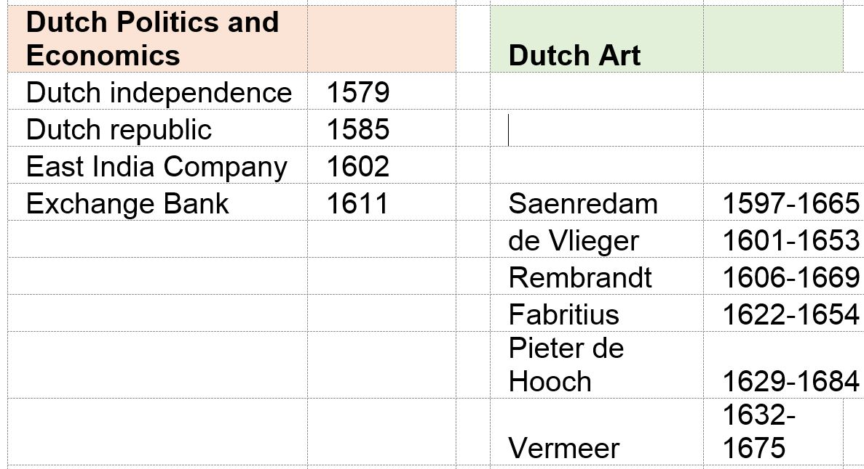

Slide 47
Why Holland?
Economics:
Free-market economy
Cosmopolitan – visitors, immigrants
Politics:
Democracy
Tension with authoritarianism
Foreign tension with Spain, England
Religion and Philosophy:
Worldly
Diversity

Slide 48
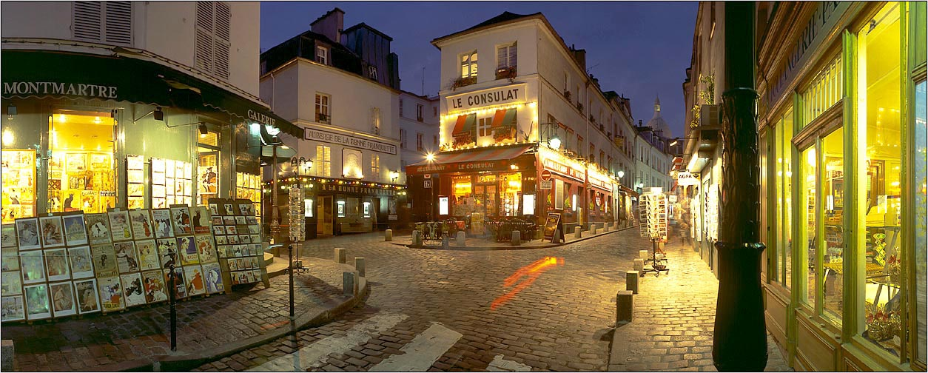

Slide 49
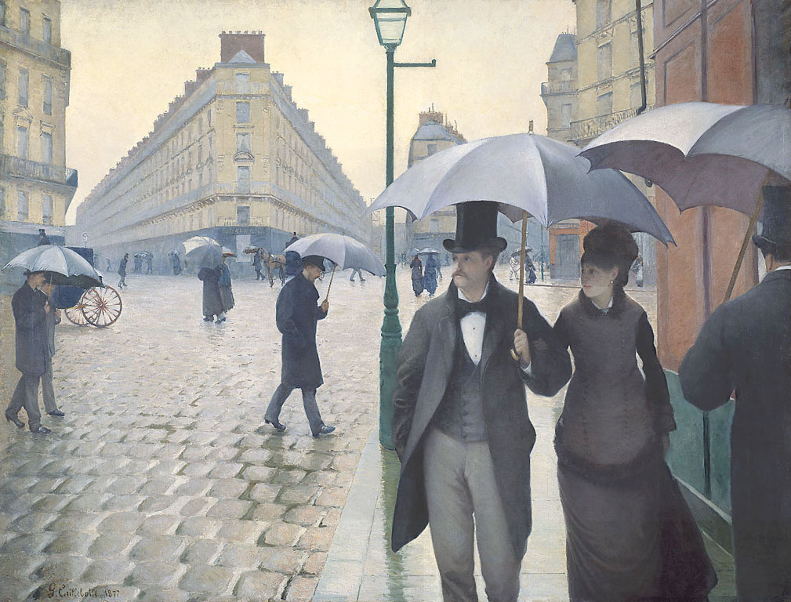
Caillebotte, Paris Street, Rainy Day (1877)

Slide 50
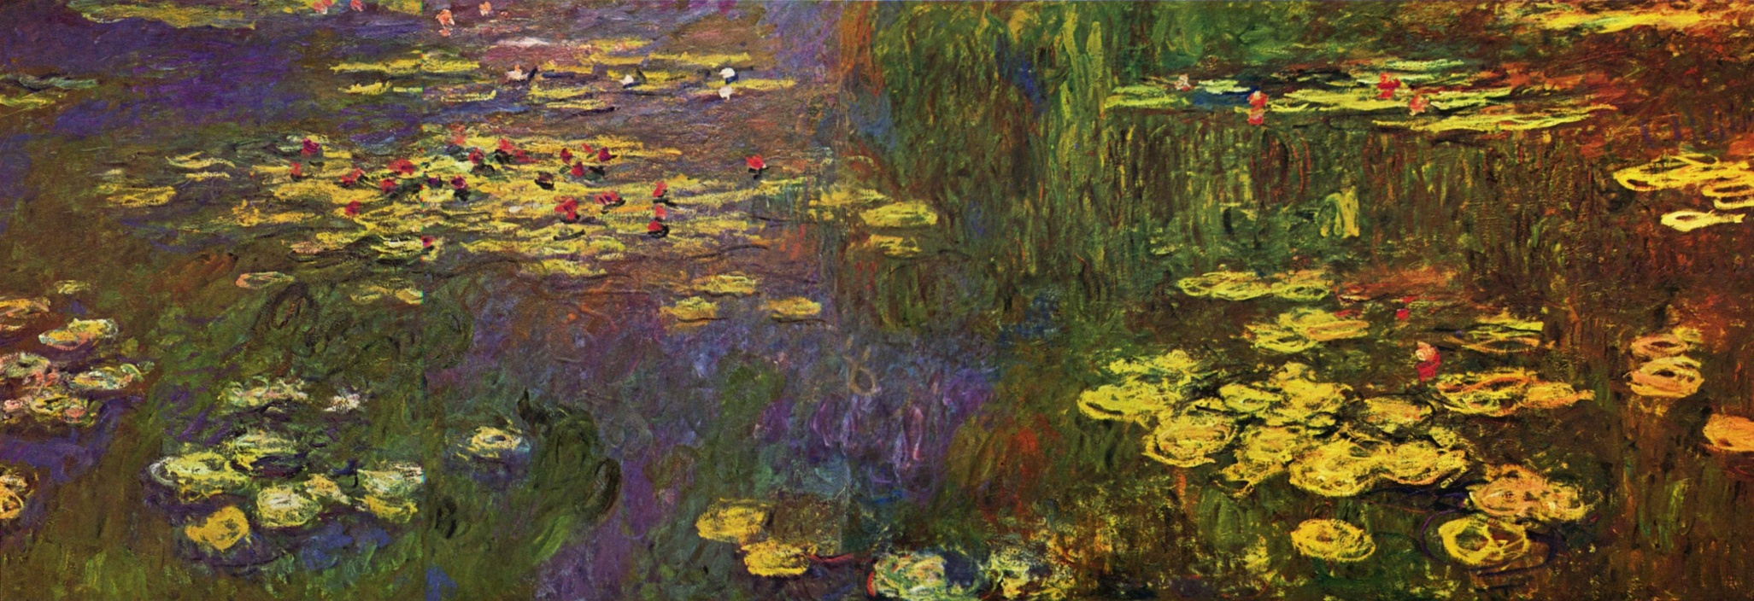
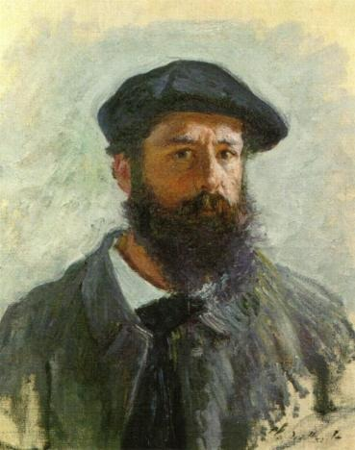
Water Lilies
Claude Monet

Slide 51
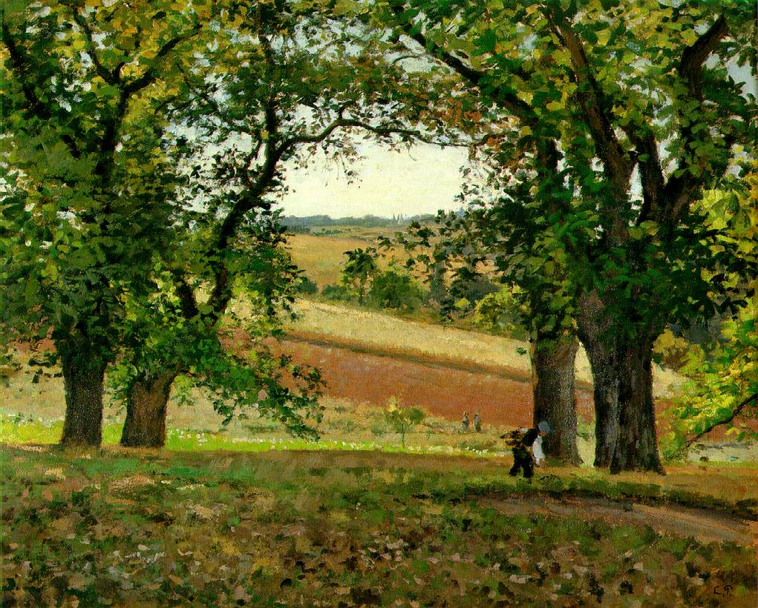
Camille Pissarro, The Chestnut Trees at Osny (1873)

Slide 52
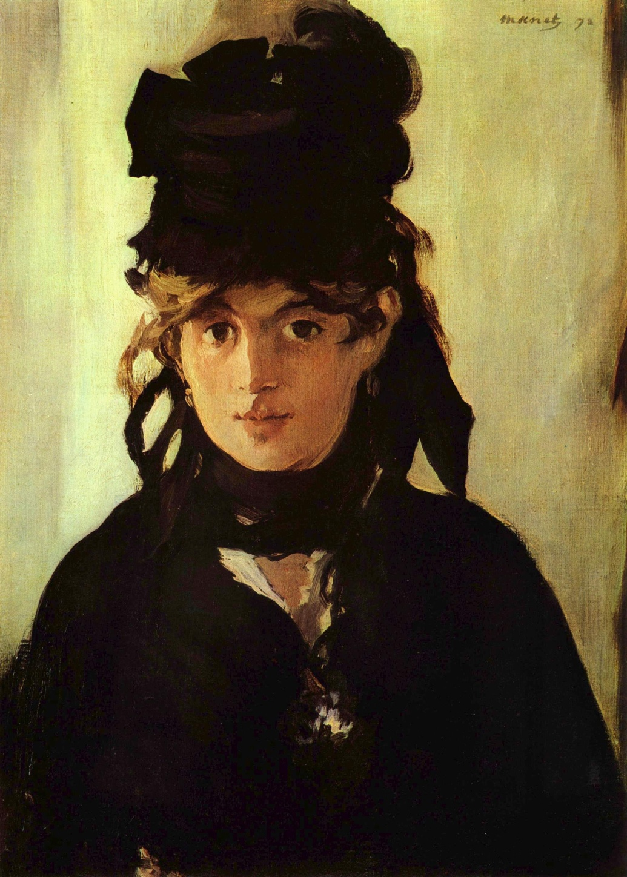
Berthe Morisot
1872
Eduoard Manet

Slide 53
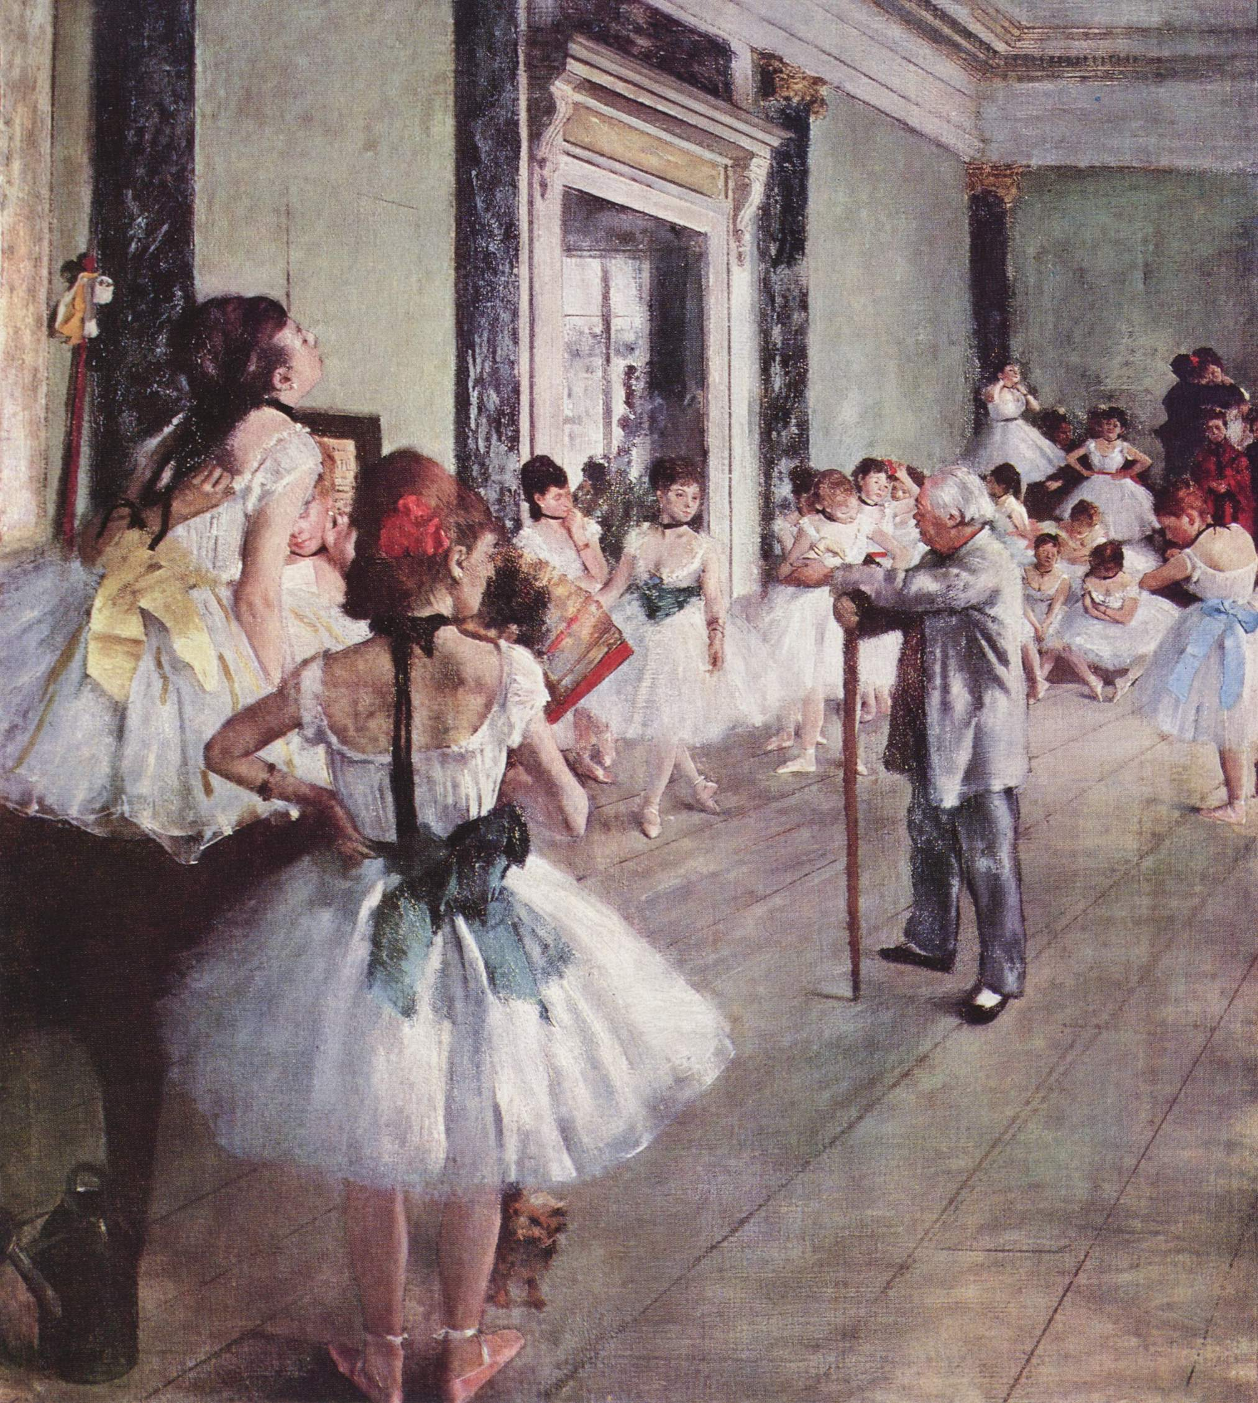
The Dance Class
1873-1876
Degas

Slide 54
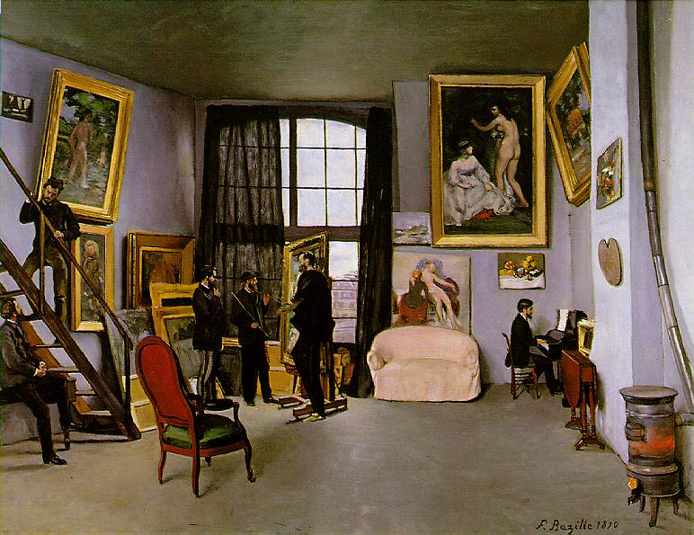
Bazille's Studio; 9 rue de la Condamine, 1870

Slide 55
The Bath
Mary Cassat

Slide 56
Theatre Box
Renoir

Slide 57
Why Paris?

Slide 58
Why Paris?
Economics:
Free-market economy
Cosmopolitan – visitors, immigrants
Politics:
Republican-democratic
Tension with authoritarianism
Foreign tension with Prussia
Religion and Philosophy:
Worldly
Diversity

Slide 59
Contemporary cultures contrasted

Slide 60
The United States of America

Slide 61
Decisive individuals

Slide 62
Pericles

Slide 63
Lorenzo de’ Medici

Slide 64
Constantijn Huygens

Slide 65
Paul Durand-Ruel

Slide 66
Georges-Eugène Haussmann

Slide 67
Solomon and Peggy Guggenheim

Slide 69
Hong Kong and Kowloon City

Slide 73
Hong Kong and Kowloon City
Economics:
Free-market economy
Cosmopolitan – visitors, immigrants
Politics:
Republican-democratic
Tension with authoritarianism
Religion and Philosophy:
Worldly
Diversity

Slide 74
Opportunity:
The tiredness of postmodernism
Vested interests and artistic conservatism

