Slide 1
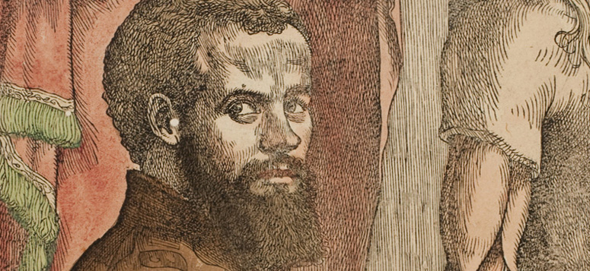
Human Nature and the New Biology

Slide 2
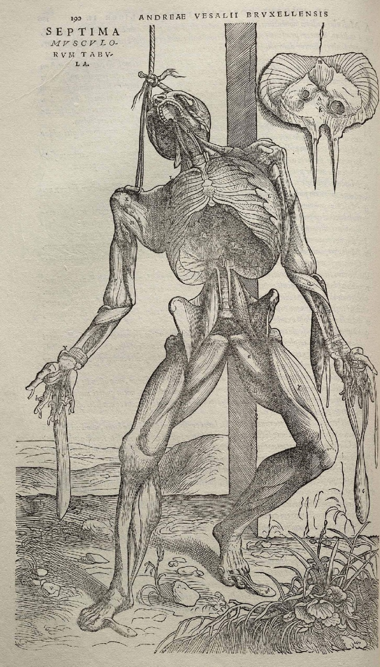
Andreas Vesalius, Fabrica (1543)

Slide 3
The Revolution in Surgery
1700s:
“Although medical students usually learned some rudimentary anatomy, this was considered a useful but not vital adjunct to on-the-job experience. And when patients died on the operating table as a result of ignorance and blundering, as they frequently did, few, if any, lessons were learned from the outcome.”
(Wendy Moore, The Knife Man: Blood, Body Snatching, and the Birth of Modern Surgery)

Slide 4
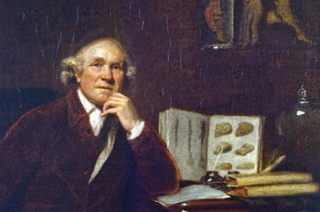
John Hunter (1728-1793) The “Knife Man”

Slide 5
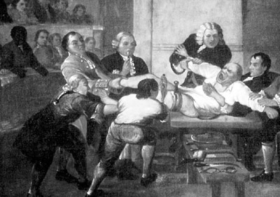
Surgery before anesthesia

Slide 6
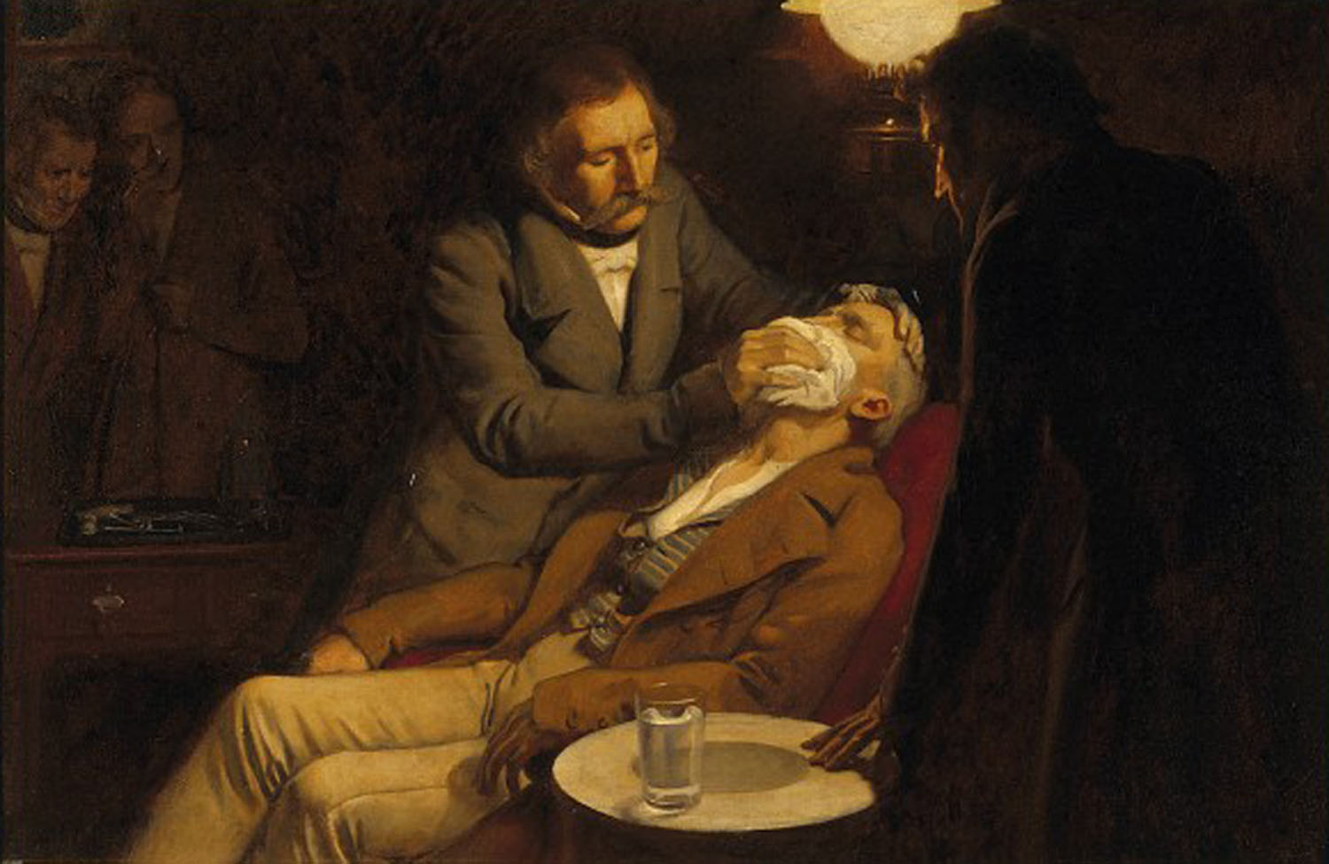
1846: William Thomas Green Morton (a dentist) anesthetized a patient at a Massachusetts hospital by means of sulfuric ether.

Slide 7
Opposition to anesthesia

Slide 8
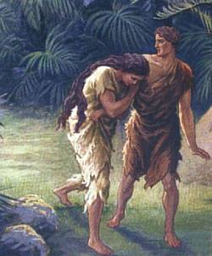
Punishments for Original Sin
Death.
Work.
Pain in childbirth.
(Genesis 3:16-19)

Slide 9
“Using chloroform in the Crimean War [1853-1856], the French reported more than 25,000 operations without a fatality, and the British reported 20,000 operations with one fatality.” (http://www.general-anaesthesia.com/objections.html)
Evidence of success in using anesthesia in surgery:

Slide 10
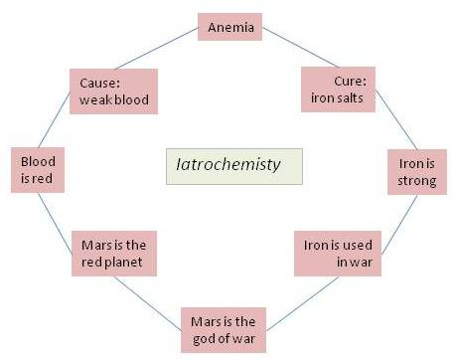
What causes disease?

Slide 11
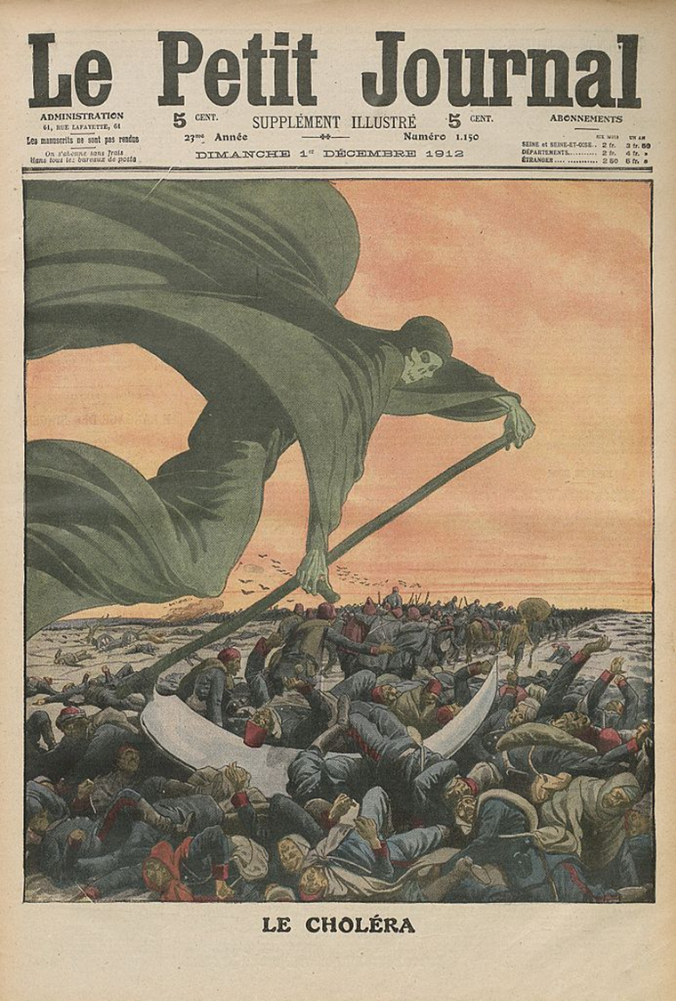
Cholera? Tuberculosis? Anthrax?

Slide 12
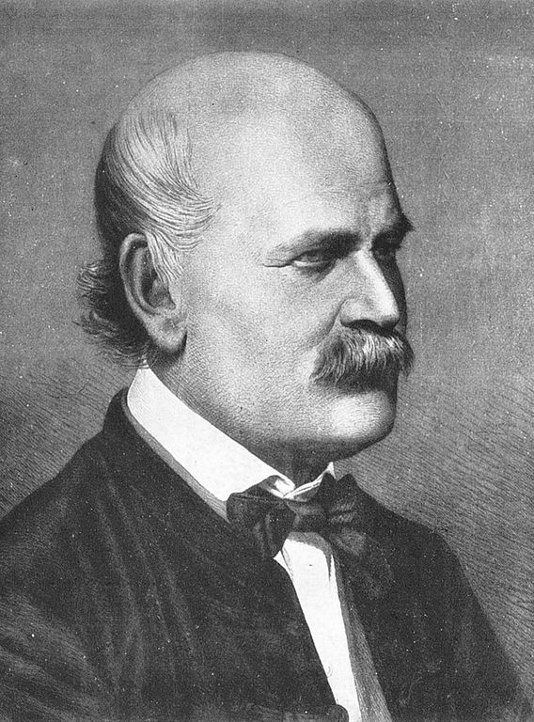
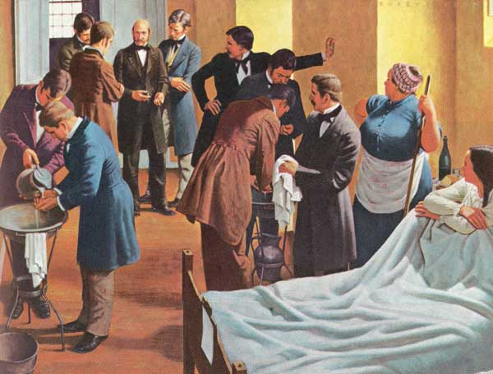
Ignaz Semmelweis (1818-1865) and Childbed Fever

Slide 13
Robert Koch (1843-1910) and microbiology:

Slide 14
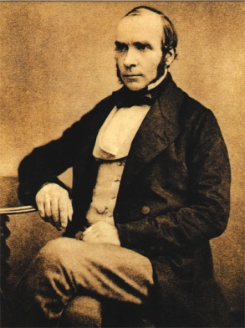
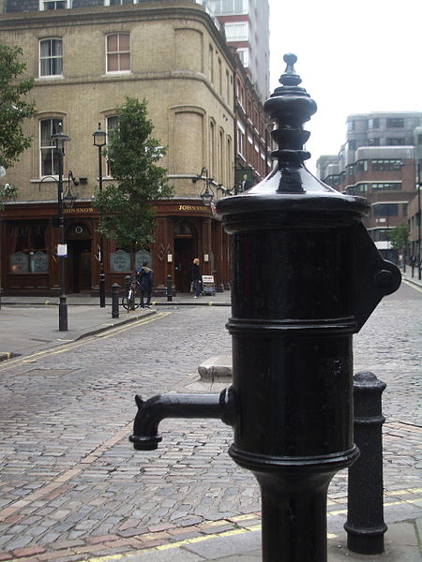
John Snow (1813-1858) and cholera in London

Slide 15
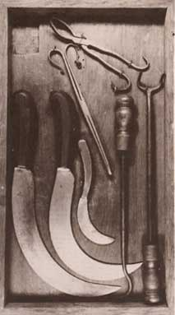
Antiseptic: Before 1860, 50% of surgical patients would die afterwards of gangrene or septicemia.

Slide 16
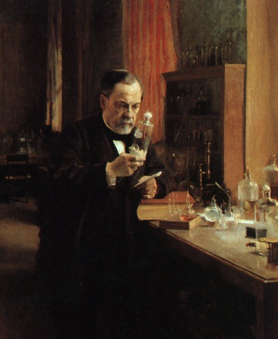
Louis Pasteur (1822-1895) Germ theory of disease Vaccination “Pasteurization”

Slide 17
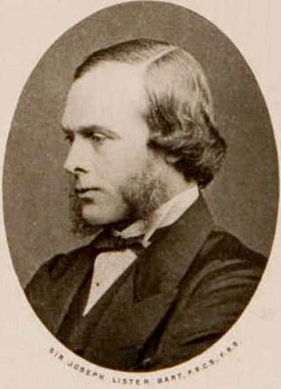
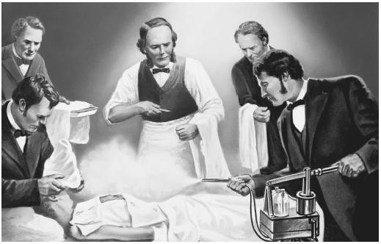
Joseph Lister (1827-1912) and the discovery of antiseptics

Slide 18
Summary: Anatomy: better understanding of the human body’s workings. Microbiology: better understanding of what causes diseases. Anesthesia: better ability to control pain and shock of surgery. Antiseptic: better cleanliness during and after surgery.

Slide 19
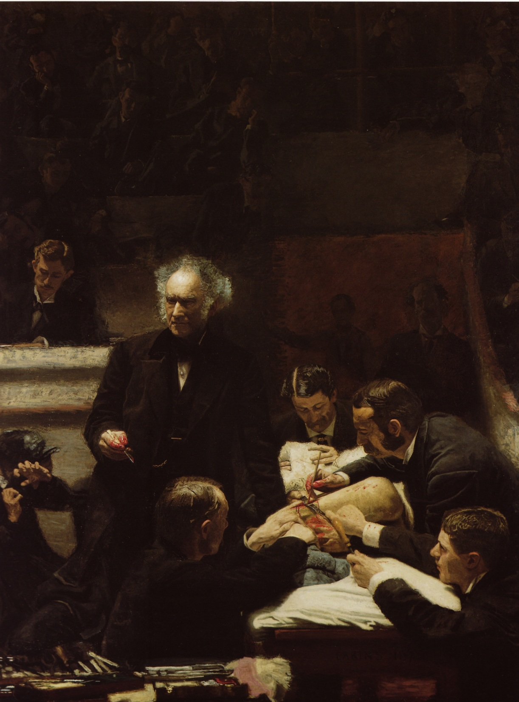
Thomas Eakins, The Clinic of Dr. Gross (1875; oil on canvas; 8’ x 6.5’)

Slide 20
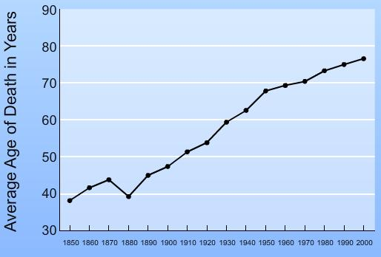
Life expectancy at birth

Slide 22
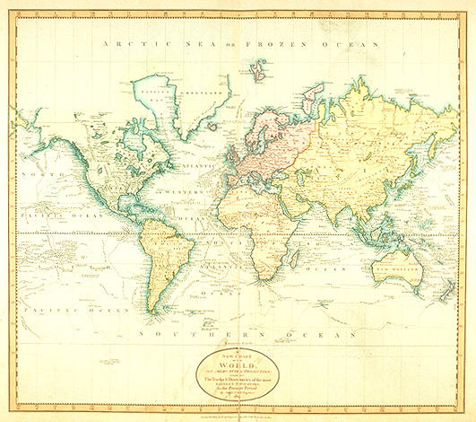
Man and his world
British map, 1800

Slide 23
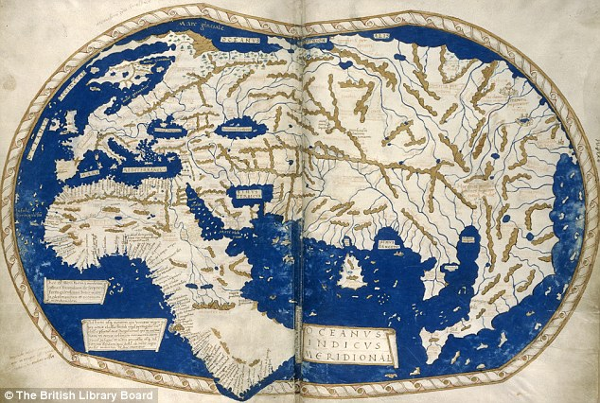
World map, 1488

Slide 24
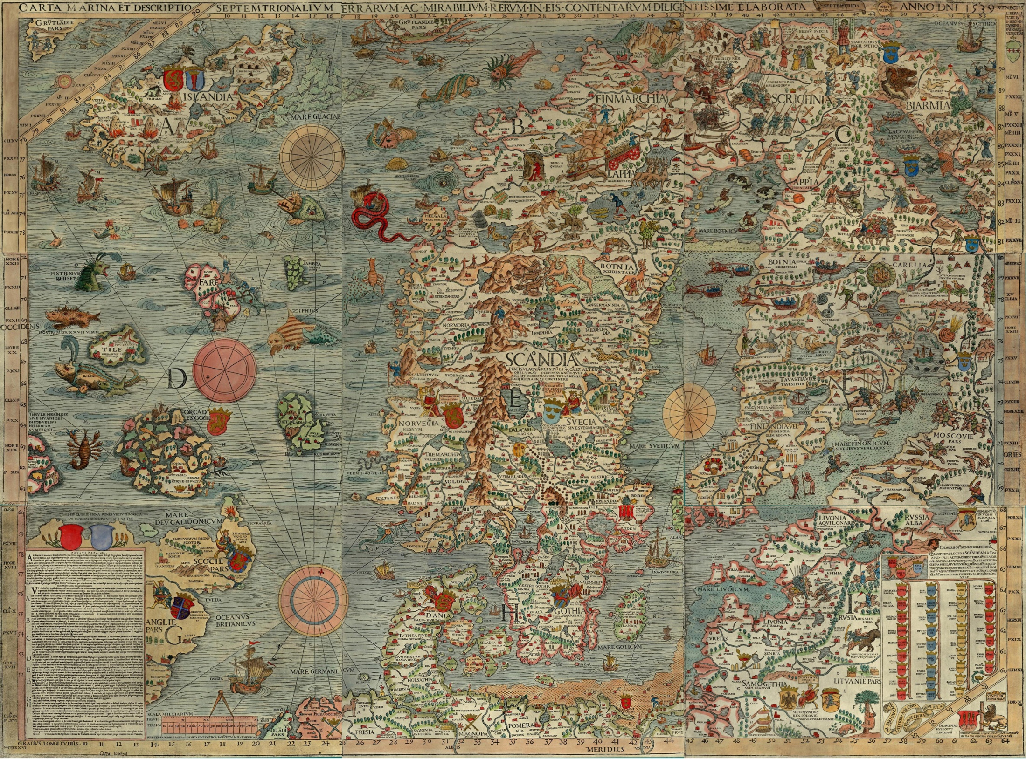

Slide 25
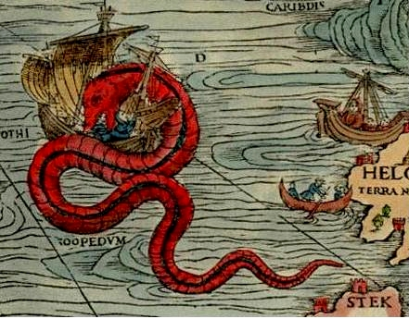

Slide 26
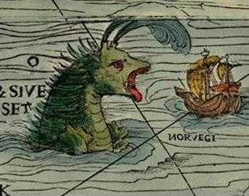

Slide 27
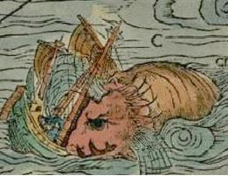

Slide 29
British map, 1800

Slide 30
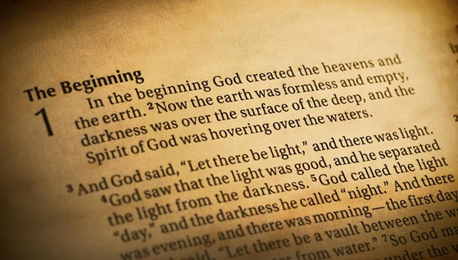
Traditional Creationism
God created the Earth and its inhabitants around 4,000 BC.
Then God rested. The world is essentially as he made it. God is perfect, so his creations are perfect and do not change.
Humans are a special creation by God. God took dust of the earth and “breathed” into it. Man is matter plus spirit.

Slide 31
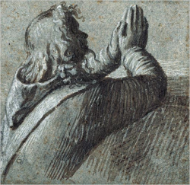
Traditional creationism and values
The soul is immortal.
God watches us: He punishes the bad and rewards the good, so humans have an incentive to be moral.
Humans are special to the extent that they are not of the natural world.

Slide 32
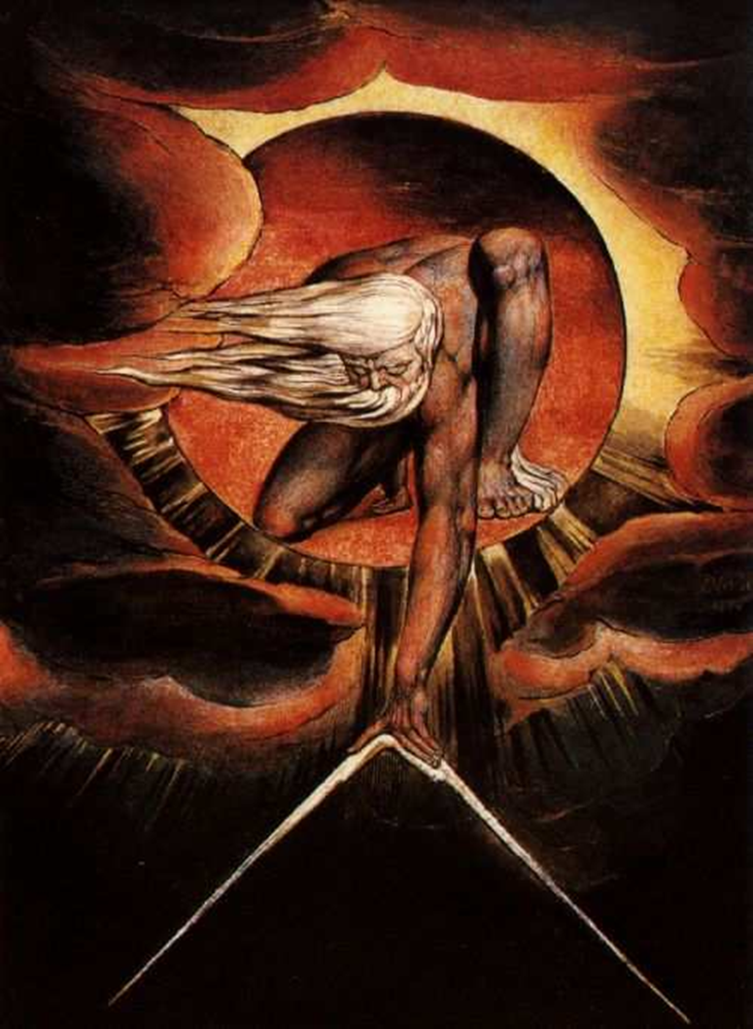
The Design Argument

Slide 33
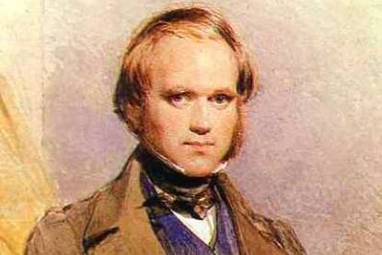
Charles Darwin (1809-1882)

Slide 34
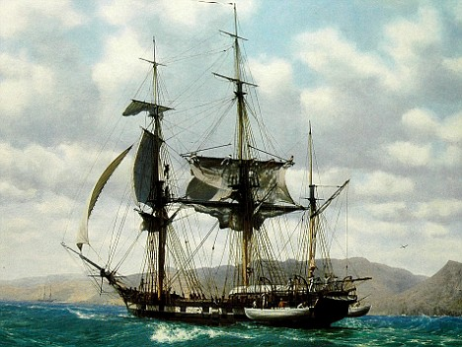
The voyage of the Beagle (1831-1836)
Young Darwin gets position on HMS Beagle as naturalist.

Slide 35
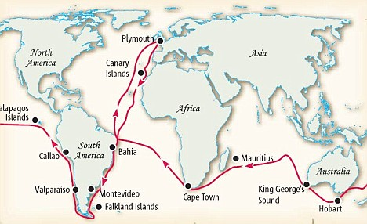

Slide 36
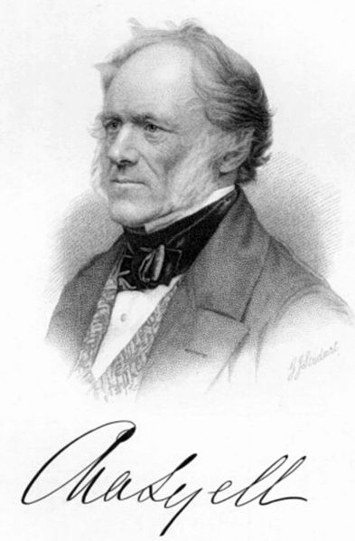
Charles Lyell (1797-1875) Geologist

Slide 37
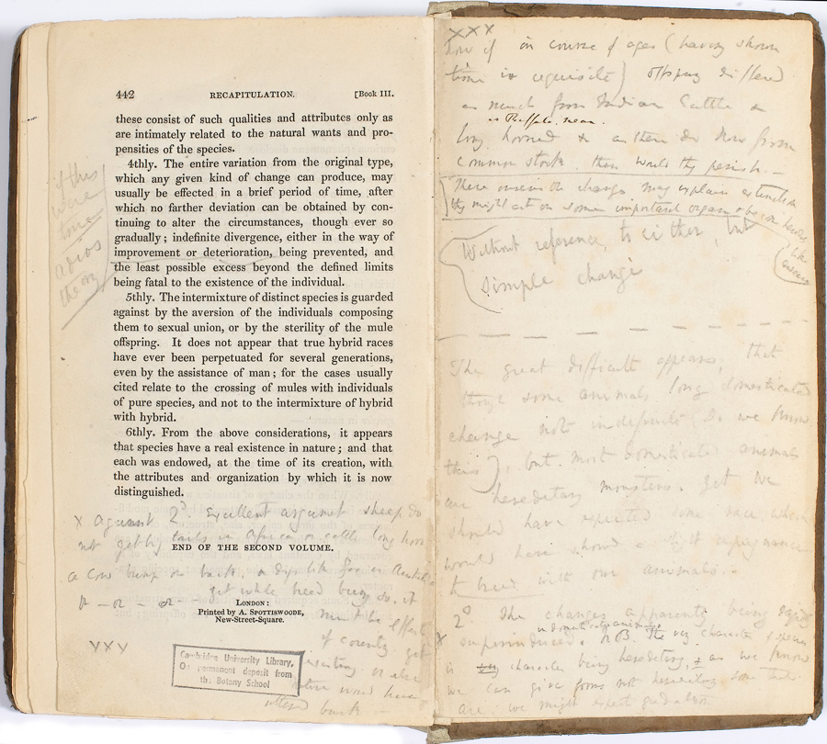
Darwin’s copy of Lyell’s Principles of Geology

Slide 38
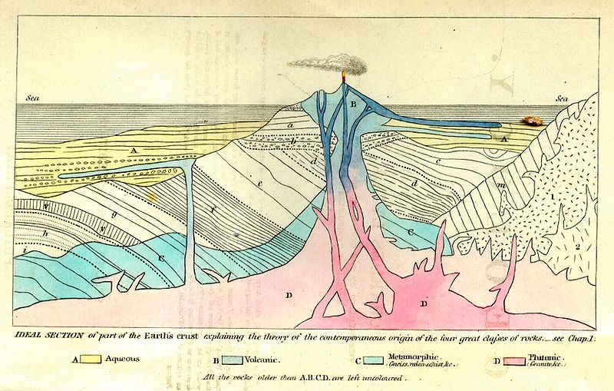
Frontispiece to Lyell’s Principles of Geology

Slide 39
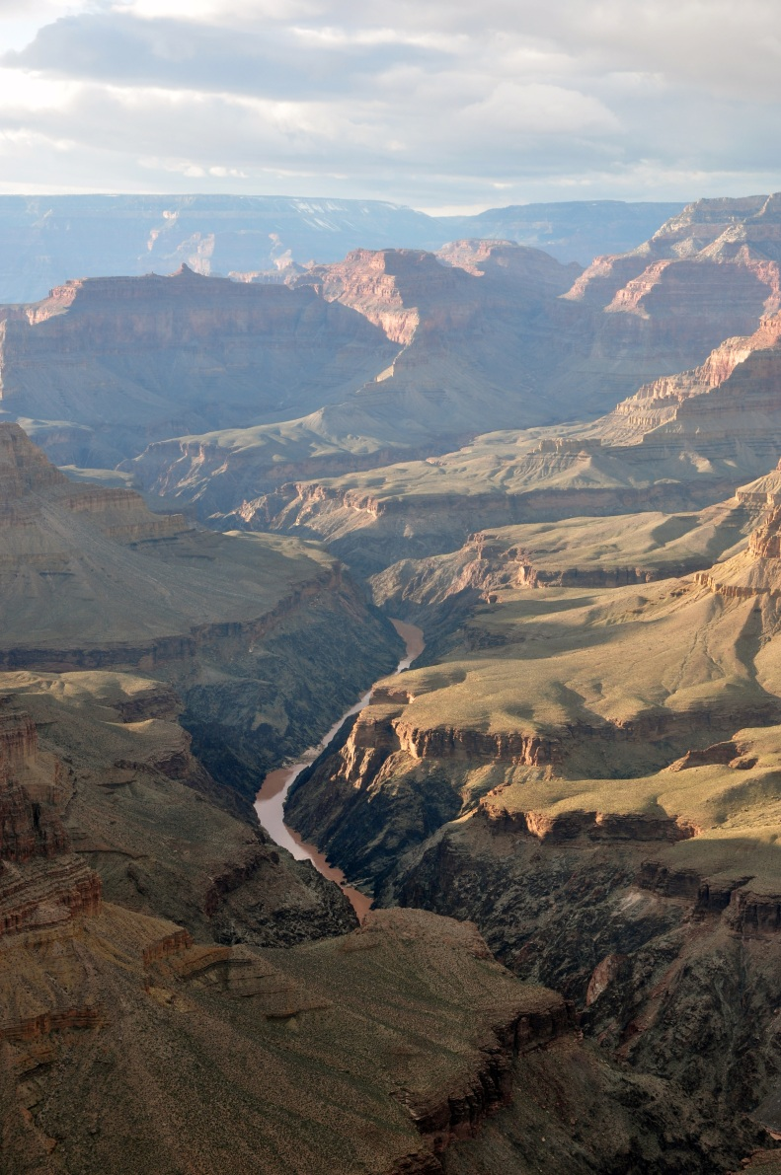
How old is the Earth?
Earthquakes
Overlapping volcanoes
Marine fossils in the hills

Slide 40
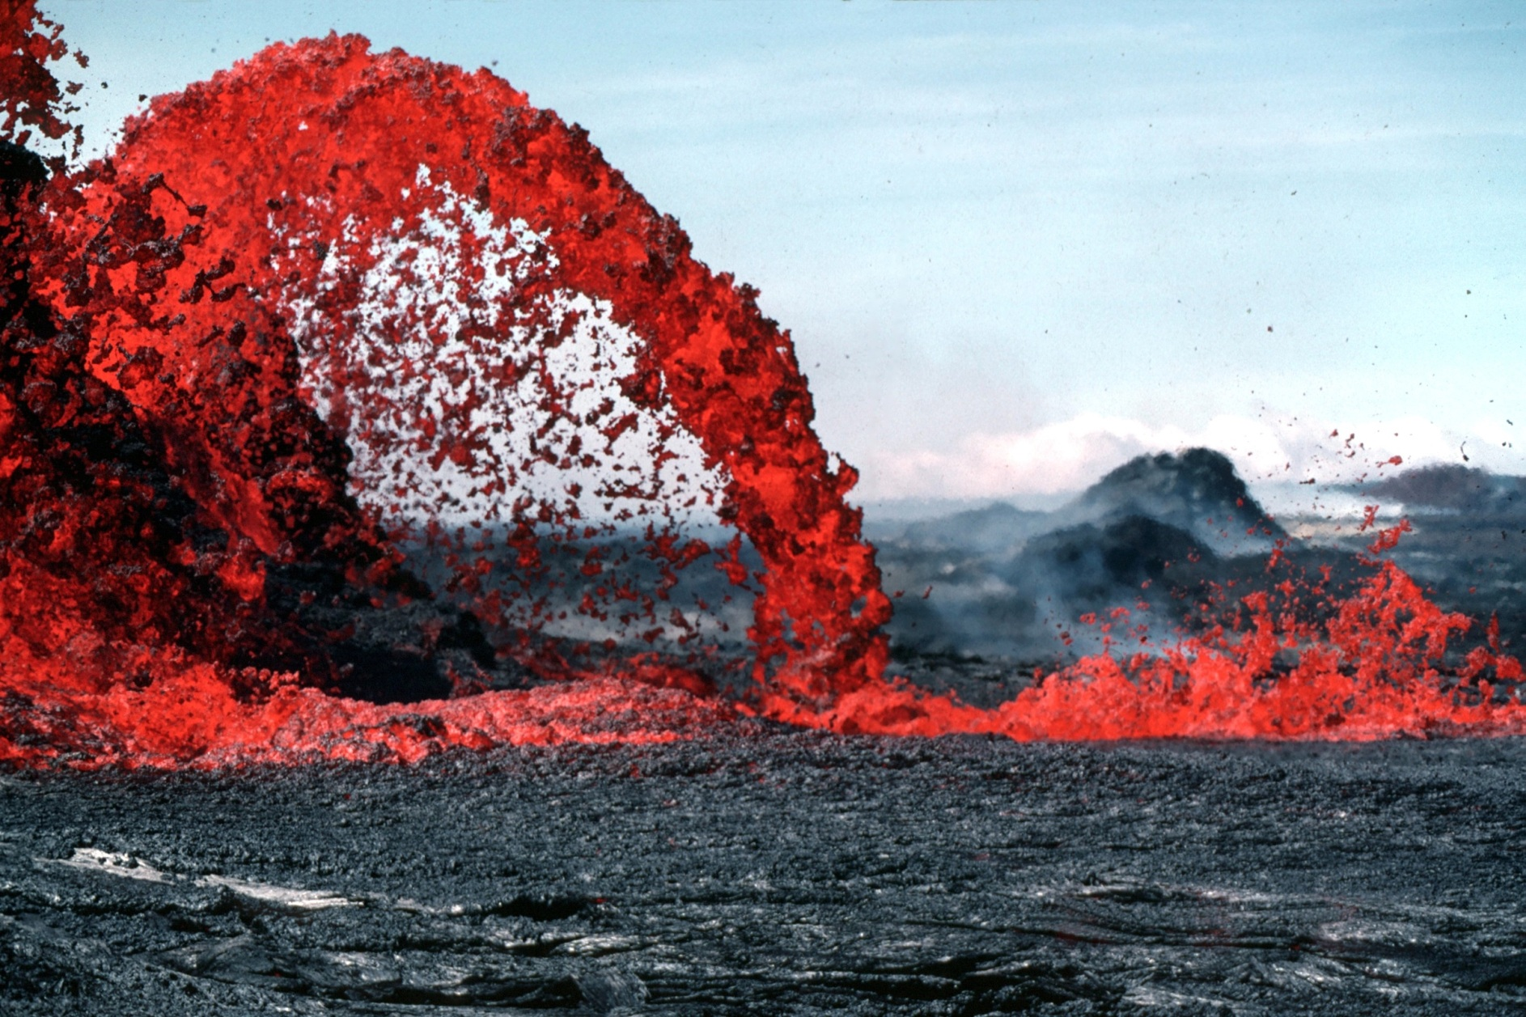
How much has the Earth changed?

Slide 41
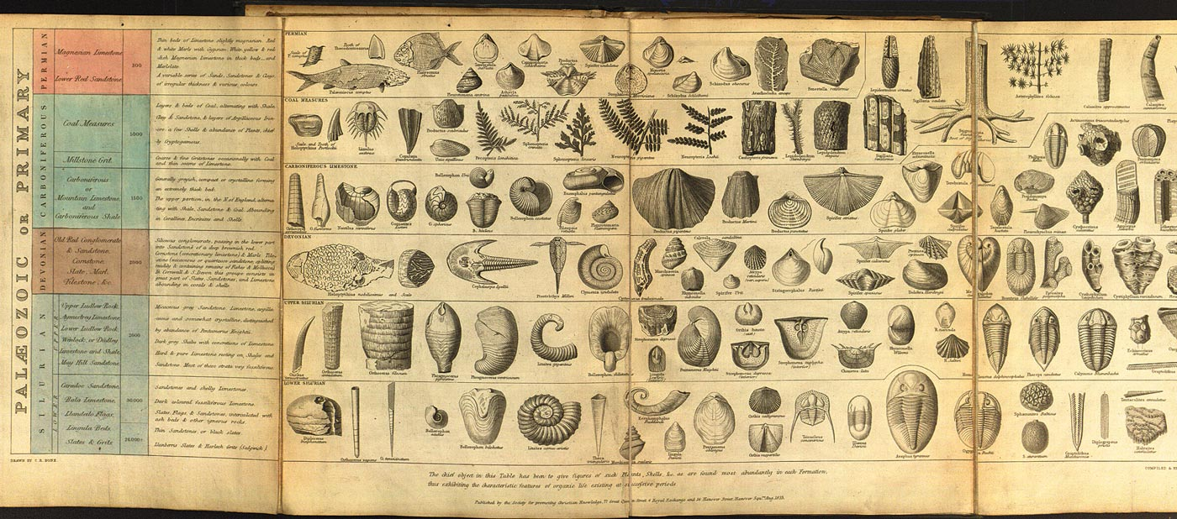
Joseph Wilson Lowry, Tabular View of Characteristic British Fossils, Stratigraphically Arranged (1853)

Slide 42
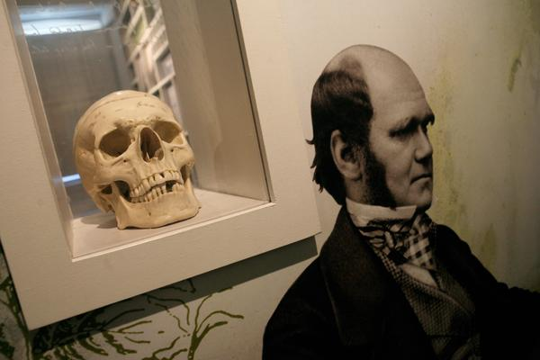
About 1836, Darwin begins to question the stability of species.

Slide 43
Come the 1830s: Many (though not all) scientists accept evolution.

Slide 44
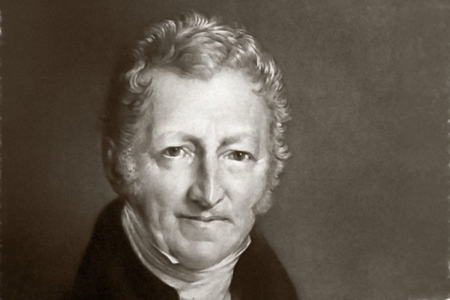
September 28, 1838: Darwin reads Thomas Malthus’s Essay on Population.

Slide 45
Malthus:
“Population, when unchecked, goes on doubling itself every 25 years or increases in a geometrical ratio.”
“The power of population is indefinitely greater than the power in the earth to produce subsistence for man.”

Slide 46
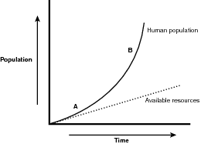
Malthusian chart

Slide 47
Question:
When population outstrips the food supply:
Who survives and who dies?

Slide 48
For 20 years, Darwin publishes nothing about evolution.

Slide 49
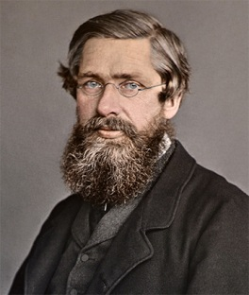
Alfred Russell Wallace (1823-1913)

Slide 50
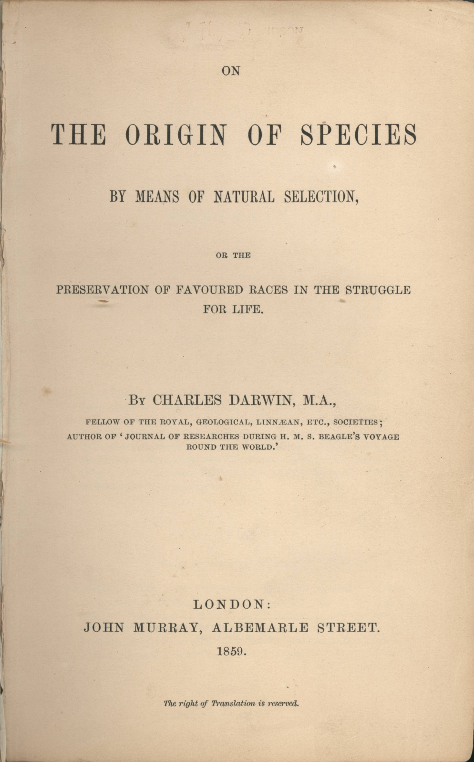
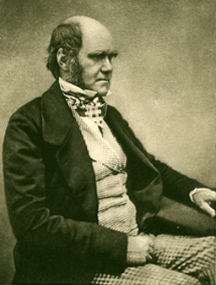
Published 1859.
No mention of humans.

Slide 51
Arguing that evolution happens and explaining how evolution happens.

Slide 52
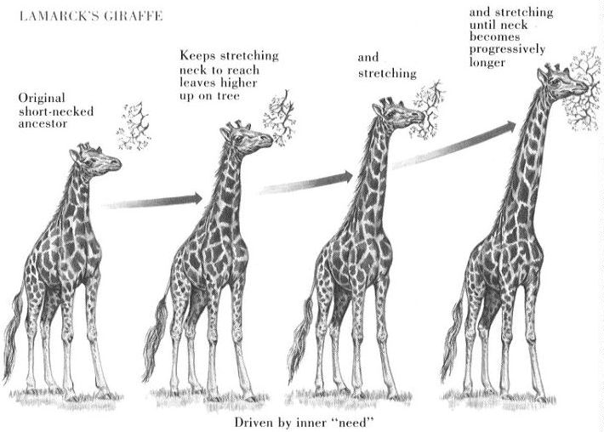
Lamarck: “inheritance of acquired characteristics”

Slide 53
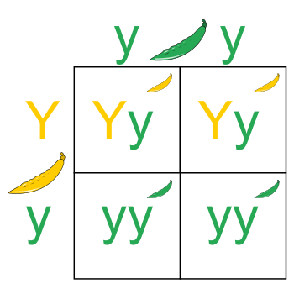
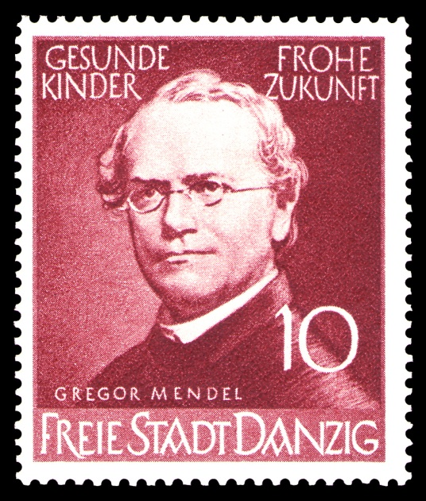
Gregor Mendel

Slide 54
Religious and political reactions to evolutionary theory?

Slide 55
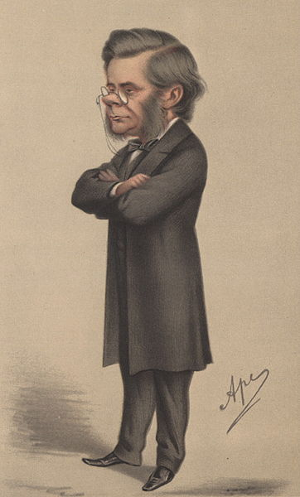
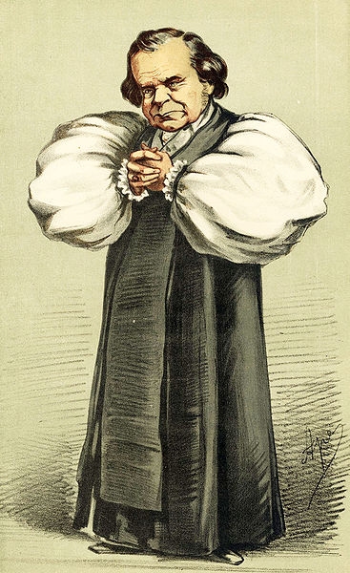
The 1860 Oxford evolution debate
Thomas Henry Huxley
Samuel Wilberforce

Slide 56
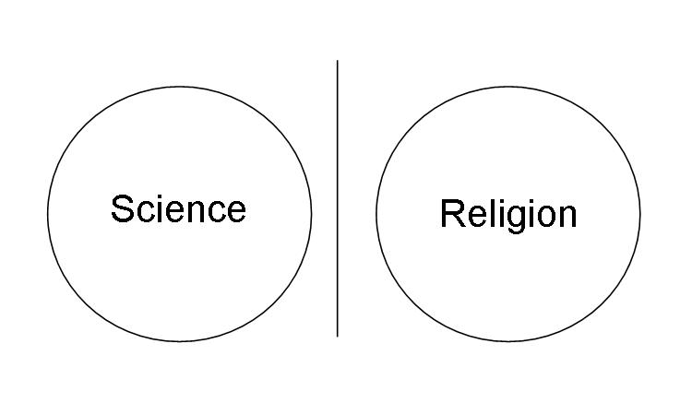
The public theme: traditional Christianity versus the new science.
(But at the time, not all scientists accepted evolution and not all theologians were opposed.)

Slide 57
Politics and Social Darwinism
Utilitarian laissez-faire?
Government-imposed eugenics?
National Socialism?
Socialism/Communism?

Slide 58
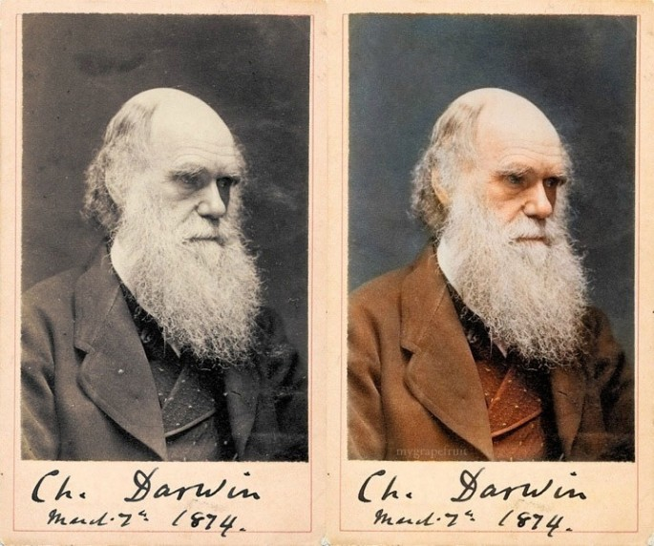
Darwin, older

Slide 59
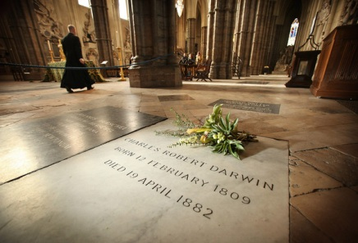
Darwin’s tomb at Westminster Abbey, London

