Slide 1
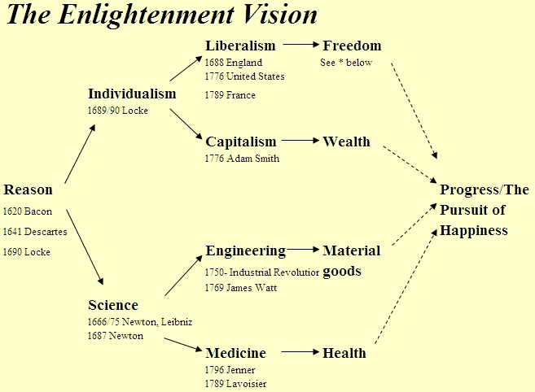
The Enlightenment

Slide 2
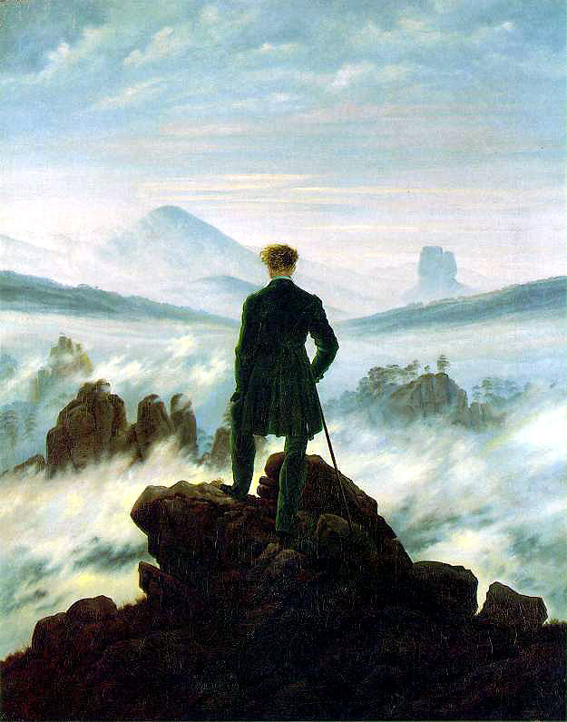
What is Enlightenment?

Slide 3
Science Philosophy Arts Engineering Morals Culture Medicine Music Hygiene Exploration

Slide 4
Why have humans been ignorant and crude for millennia?

Slide 5
Answer:
Because that’s human nature and we deserve it.

Slide 6
Human history: Cyclical versus Decline

Slide 7
Ecclesiastes:
² Vanity of vanities, says the Preacher, vanity of vanities! All is vanity. ³ What does man gain by all the toil at which he toils under the sun? ⁴ A generation goes, and a generation comes, but the earth remains forever. ⁵ The sun rises, and the sun goes down, and hastens to the place where it rises. ⁶ The wind blows to the south and goes around to the north; around and around goes the wind, and on its circuits the wind returns. ⁷ All streams run to the sea, but the sea is not full; to the place where the streams flow, there they flow again.
⁸ All things are full of weariness; a man cannot utter it; the eye is not satisfied with seeing, nor the ear filled with hearing. ⁹ What has been is what will be, and what has been done is what will be done, and there is nothing new under the sun. ¹⁰ Is there a thing of which it is said, “See, this is new”? It has been already in the ages before us. ¹¹ There is no remembrance of former things, nor will there be any remembrance of later things yet to be among those who come after.

Slide 8
Pessimism through the ages

Slide 9
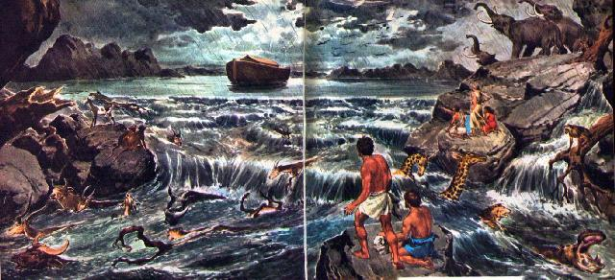
Pessimism 1: From the Garden of Eden to Noah

Slide 10
Pessimism 2: Plato (360 BCE): “In that country [Egypt] arithmetical games have been invented for the use of mere children, which they learn as pleasure and amusement. I have late in life heard with amazement of our ignorance in these matters [science in general]; to me we appear to be more like pigs than men, and I am quite ashamed, not only of myself, but of all Greeks.” (Laws, Book VII)

Slide 11
Pessimism 3: Sallust (86- c. 35 BCE): “To speak of the morals of our country, the nature of my theme seems to suggest that I go farther back and give a brief account of the institutions of our forefathers in peace and in war, how they governed the commonwealth, how great it was when they bequeathed it to us, and how by gradual changes it has ceased to be the noblest and best, and has become the worst and most vicious.”

Slide 12
Pessimism 4 Horace (c. 23-13 BCE): “Our fathers, viler than our grandfathers, begot us who are viler still, and we shall bring forth a progeny more degenerate still.” (Odes 3:6)

Slide 13
Pessimism 5 Alberti (1436): Nature is no longer producing great intellects — “or giants which in her youthful and more glorious days she had produced so marvelously and abundantly.” (On Painting)

Slide 14
Pessimism 6 Peter Paul Rubens (c. 1620): “For what else can our degenerate race do in this age of error. Our lowly disposition keeps us close to the ground, and we have declined from that heroic genius and judgment of the ancients.”

Slide 15
But by the 1700s …

Slide 16
Human history: Cyclical? Decline? Progress.

Slide 17
Again: Why have humans been ignorant and crude for millennia?

Slide 18
Knowledge
What is the source of authoritative knowledge?
Scripture?
The Church?
The Ancients (especially the Greeks) ?
One’s own reason?

Slide 19
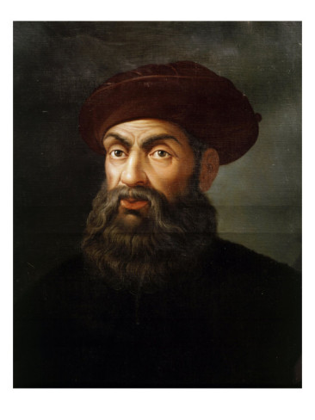
“The Church says that the Earth is flat, but I know that it is round. For I have seen the shadow on the moon, and I have more faith in Shadow than in the Church.”
Ferdinand Magellan, 1470-1521

Slide 20
Use your own judgment.

Slide 21
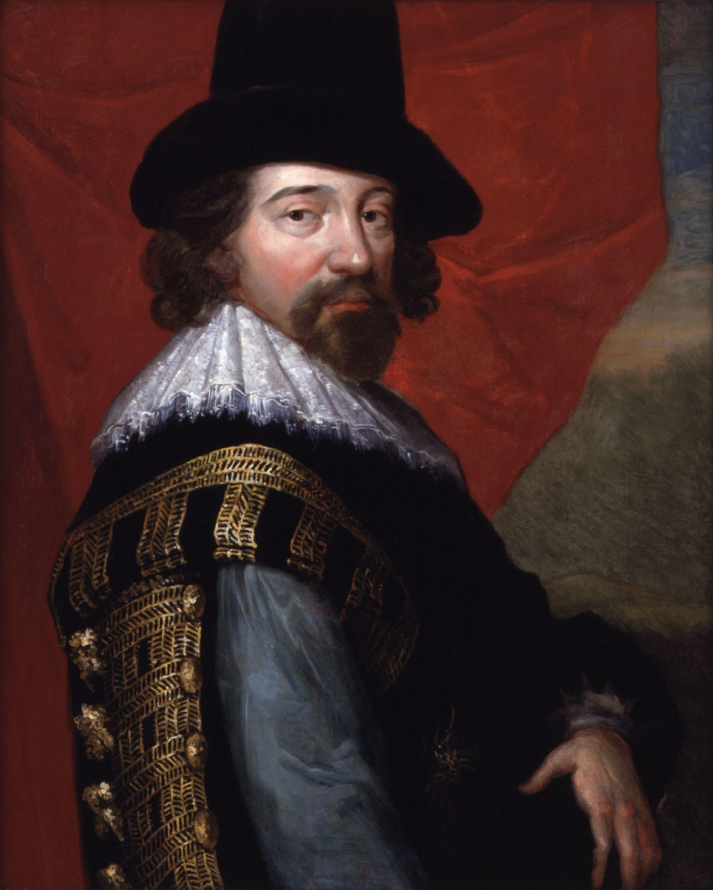
Francis Bacon (1561-1626)
“Knowledge is power.”
“Nature, to be commanded, must be obeyed.”

Slide 22
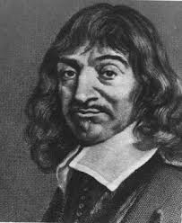
René Descartes (1596-1650)
“I think, therefore I am.”

Slide 23
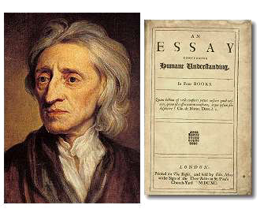
John Locke (1632-1704)

Slide 24
“Men must think and know for themselves. … . Not that I want a due respect to other men’s opinions; but, after all, the greatest reverence is due to truth … . [W]e should make greater progress in the discovery of rational and contemplative knowledge, if we sought it in the fountain, in the consideration of things themselves; and made use rather of our own thoughts than other men’s to find it. For I think we may as rationally hope to see with other men’s eyes, as to know by other men’s understandings. …
Locke on independence of judgment:

Slide 25
Locke, continued
The floating of other men’s opinions in our brains, makes us not one jot the more knowing, though they happen to be true. ... Aristotle was certainly a knowing man, but nobody ever thought him so because he blindly embraced, and confidently vented the opinions of another. … In the sciences, every one has so much as he really knows and comprehends. What he believes only, and takes upon trust, are but shreds.” (Essay Concerning Human Understanding)

Slide 26
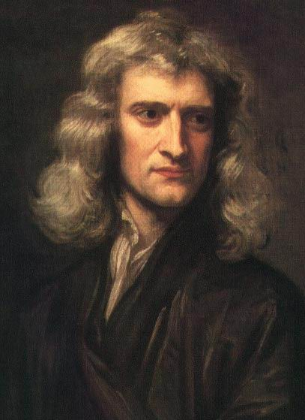
Isaac Newton (1642-1727)
“But hitherto I have not been able to discover the cause of those properties of gravity from phenomena, and I frame no hypotheses; for whatever is not deduced from the phenomena is to be called a hypothesis; and hypotheses, whether metaphysical or physical, whether of occult qualities or mechanical, have no place in experimental philosophy.” (Principia Mathematica, “General Scholium”)

Slide 27
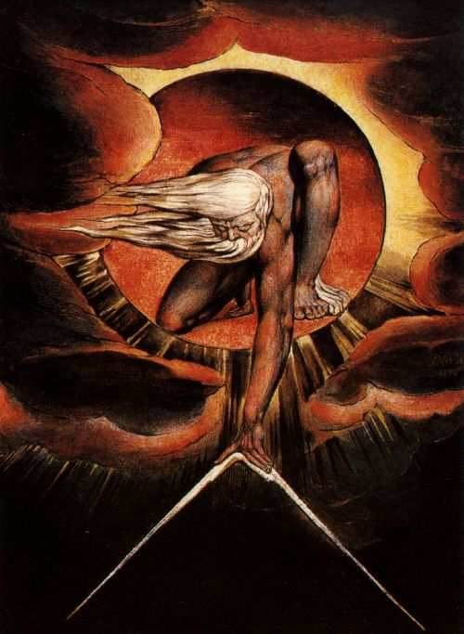
Deism
William Blake, The Ancient of Days (1794)

Slide 28
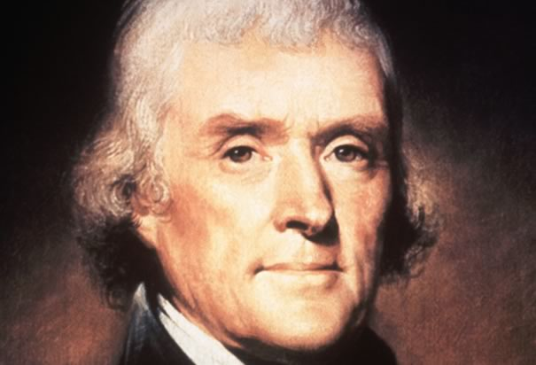
Thomas Jefferson
“Question with boldness even the existence of a God; because, if there be one, he must more approve of the homage of reason, than that of blindfolded fear.”

Slide 29
American religious belief
“At the time of the founding, historians estimate that only about 17% of Americans professed formal religious adherence, a historic low point. The framers were deists, who believed in a divine providence knowable only through reason and experience and not prone to intervene in the affairs of men.”

Slide 30
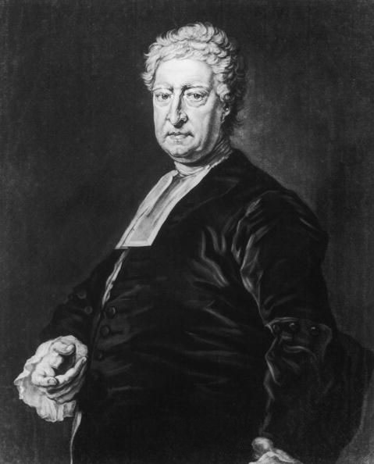
Matthew Tindal
England’s most influential deist.
God made man with the capacity for natural pleasure and avoidance of natural pain.
Natural pleasure and pain the standard of good and bad.
So: “nothing can be a part of the divine law, but what tends to promote the common interest and mutual happiness of his rational creatures.”
(Christianity as Old as the Creation, 1730)

Slide 31
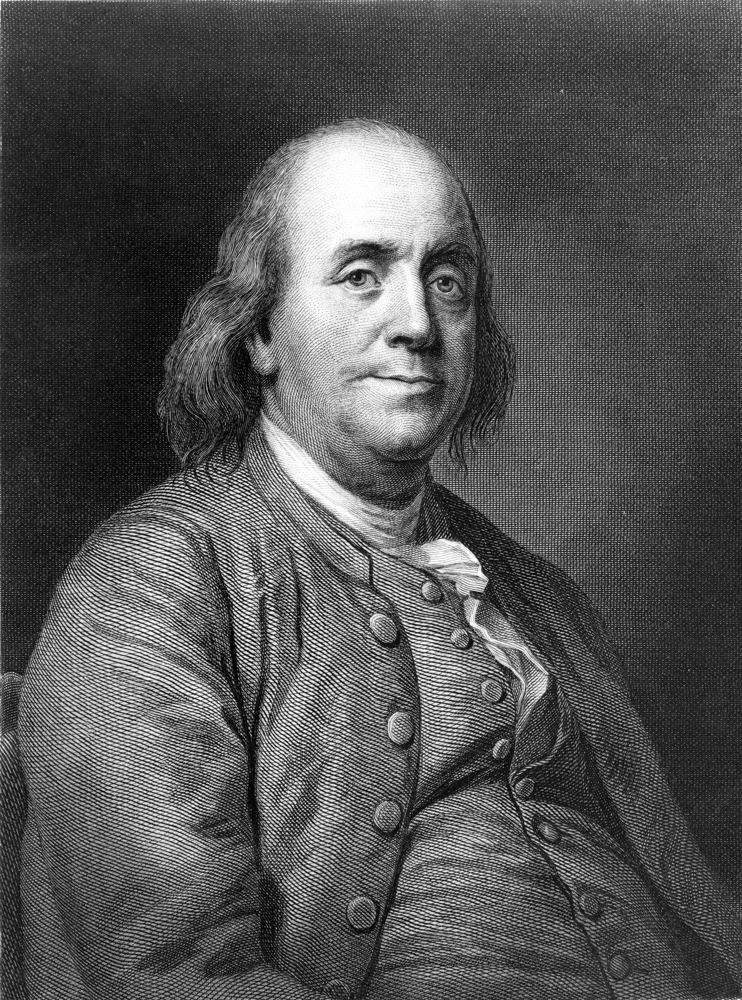
The pursuit of happiness
“Beer is proof that God loves us and wants us to be happy.”
Ben Franklin

Slide 33
What formerly caused misery and conflict |  | The Enlightenment
Symptom | Cause | Solutions
Mass ignorance | Intellectual authoritarianism | Individual reason, literacy, education
Feeling the world mysterious, frightening | Whimsical supernaturalism | Natural cause and effect intelligibility, prediction, control. Science.
Being at the mercy of nature | Faith, ignorance, and superstition | Reason, science, technology
Stasis | Feudal collectivism, feudal status, authoritarian hierarchy | Individual freedom, individual merit, individual initiative
Social conflict | Lack of rights, conquest, dogmatism | Rights, trade, tolerance
Poverty | Economic: political control of assets; conflict and war; lack of freedom (serfs); stigmas on money and work | Naturalistic happiness, private property and liberty: incentive, production, trade, peace
Political tyranny | Belief that individuals can’t run their own lives | Confidence in the power of every individual’s reason.

Slide 34
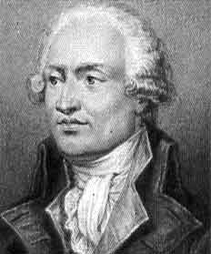
Condorcet
“Sketch for a Historical Picture of the Progress of the Human Mind”
(1795)

Slide 35
Marquis de Condorcet

Slide 36
But not everyone agrees.

Slide 37
Reason without tradition – chaos? Reason without religion – a void?

Slide 38
Conservatives against the Enlightenment
Social
Engineering
Hubris
Conflict,
Poverty,
Death
Reason
Individualism
Selfishness

Slide 39
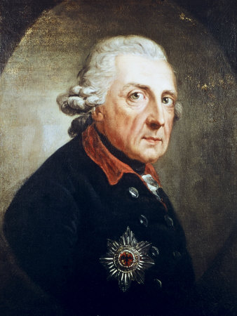
The 1780 Berlin Academy of Science's essay contest. Topic: “Is it expedient to deceive the people?” (Topic suggested by Frederick the Great.)

