Slide 1
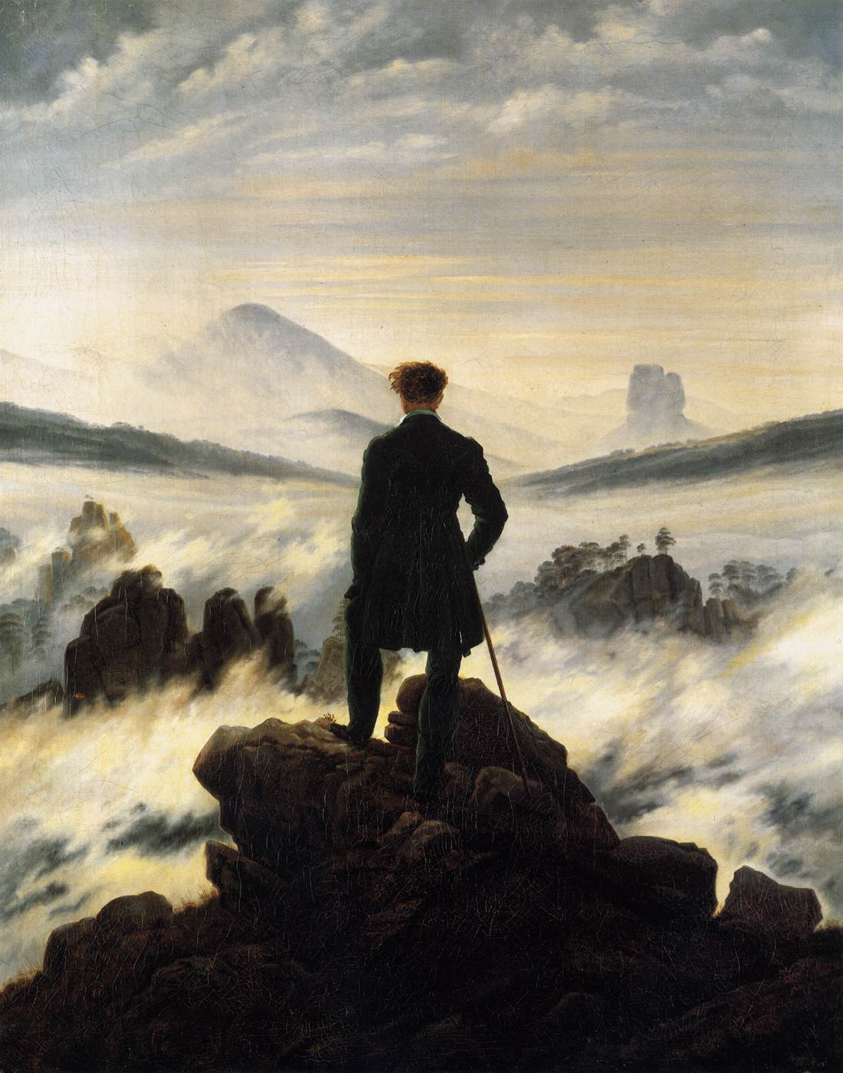
Romanticism

Slide 2
Romanticism as a 19th-century artistic and philosophical movement
Painting
Music
Literature

Slide 3
W. H. Wackenroder, an early German romantic:
“We sons of this century have the advantage of standing on a high mountain peak with many lands and ages visible to our eyes spread out at our feet. Let us use our good fortune, let us lovingly survey all epochs and peoples, and in their manifold feelings and creative works let us always seek the human qualities.”

Slide 4
Albert Bierstadt, Valley of the Yosemite (1864)

Slide 5
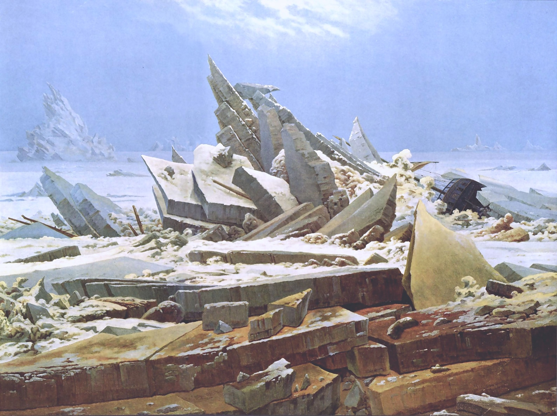
Caspar David Friedrich, The Sea of Ice

Slide 6
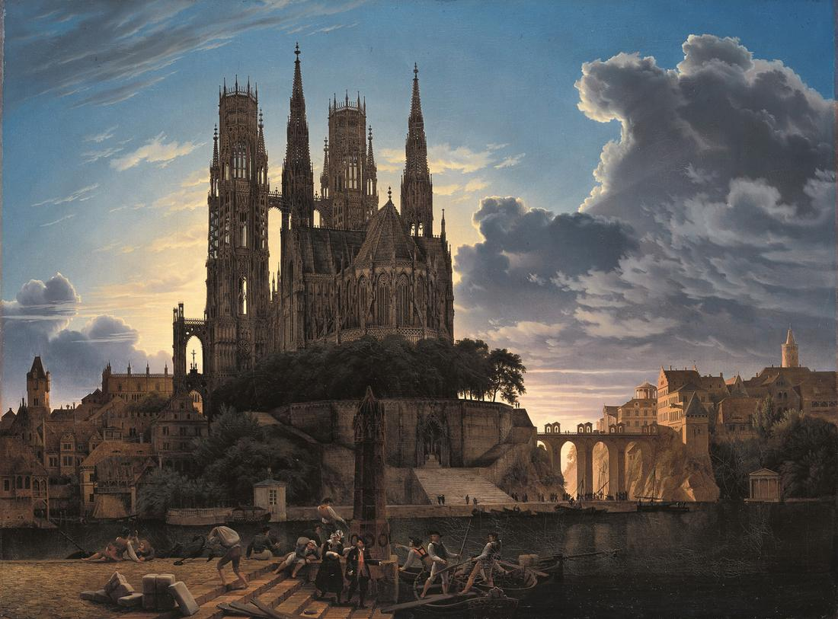
Karl Friedrich Schinkel, Medieval Town by Water (1813)

Slide 7
Delacroix, Tiger Attacking a Wild Horse

Slide 8
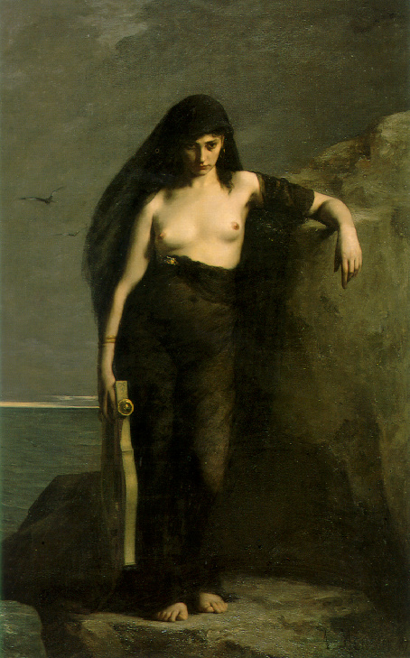
Charles Mengin, Sappho

Slide 9
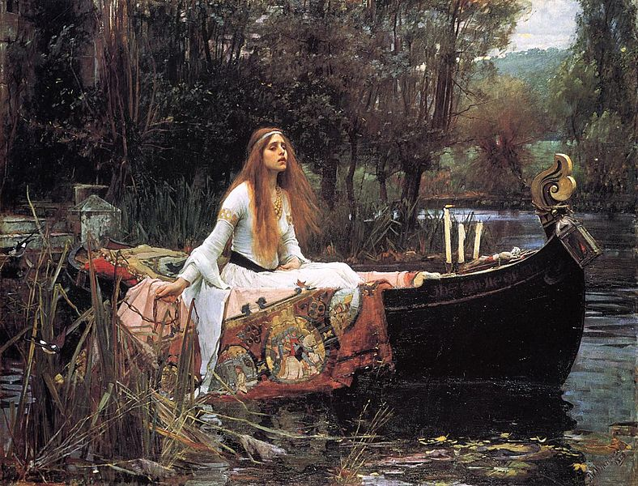
Waterhouse, The Lady of Shallot (1888)

Slide 10
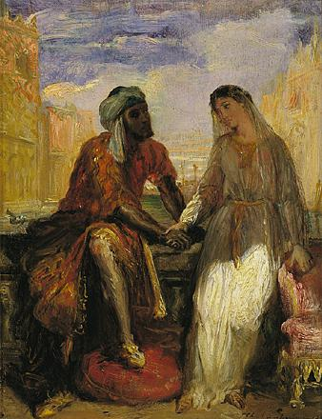
Chassériau, Othello and Desdemona in Venice

Slide 11
Jean-Léon Gérôme, Duel after a Masked Ball

Slide 12
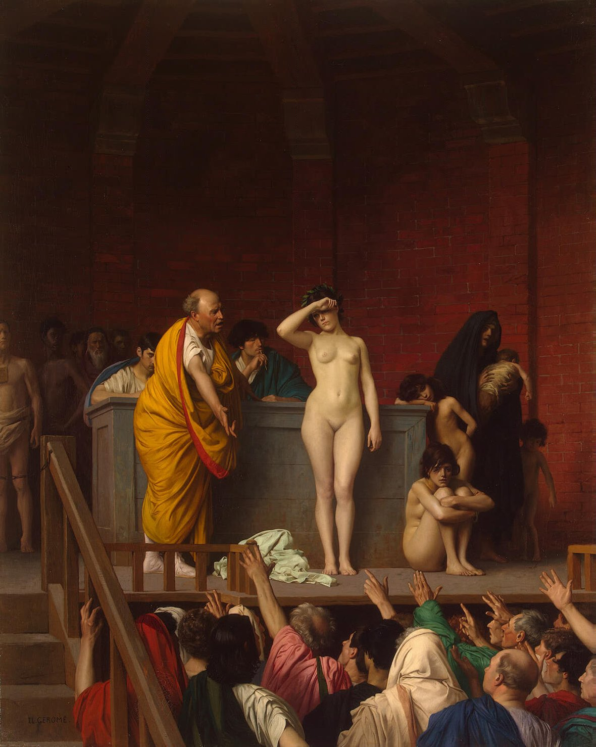
Gérôme, Slave Market in Rome

Slide 13
Jean-Léon Gérôme, Pygmalian

Slide 14
Romantic positive themes
Nature: majestic, inviting, sublime, dangerous
People: passionate, exotic, adventurous, extreme action

Slide 15
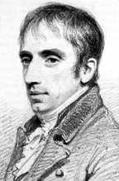
Wordsworth, from The Excursion (1814)
My voice proclaims
How exquisitely the individual Mind
(And the progressive powers perhaps no less
Of the whole species) to the external World
Is fitted:—and how exquisitely, too,
Theme this but little heard of among Men,
The external World is fitted to the Mind.

Slide 16
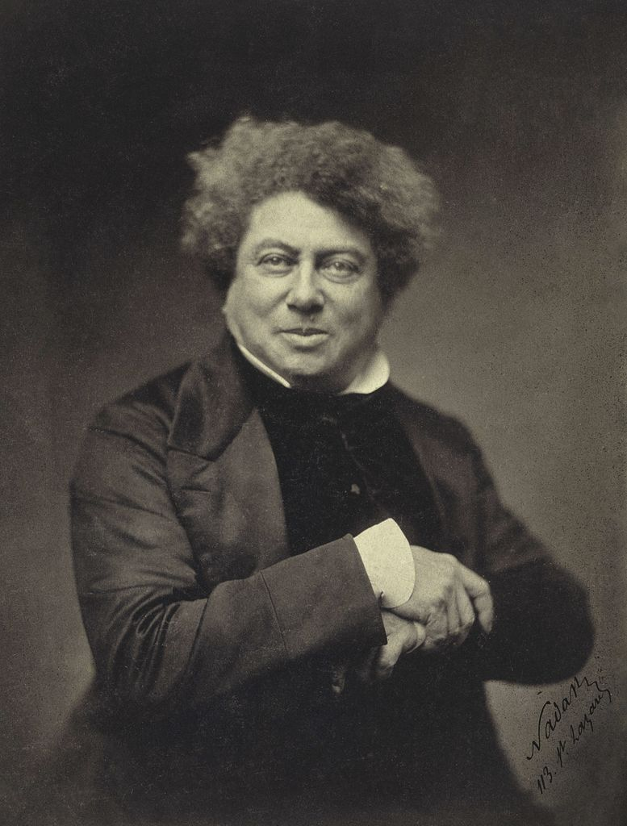
Alexander Dumas
The Three Musketeers
The Count of Monte Cristo
The Man in the Iron Mask

Slide 17
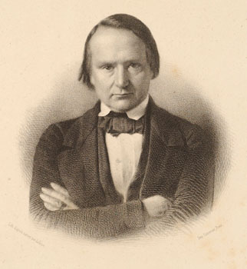
Victor Hugo
Les Miserables
The Man Who Laughs
Notre Dame de Paris (The Hunchback of Notre Dame)

Slide 18
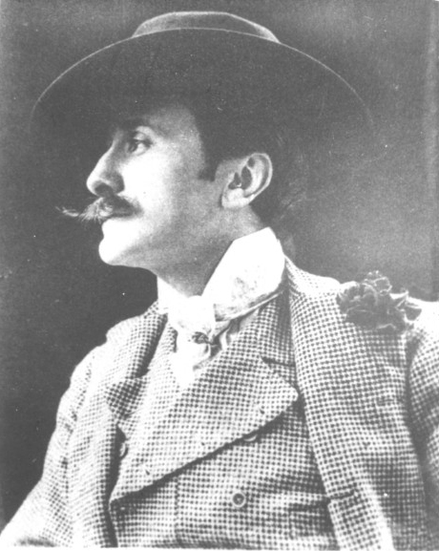
Edmond Rostand
Cyrano de Bergerac

Slide 19
Romantic negative themes
Contrast to Classicism’s rules, formulae, copying old, dead things.
Fear of mechanistic, reductionist view of life.
Variations:
spiritualism versus materialism
passion versus cold reason
spontaneity versus routine
freedom versus restraint
fantasy versus realism

Slide 20
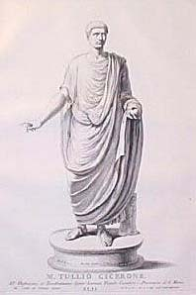
Contra Classicism
Rules, tradition, old.
Romantics:
Freedom, the future, the new.

Slide 21
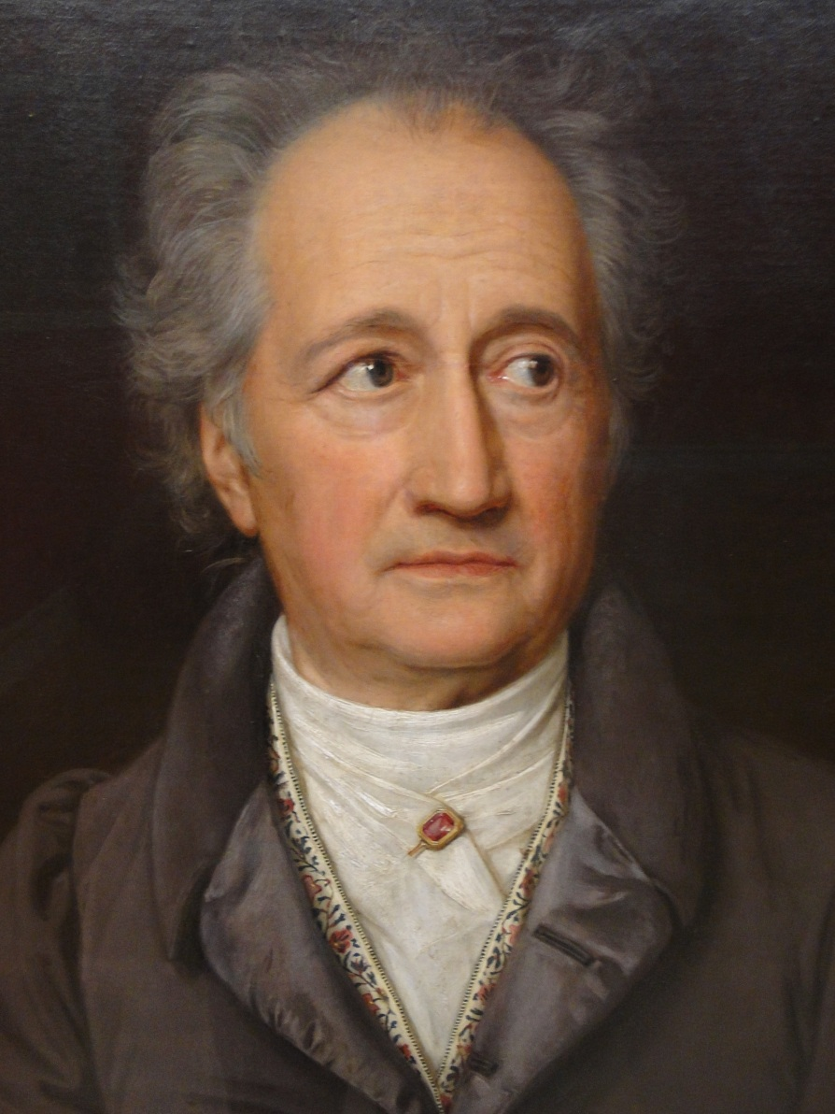
Contra reason, science, philosophy
Johann Wolfgang Goethe:
“Gray, dear friend, is all theory,
But green is life’s golden tree.”
“Feeling is all,
Name is only sound and smoke.”

Slide 22
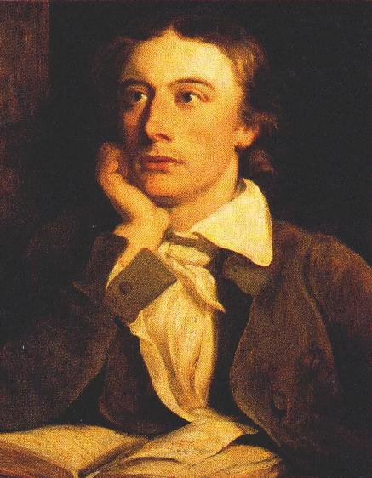
John Keats, “Lamia”
Do not all charms fly
At the mere touch of cold philosophy?
There was an awful rainbow once in heaven: We know her woof, her texture; she is given
In the dull catalogue of common things.
Philosophy will clip an Angel's wings,
Conquer all mysteries by rule and line,
Empty the haunted air, and gnomed mine –
Unweave a rainbow, as it erstwhile made
The tender-person'd Lamia melt into a shade.

Slide 23
John Keats, “Lamia” (cont’d)
The bald-headed philosopher
Had fix’d his eye, without a twinkle or stir
Full on the alarmed beauty of the bride,
Brow-beating her fair form, and troubling her sweet pride.

Slide 24
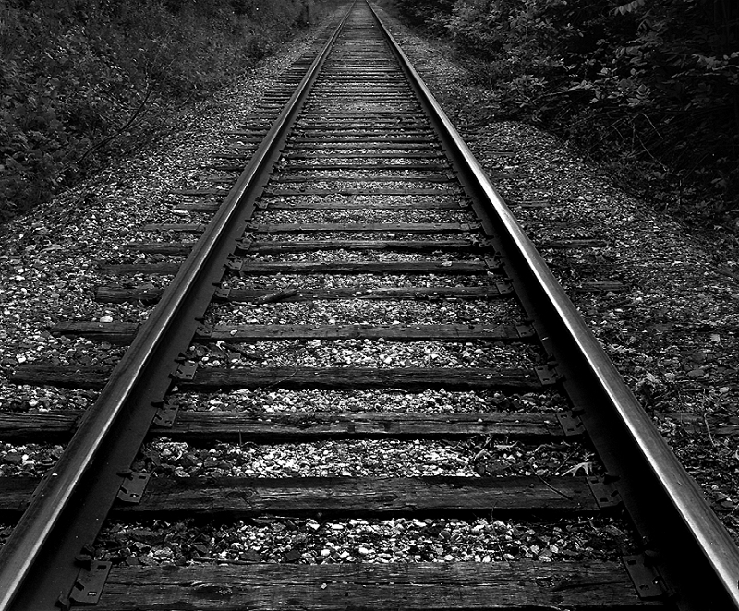
Contra mechanism
Is the Industrial Revolution a good thing?
Thoreau: “We do not ride on the railroad; it rides upon us.”

Slide 25
Disquiet over the decline of religion
Is God dead?
Is there no magic in the world?
Replace with self-creation and nature worship?

Slide 26
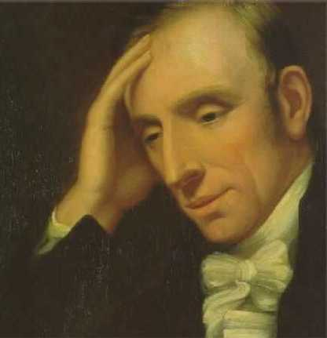
William Wordsworth (1770-1850)
The World Is Too Much with Us (1802)
The Tables Turned (1798)

