Slide 1
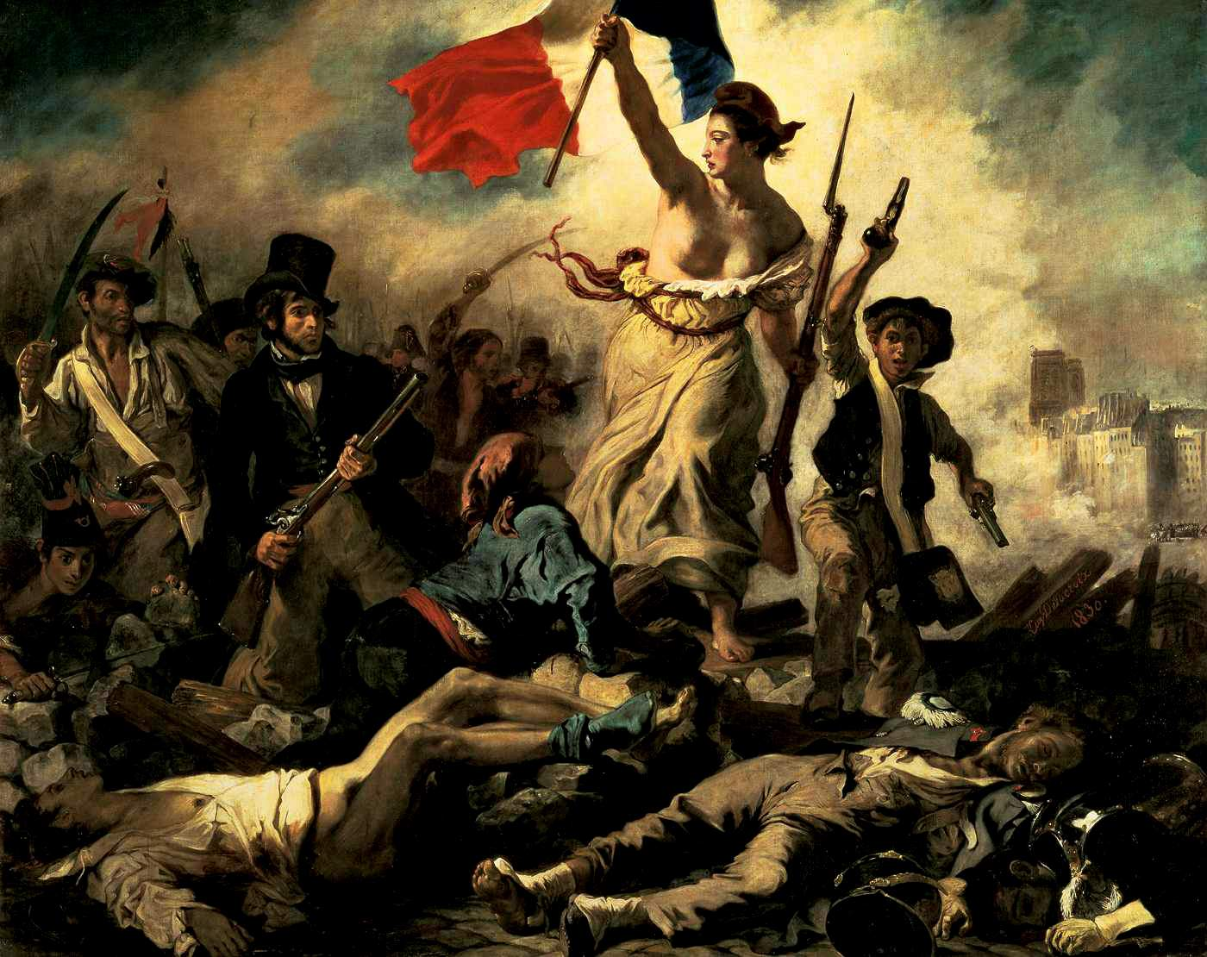
The French Revolution

Slide 2
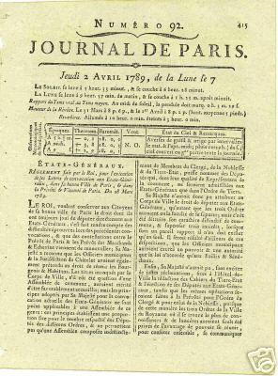
1789

Slide 3
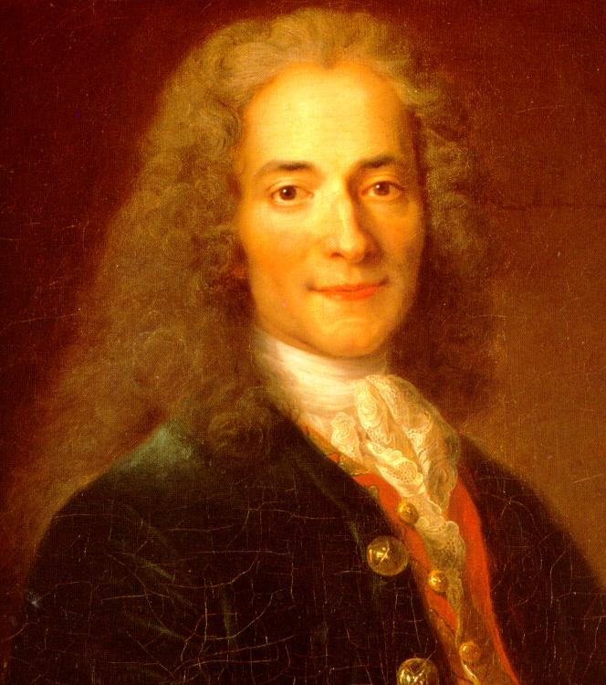
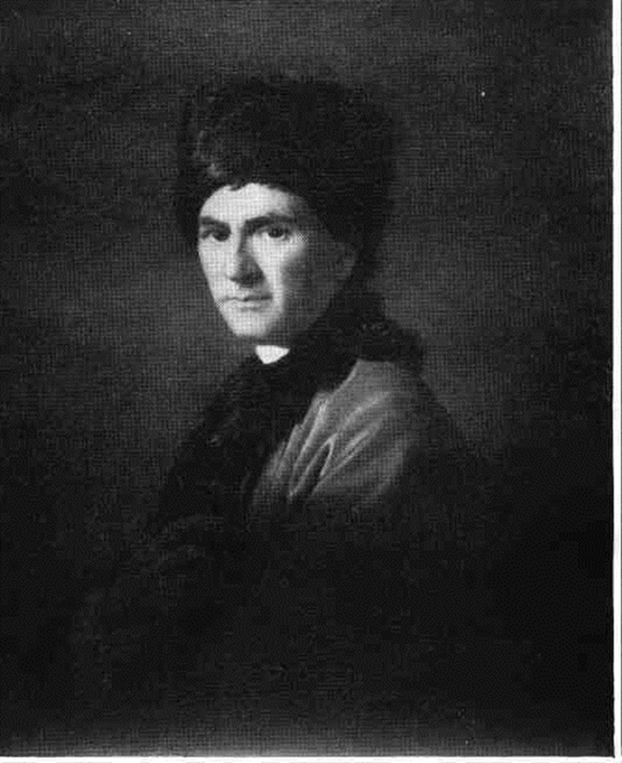
Voltaire versus Rousseau
Enlightenment
Counter-Enlightenment

Slide 4
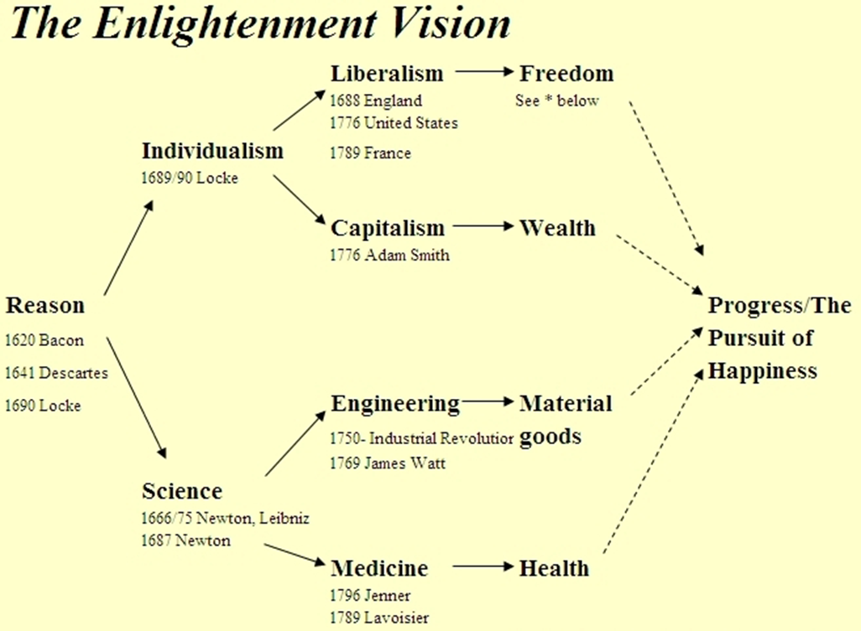

Slide 5
Rousseau’s counter-Enlightenment
Reason?
Science?
The arts?
Liberty?
Medicine?
Back to nature!
Equality!

Slide 6
Power struggle in 1600s and 1700s: King versus Aristocrats King wants centralization Aristocrats want decentralization

Slide 7
What do kings want?
Wine, Women, and War
(Plus some hunting)

Slide 8
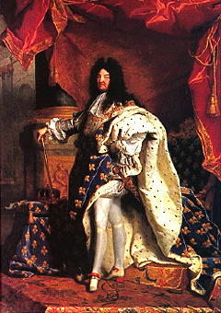
Louis XIV

Slide 9
The “Sun King”

Slide 10
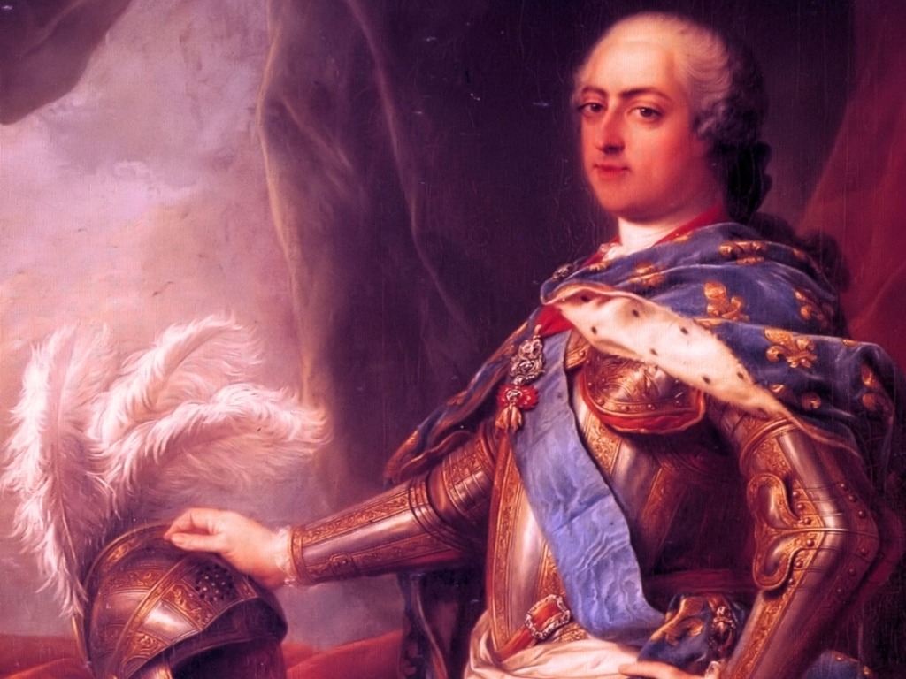
Louis XV

Slide 11
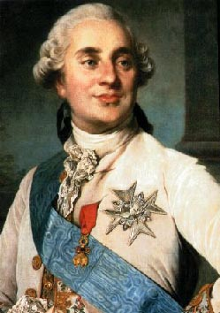
Louis XVI

Slide 12
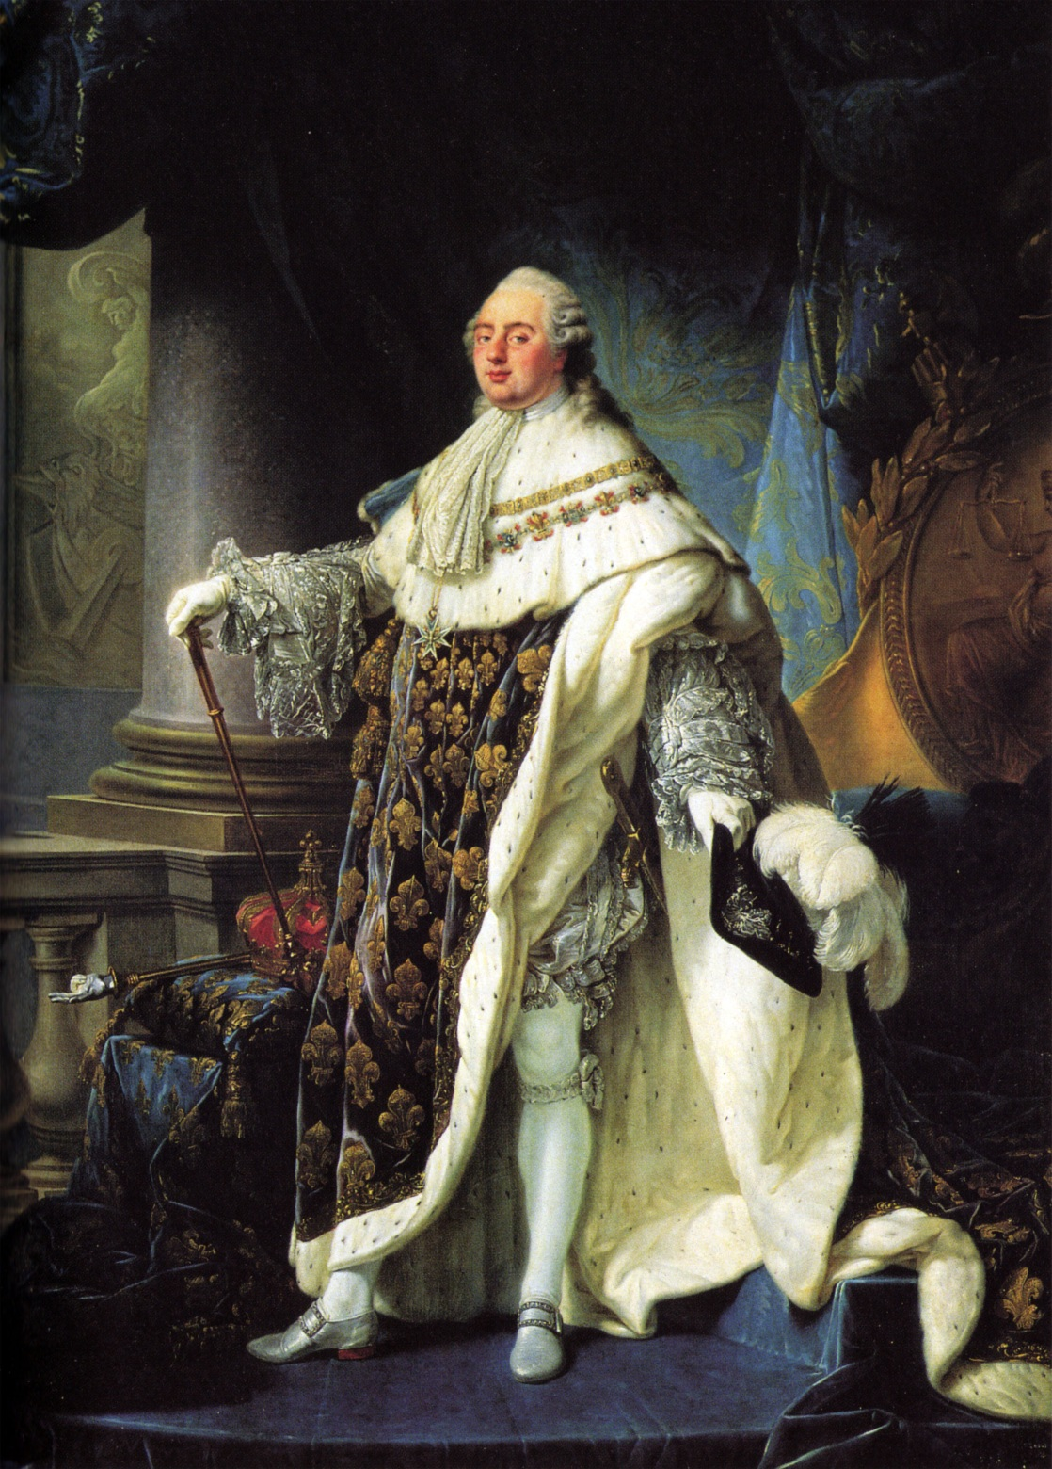
Louis XVI, older

Slide 13
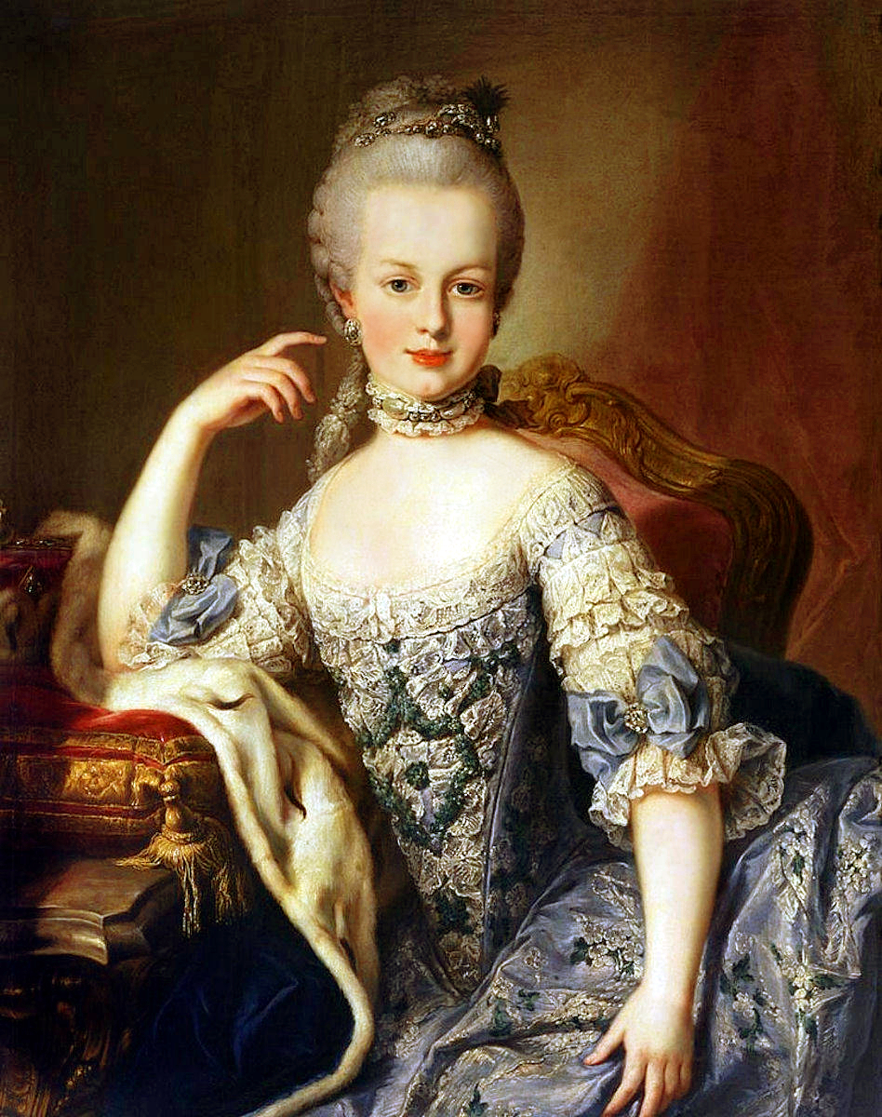
Marie Antoinette in 1867

Slide 14
Problems for the monarchy
Debts
Bad harvests
Enlightenment aspirations

Slide 15
Ideology plus interests: Aristocrats versus Liberals versus Jacobins

Slide 16
First phase of the French Revolution
Aristocrats dominate.

Slide 17
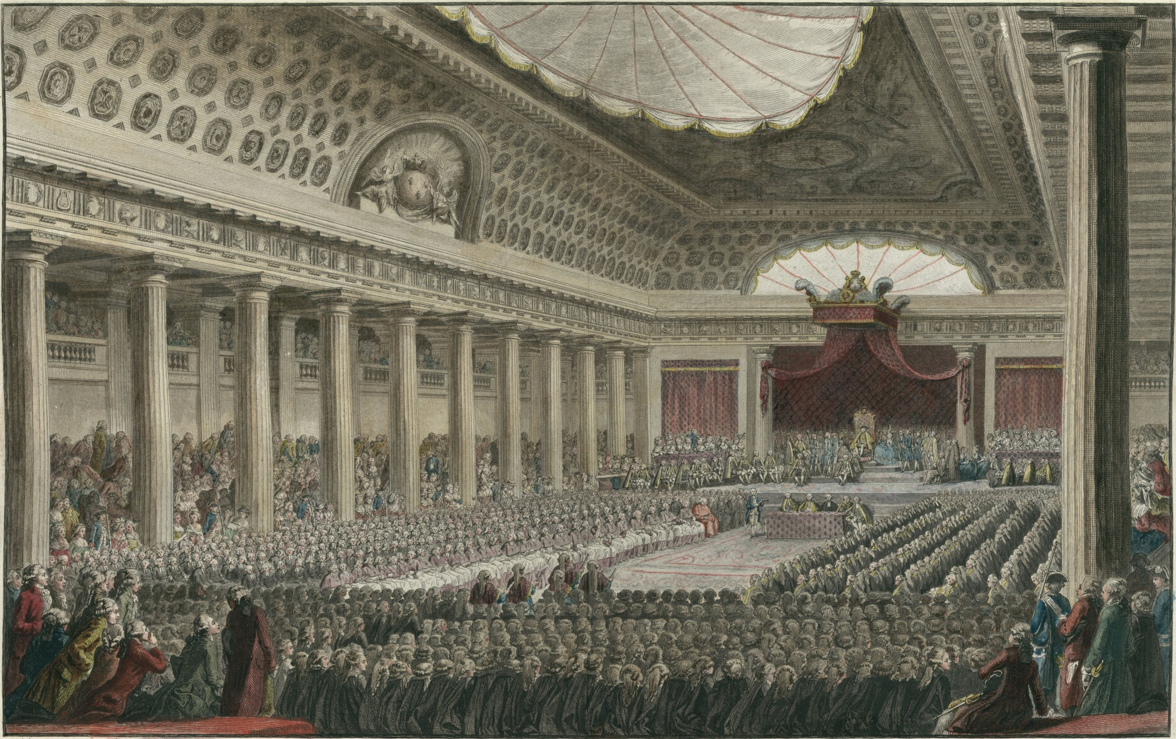
Aristocrats force calling of the Estates-General in 1789

Slide 18
The meeting of the Estates General
Three estates: (1st) Clergy, (2nd) Nobility, (3rd) everyone else.
Each estate has different codified rights.
French population is about 25 million.
Clergy about 100,000. Nobles about 400,000.
Collectively, each estate has one vote.
Anything passed by two of the three estates almost guaranteed to be accepted by king.

Slide 19
Second phase of the French Revolution
Liberals dominate.

Slide 20
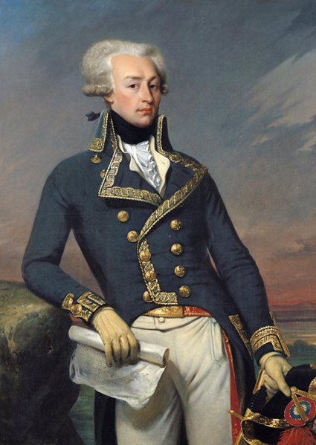
Lafayette, the “Hero of Two Worlds”

Slide 21
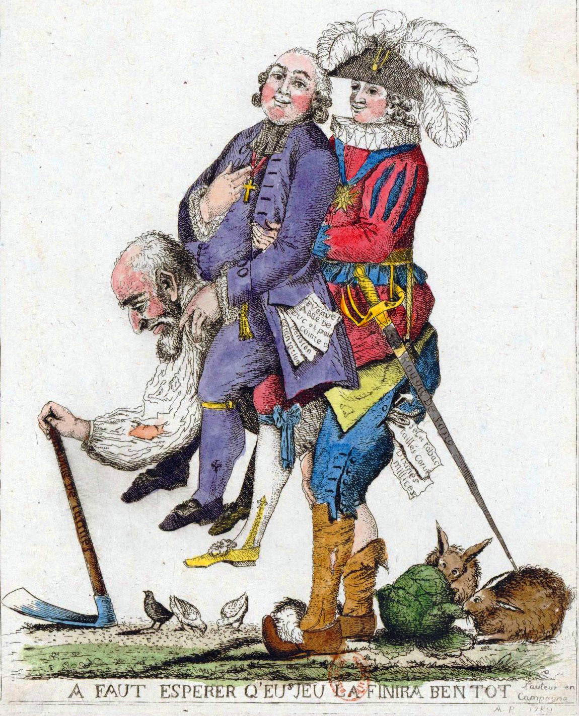
The Three Estates, cartoon

Slide 22
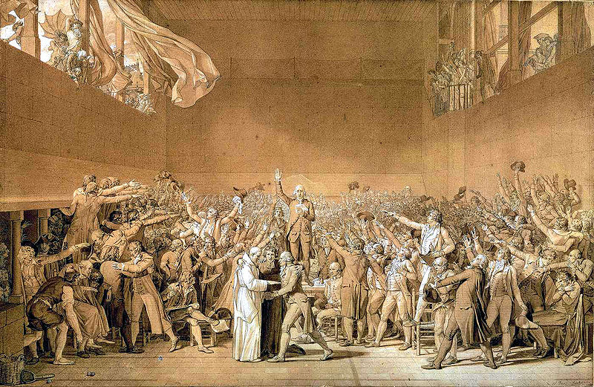
The Oath of the Tennis Court

Slide 23
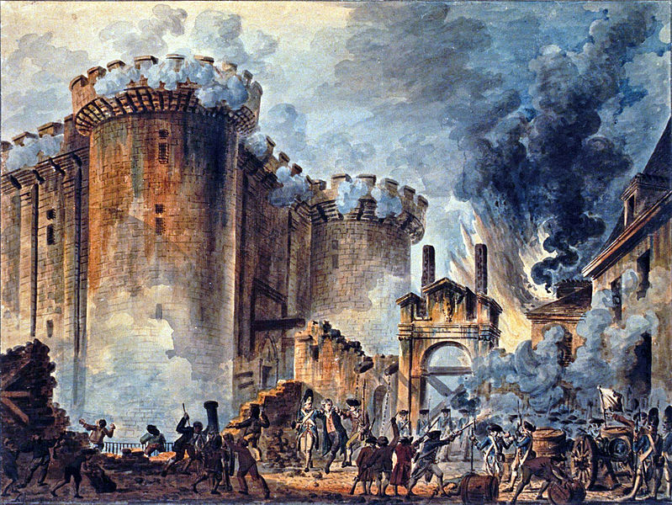

Slide 24
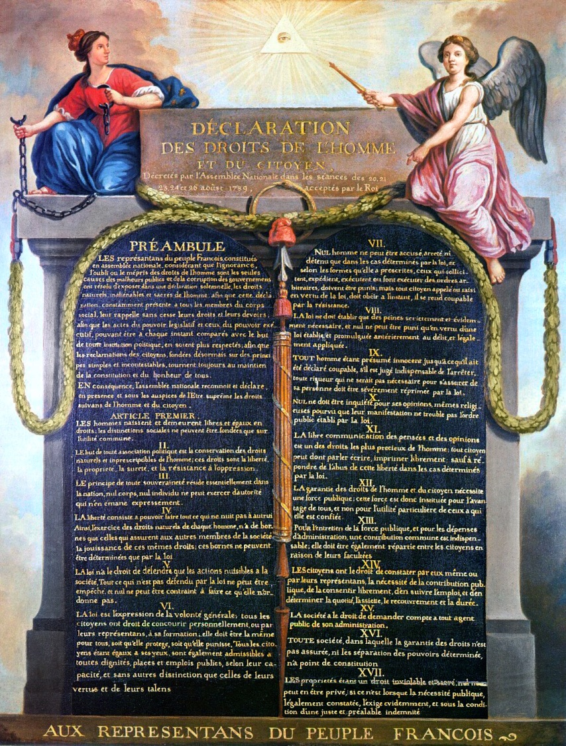
Declaration of the Rights of Man and of the Citizen
First draft by written by Lafayette.

Slide 25
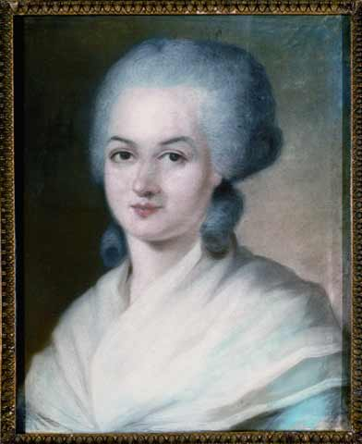
Olympe de Gouges, The Declaration of the Rights of Woman (1791)
1. Woman is born free and remains equal to man in rights. Social distinctions may be based only on common utility.
2. The purpose of all political association is the preservation of the natural and imprescriptible rights of woman and man. These rights are liberty, property, security, and especially resistance to oppression. …

Slide 26
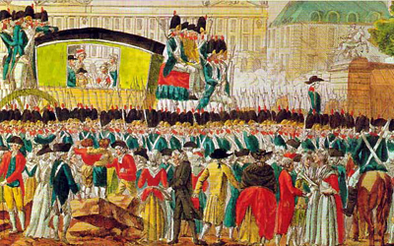
July 1791: Louis XVI tries to leave France but is caught

Slide 27
Third phase of the French Revolution
Jacobins dominate.

Slide 28
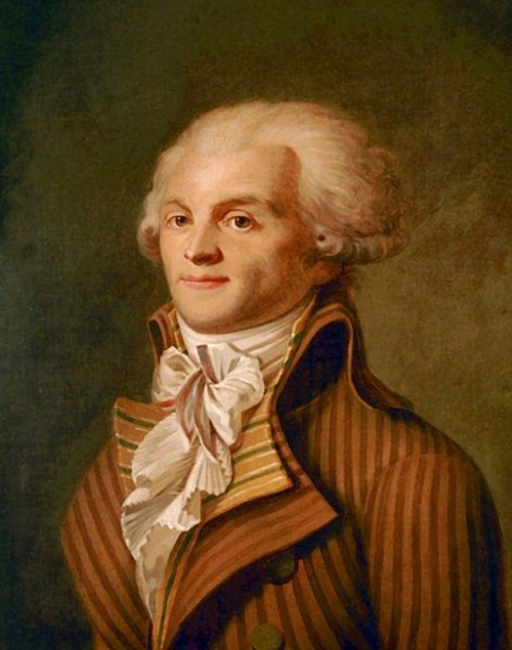
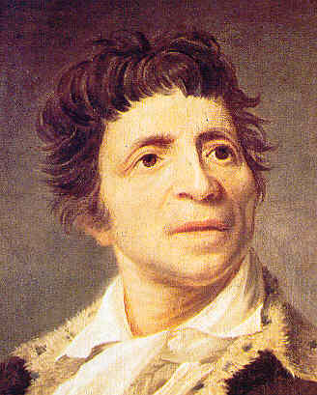
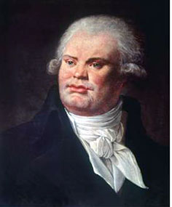
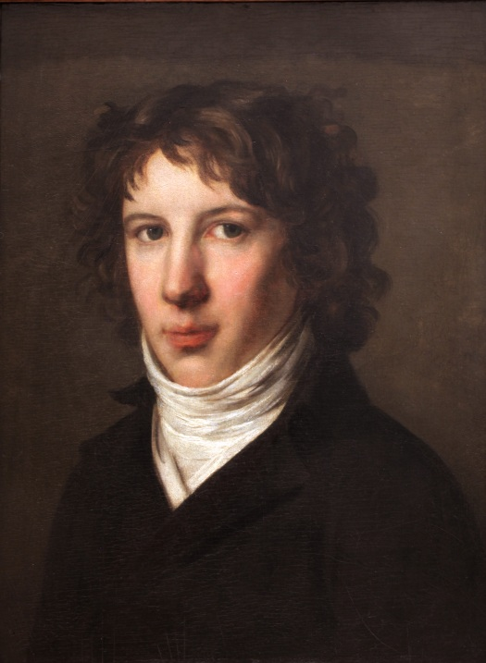
The Jacobins: Robespierre, Saint-Just, Danton, Marat (clockwise from top right)

Slide 29
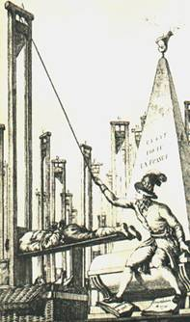
Guillotine

Slide 30
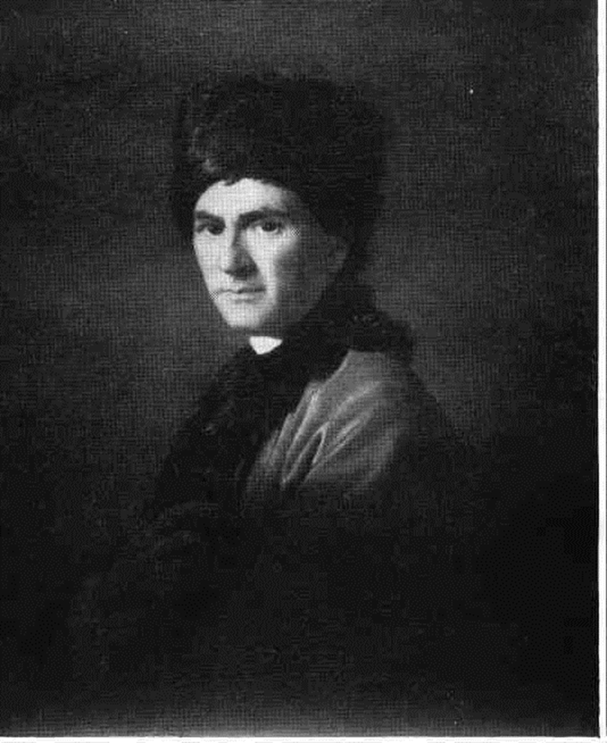
Rousseau and the Jacobins

Slide 31
Robespierre: “I am imbued with Rousseau’s doctrines.” “I live by Émile.”

Slide 32
Robespierre: “Rousseau is the one man who, through the loftiness of his soul and the grandeur of his character, showed himself worthy of the role of teacher of mankind.”

Slide 33
Robespierre: “Children belong to the mother until age five, and to the Republic after that.”

Slide 34
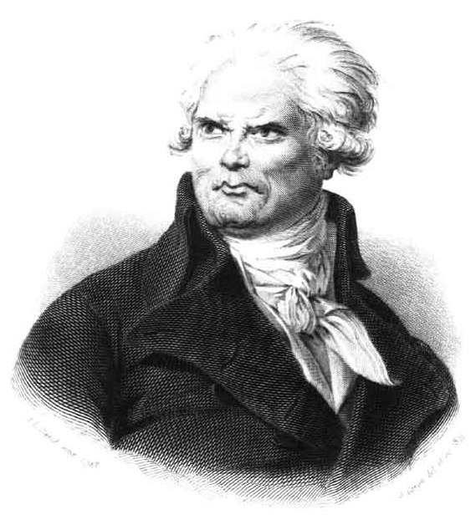
Georges Danton
Became politically active because of feelings inspired in him as young man by his reading of Rousseau.

Slide 35
Jean-Paul Marat: Took on a disheveled unkempt, unbathed appearance in order “to live simply and according to the precepts of Rousseau.”

Slide 36
Marat: “My ambition is to sacrifice myself to my country because I adore virtue.”

Slide 37
Saint-Just: “The vessel of the Revolution can arrive in port only on a sea reddened with torrents of blood.”

Slide 38
Saint-Just’s nickname: “Angel of Death”

Slide 39
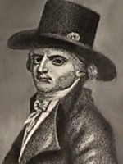
“Gracchus” Babeuf
“We aim at common property, or the community of goods! No more individual property in lands. The earth belongs to no one, the fruits belong to all.”

Slide 40
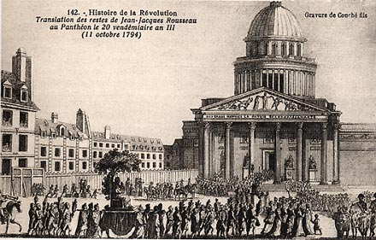
1794
Rousseau’s funeral urn brought in grand procession to Paris to rest in the Pantheon, France’s highest place of honor.

Slide 41
1792 to 1793
Power shifts from the Liberals to the Jacobins.
Tuileries Palace attack: killings of 600 Swiss Guards.
Increasing street violence.
The killing of 1,500 nobility being held in prison.
Robespierre and Saint-Just take control.

Slide 42
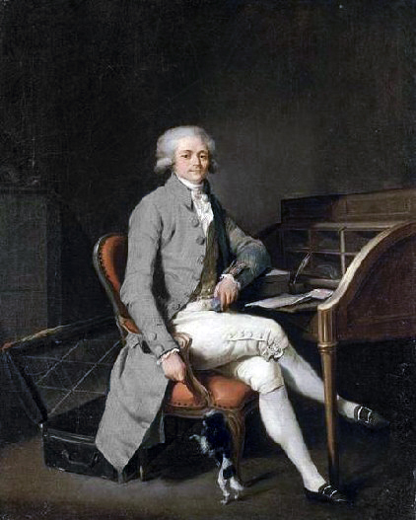
Committee of Public Safety
Robespierre

Slide 43
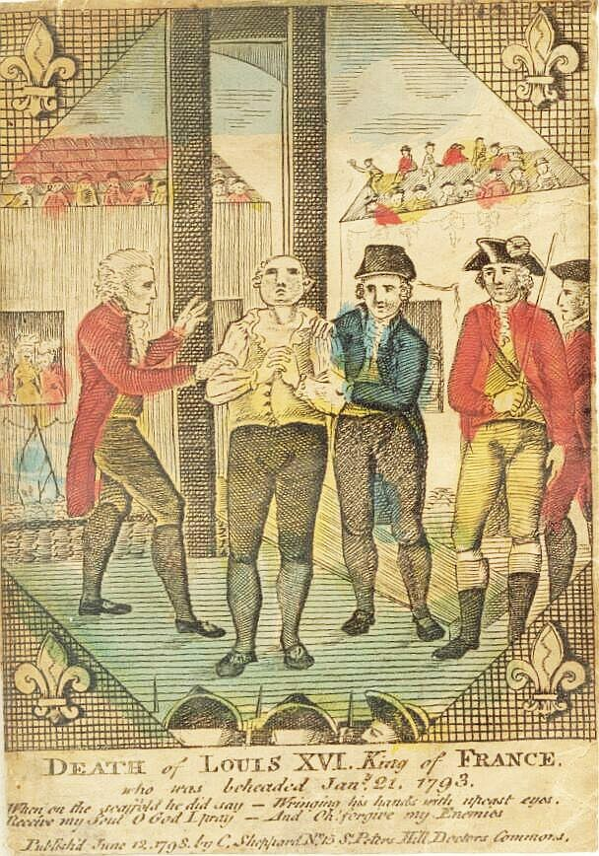
Beheading of Louis XVI
Royal family executed
(Starting Jan. 21, 1793)

Slide 44
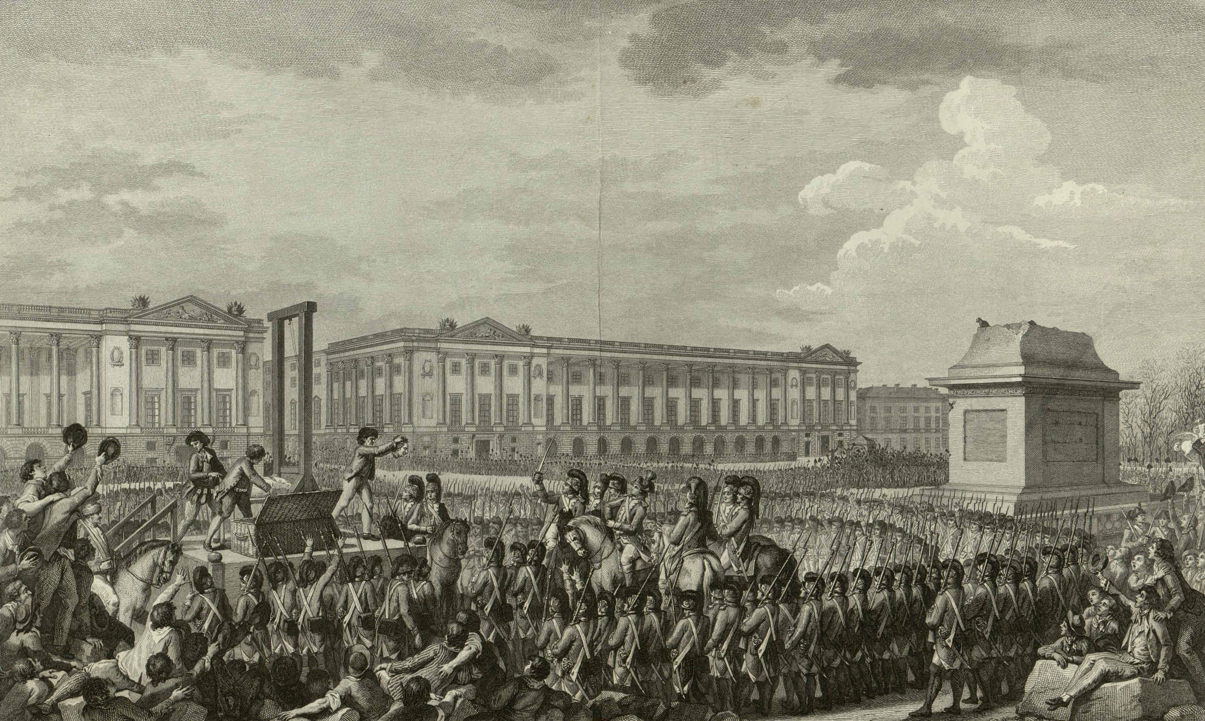

Slide 45
International War
France versus Austria
France versus Prussia
France versus Spain and Portugal
France versus the Dutch Republic
France versus Great Britain
Etc.

Slide 46
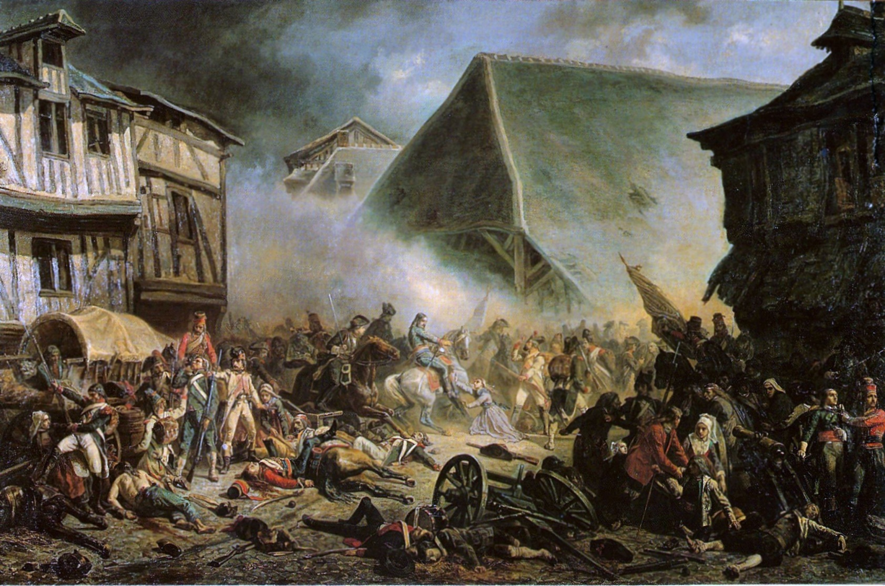
Civil War, 1793-96

Slide 47
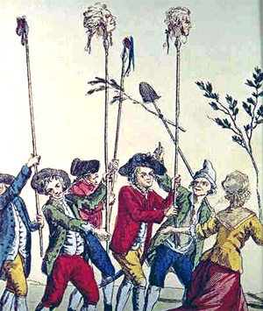
The Reign of Terror

Slide 48
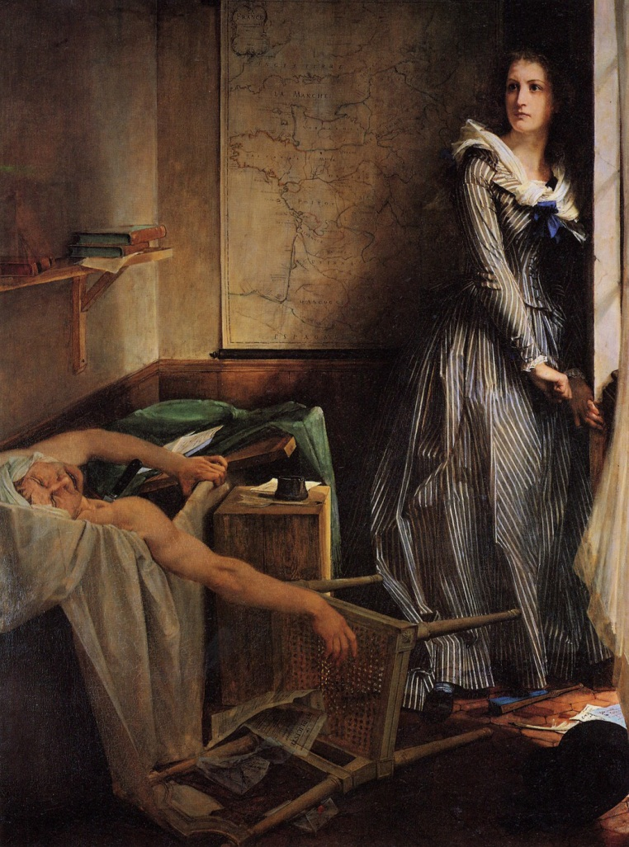
Charlotte Corday assassinates Marat, July 1793

Slide 49
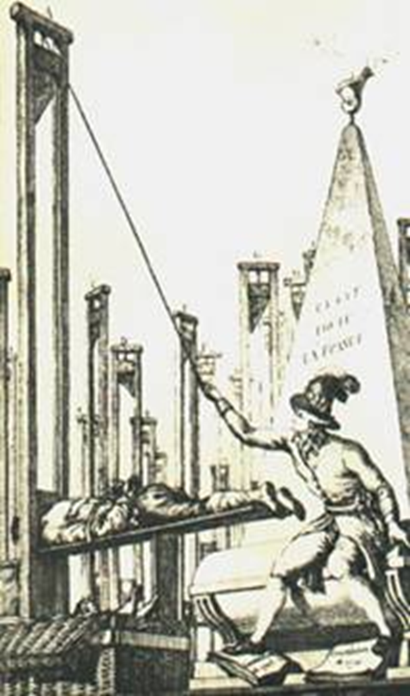
July 1794
Robespierre and St. Just arrested.
On the 28th, they are guillotined along with 20 other supporters.
80 more followers of Robespierre executed on July 29.

Slide 50
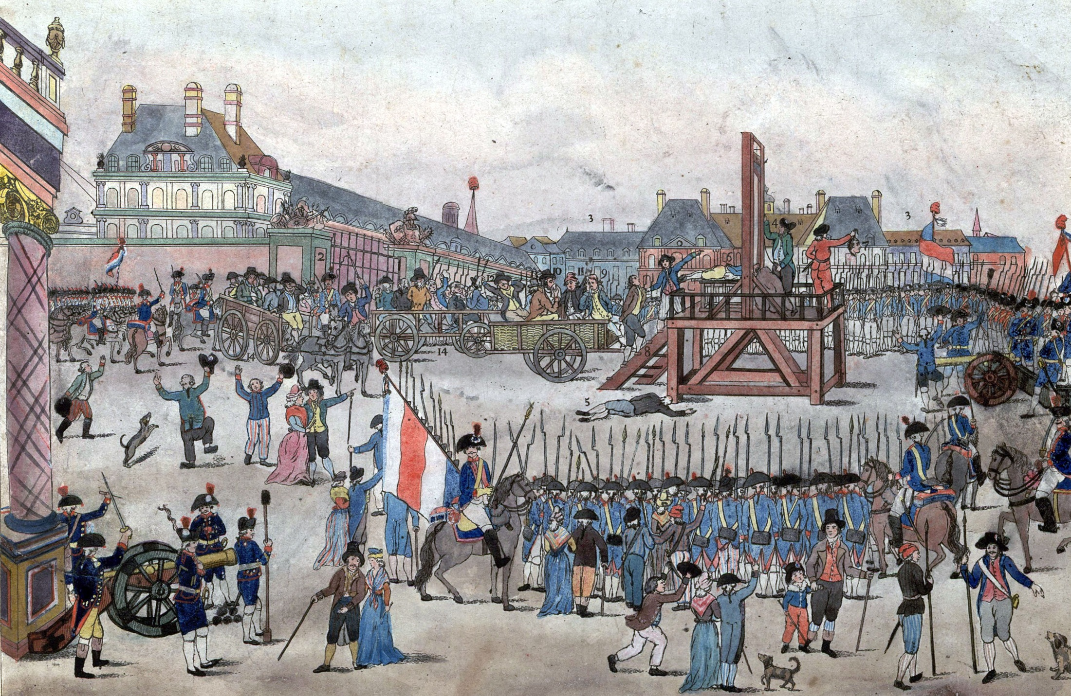

Slide 51
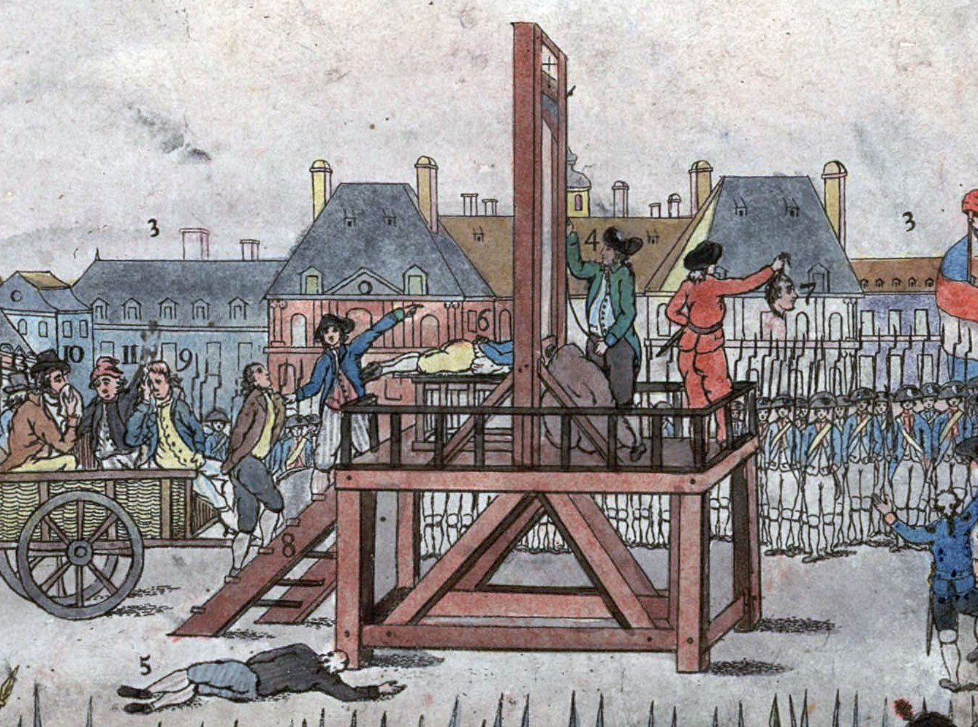

Slide 52
Power vacuum

Slide 53
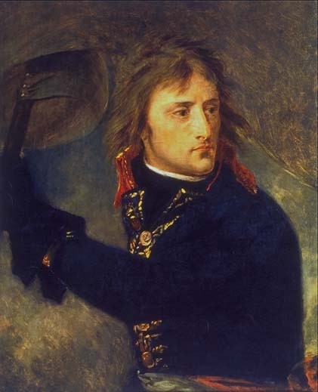
Napoleon at Arcole Bridge

Slide 54
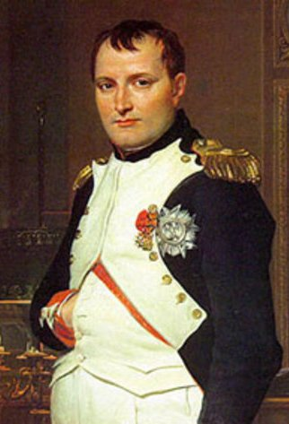
“If there had been no Rousseau, there would have been no Revolution, and without the Revolution, I should have been impossible.”
Napoleon Bonaparte:

Slide 55
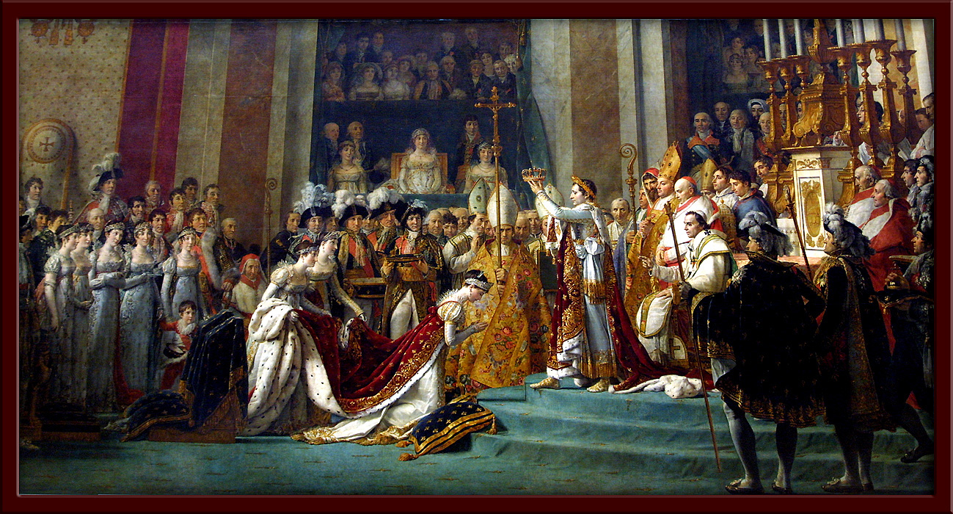
Napoleon crowns himself and Josephine (painting by J-L David)

Slide 56
Next: Rousseau

