Slide 1
Women’s Liberty and Equality
Statue of Liberty, 1875

Slide 2
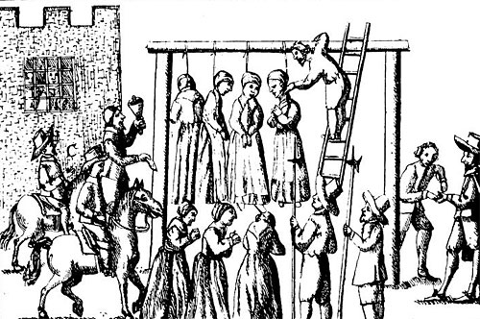
Witches hanged

Slide 3
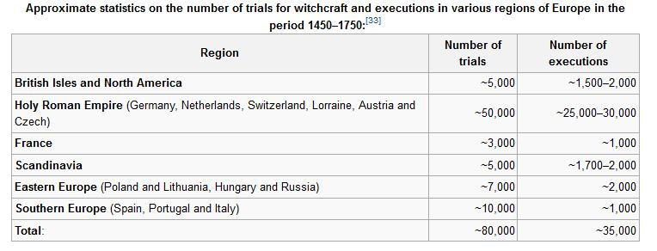

Slide 4
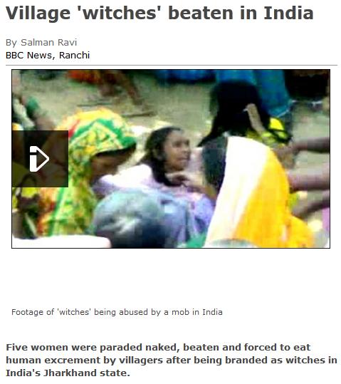

Slide 6
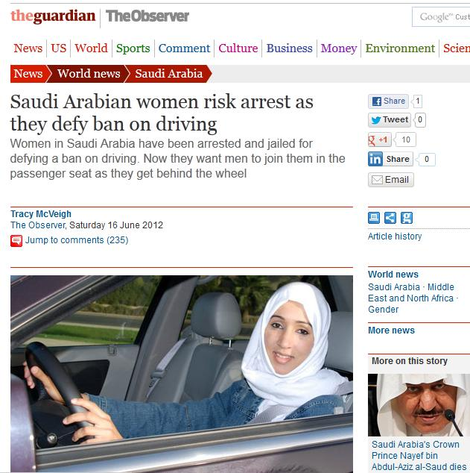

Slide 7
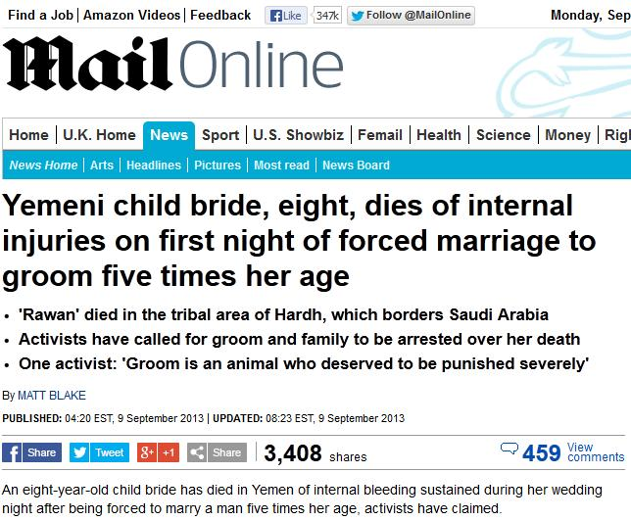

Slide 10
Traditional attitudes

Slide 11
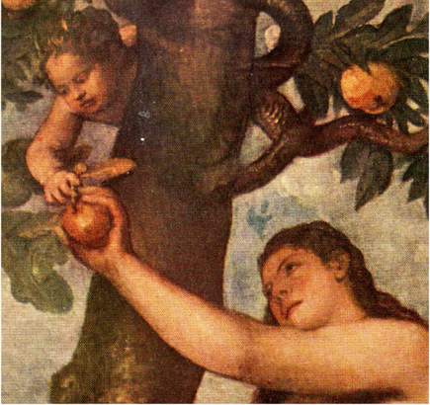
The Original Sinner?
1 Timothy 2:11-12:
“Let the woman learn in silence with all subjection.
But I suffer not a woman to teach, nor to usurp authority over the man, but to be in silence.
For Adam was first formed, then Eve.
And Adam was not deceived, but the woman being deceived was in the transgression.”

Slide 12
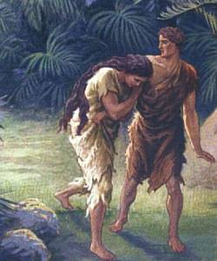
Punishments for Original Sin
Death.
Work.
Pain in childbirth.
(Genesis 3:16-19)

Slide 13
Who will go to Heaven? “It is these who have not defiled themselves with women, for they are chaste; it is these who follow the Lamb wherever he goes; these have been redeemed from mankind as first fruits for God and the Lamb.” (Revelation 14:4)

Slide 14
Marriage? “An unmarried man is concerned about the Lord’s affairs—how he can please the Lord. But a married man is concerned about the affairs of this world—how he can please his wife—and his interests are divided. An unmarried woman or virgin is concerned about the Lord’s affairs: Her aim is to be devoted to the Lord in both body and spirit. But a married woman is concerned about the affairs of this world—how she can please her husband.” (I Corinthians 7:32-33. Also St. Augustine, Confes­sions, Book Two)

Slide 15
If married, who is in charge?
Ephesians 5:22-24:
“Wives, submit to your husbands as to the Lord. For the husband is the head of the wife as Christ is the head of the church, his body, of which he is the Savior. Now as the church submits to Christ, so also wives should submit to their husbands in everything.”

Slide 16
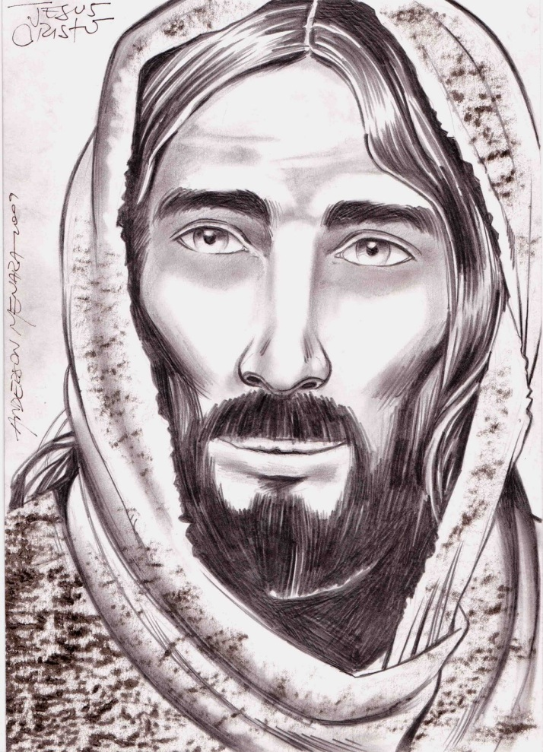
Family love?
Jesus:
“If any one comes to me and does not hate his own father and mother and wife and children and brothers and sisters – yes, even his own life – he cannot be my disciple.”
(Luke 14:26)

Slide 17
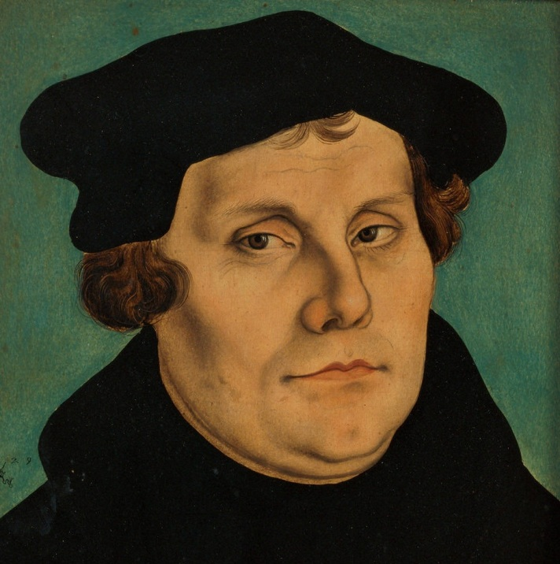
The Protestants ? Martin Luther (1500s):
“It is evident therefore that woman is a different animal to man, not only having different members, but also being far weaker in intellect. For as the sun is more splendid than the moon, so also woman does not equal the dignity and glory of the male.”

Slide 18
Martin Luther, continued: “Men have more understanding than women, who have but small and narrow breasts and broad hips to the end that they should remain at home, sit still, keep house, and bear and bring up children.”

Slide 19
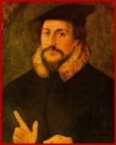
John Calvin (1500s):
“Let woman be satisfied with the state of subjection and not take it amiss that she is made inferior to the more distinguished sex.”

Slide 20
Similar themes in most traditional religions and cultures

Slide 21
How did all that change in the modern West?

Slide 22
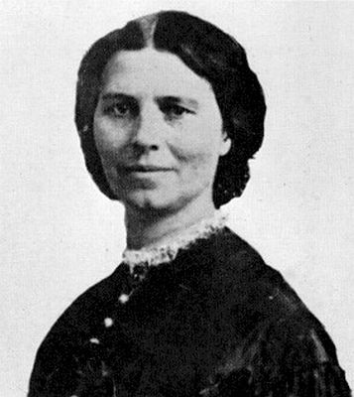
Elizabeth Cady Stanton (1815-1902)
“The prolonged slavery of women is the darkest page in human history.”
“The Bible and the Church have been the greatest stumbling blocks in the way of women's emancipation.”

Slide 23
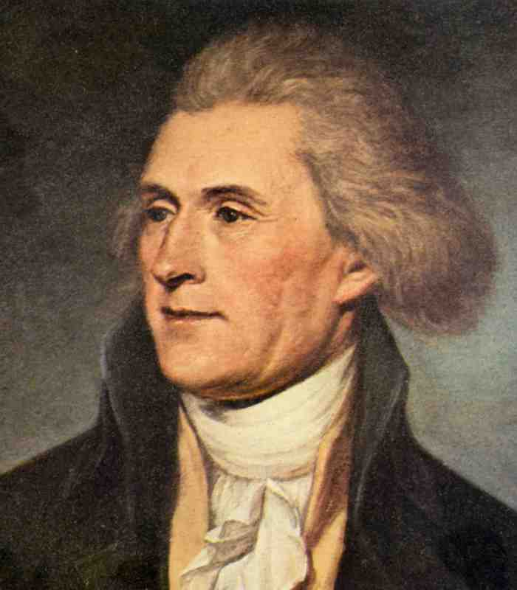
The status of women?
Jefferson on the Indian tribes:
“The women are submitted to unjust drudgery. This I believe is the case with every barbarous people. With such, force is law. The stronger sex therefore imposes on the weaker. It is civilization alone which replaces women in the enjoyment of their natural equality.”

Slide 24
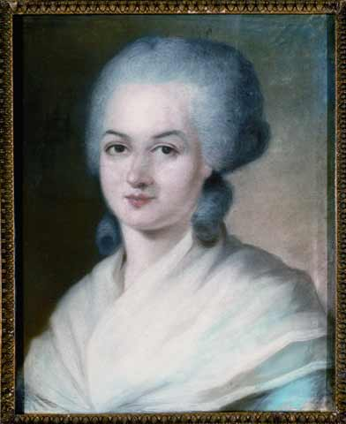
Olympe de Gouges, The Declaration of the Rights of Woman (1791)
1. Woman is born free and remains equal to man in rights. Social distinctions may be based only on common utility.
2. The purpose of all political association is the preservation of the natural and imprescriptible rights of woman and man. These rights are liberty, property, security, and especially resistance to oppression. …

Slide 25
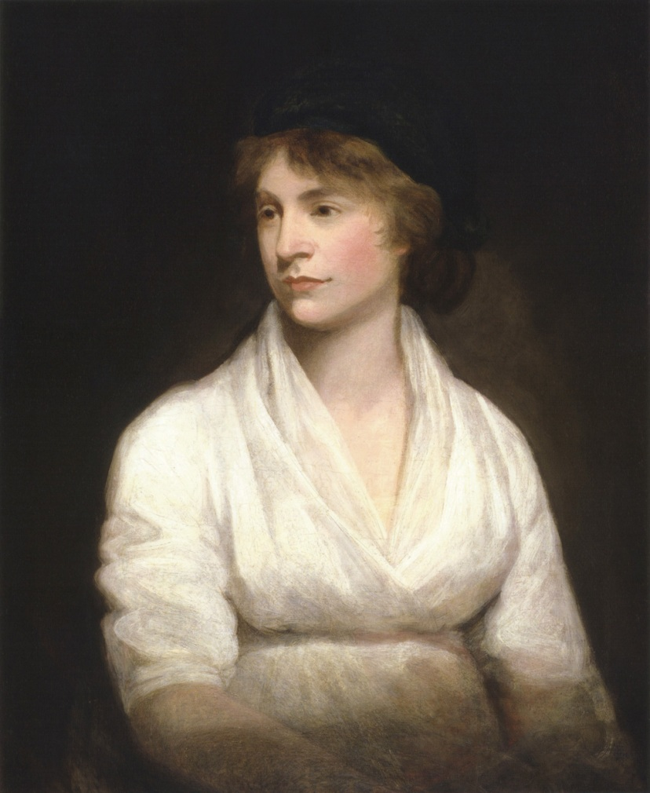
Mary Wollstonecraft (1759–1798)

Slide 26
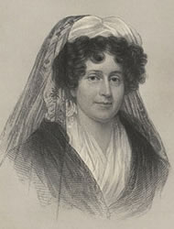
Emma Willard (1787-1870)
Troy Female Seminary opened in 1821 in New York.
First institution of higher learning for women.
(Rockford Female Seminary opened in 1847 in Illinois.)

Slide 27
New York’s Married Women’s Property Act (1848)
AN ACT for the effectual protection of the property of married women. Passed April 7, 1848.
The People of the State of New York, represented in Senate and Assembly do enact as follows:
Sec. 1. The real and personal property of any female who may hereafter marry, and which she shall own at the time of marriage, and the rents issues and profits thereof shall not be subject to the disposal of her husband, nor be liable for his debts, and shall continue her sole and separate property, as if she were a single female.

Slide 28
Women’s employment freedom
Mid-1800s, opening up of jobs and professions:
Elizabeth Blackwell: the first woman to graduate from medical school in the USA (1849).
Arabella Mansfield: the first female lawyer in the USA when admitted to the Iowa bar in 1869.
Nora Barney the first woman to receive a degree in civil engineering in 1905.

Slide 29
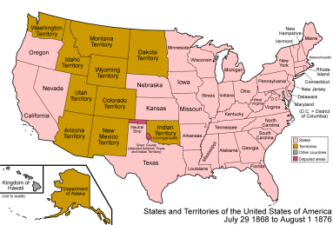
Voting? Territory of Wyoming gives women the right to vote in 1869.

Slide 30
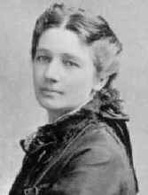
Victoria Chaflin Woodhull
1872: First woman to run for president of the USA.

Slide 31
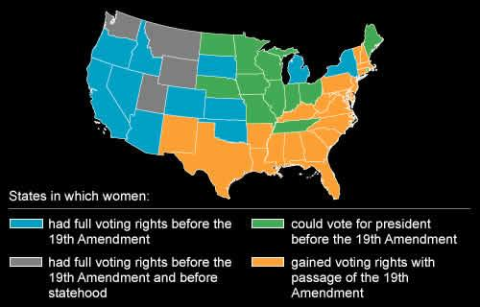
Nineteenth Amendment (1920)

Slide 32
Women’s Suffrage Granted
1893 New Zealand
1902 Australia
1906 Finland
1913 Norway
1915 Denmark
1917 Canada
1918 Austria, Germany, Poland, Russia
1919 Netherlands
1920 United States
1921 Sweden
1928 Britain, Ireland
All other countries: Granted later or not yet granted.
Note: Six of the fifteen are British or former British colonies; the other nine are northern European.

Slide 33
Compare: Universal Male Suffrage
The first six countries to grant all adult males the right to vote:
1792-1875 France
1848 Switzerland
1857-58 Self-governing colonies of Australia
1864 Greece
1868 United States
1879 New Zealand

