Slide 1
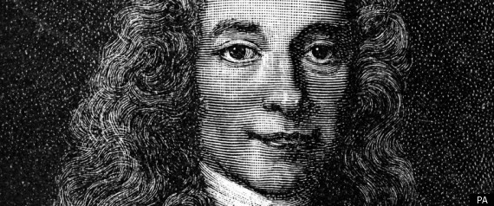
The Enlightenment in France

Slide 2
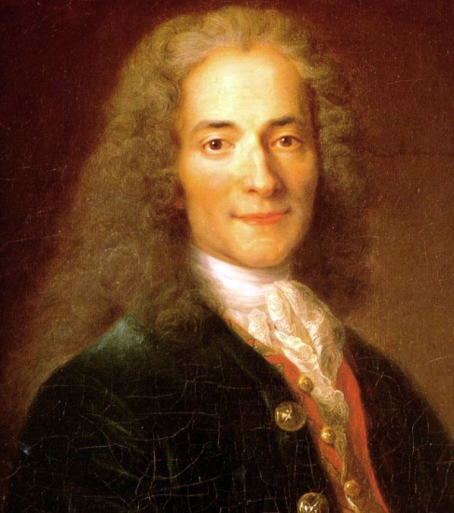
Voltaire

Slide 3
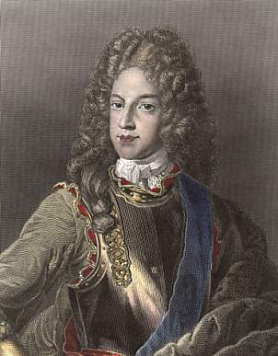
Voltaire challenges the Chevalier de Rohan-Chabot to a duel.

Slide 4
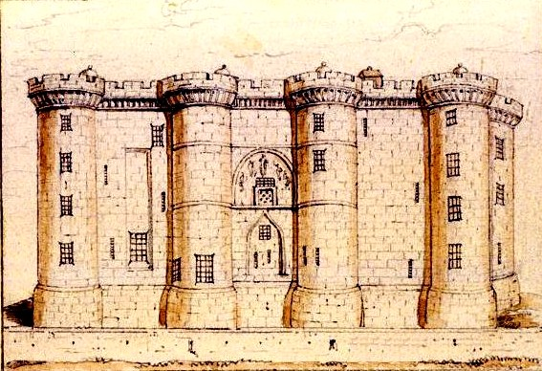
The Bastille

Slide 5
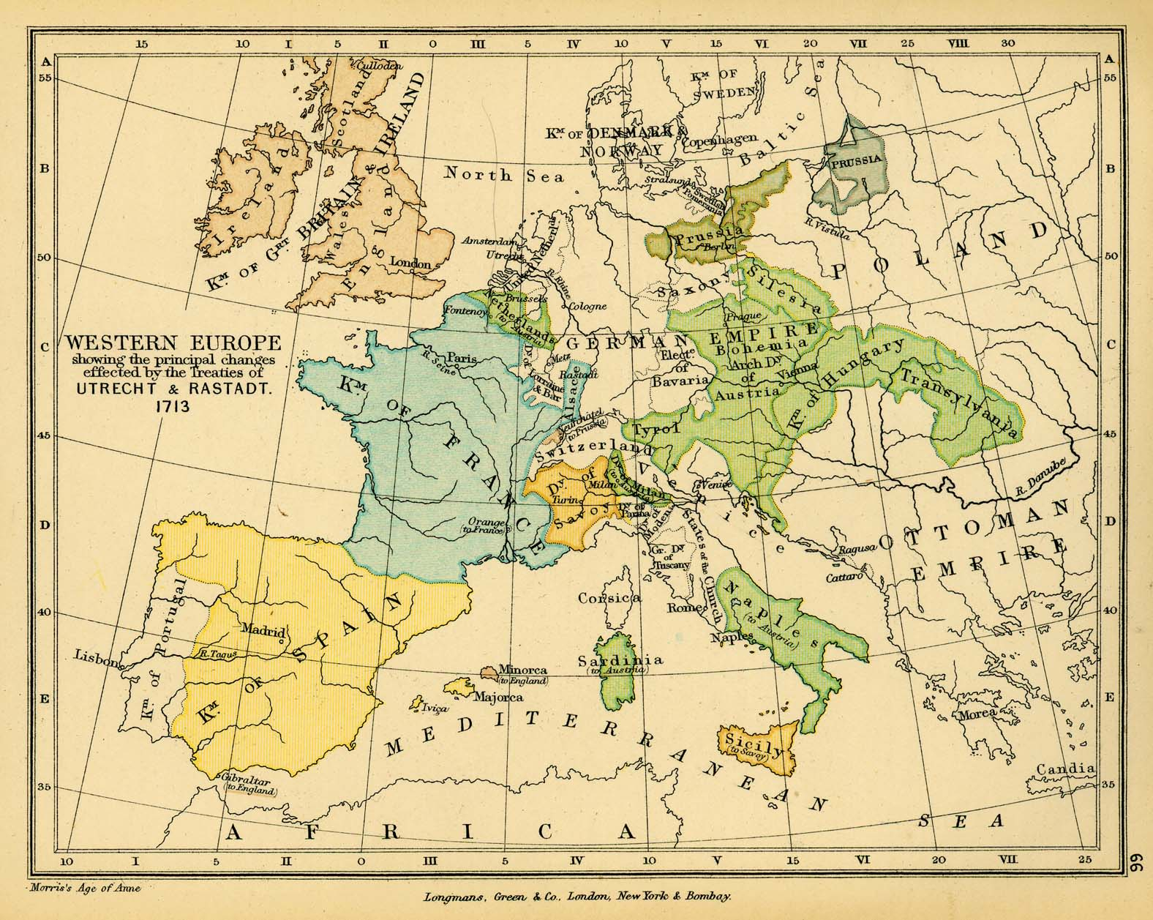
Western Europe after 1713

Slide 6
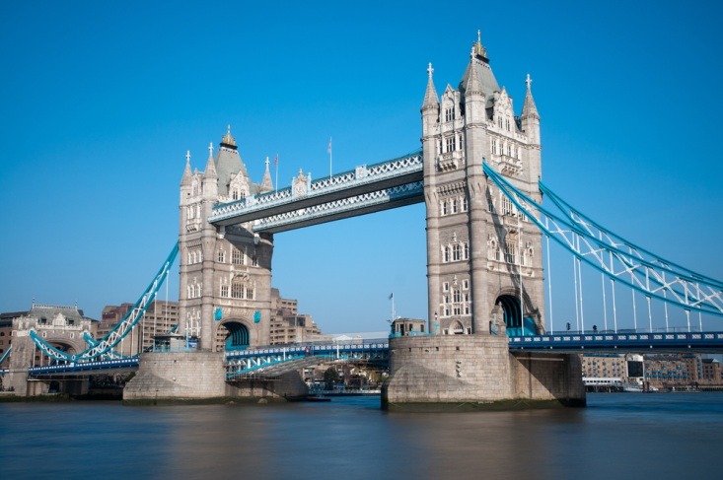
Exile in England

Slide 7
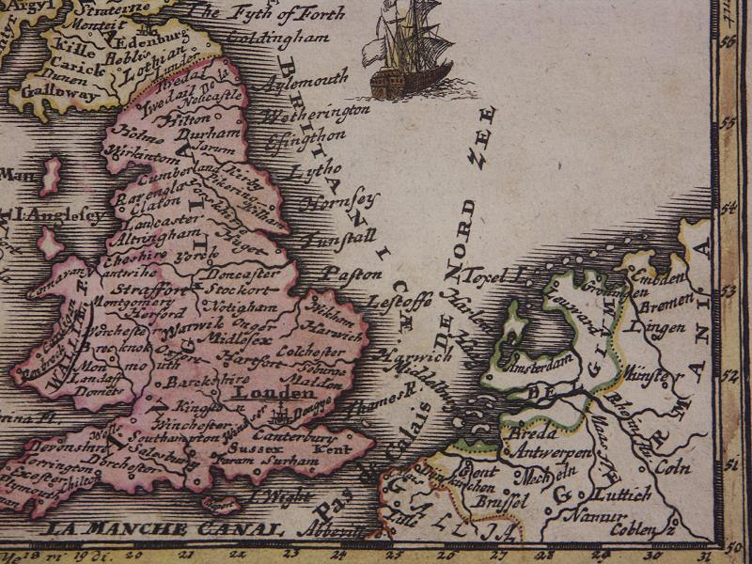

Slide 8
Voltaire returns from England

Slide 9
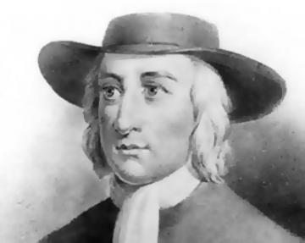
Quakers

Slide 10
Business
“Commerce, which has enriched English citizens, has helped to make them free, and this freedom in its turn has extended commerce, and that has made the greatness of the nation.” (Letter 10)

Slide 11
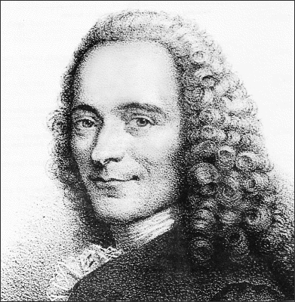
“In France anyone who is a Marquis who wants to be, and whoever arrives in Paris with money to spend an a name ending in –ac or –ille can say: ‘a man like me, a man of my standing’, and loftily despises a businessman, and the business man so often hears people speak disparagingly of his profession that he is foolish enough to blush. Yet I wonder which is the more useful to a nation, a well-powdered nobleman who knows exactly at what moment the King gets up and goes to bed, and who gives himself grand airs while playing the part of a slave in some Minister’s antechamber, or a business man who enriches his country, issues orders from his office to Surat or Cairo, and contributes to the well-being of the world.”
On the relative value of the nobleman and the businessman:

Slide 12
Commerce and peace
“Go into the London Stock Exchange—a more respectable place than many a court—and you will see representatives from all nations gathered together for the utility of men. Here Jew, Mohammedan and Christian deal with each other as though they were all of the same faith, and only apply the word infidel to people who go bankrupt. Here the Presbyterian trusts the Anabaptist and the Anglican accepts a promise from the Quaker. …

Slide 13
Commerce and peace (continued)
“… On leaving these peaceful assemblies some go to the Synagogue and others for a drink, this one goes to be baptized in a great bath in the name of the Father, Son and Holy Ghost, that one has his son’s foreskin cut and has some Hebrew words he doesn’t understand mumbled over the child, others go to their church and await the inspiration of God with their hats on, and everybody is happy.
“If there were just one religion in England, despotism would threaten; if there were two religions, they would cut each other's throats; but there are thirty religions, and they live together peacefully and happily.”

Slide 14
Religious tolerance

Slide 15
Letter 25: Deism

Slide 16
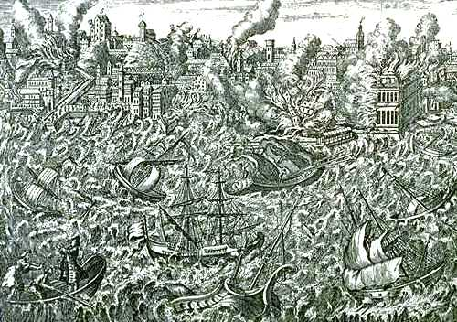
Lisbon earthquake, 1755

Slide 17
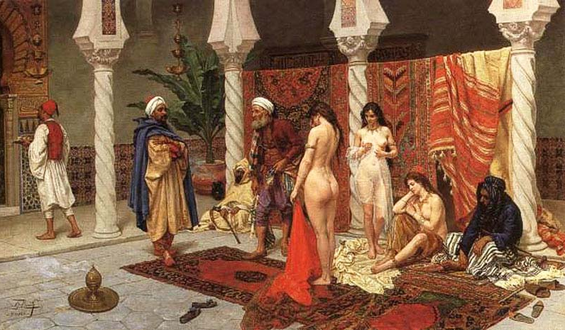
The most beautiful women in the world?

Slide 18
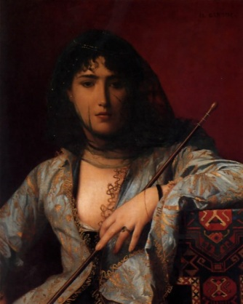
Circassian women (Letter 11)

Slide 19
Inoculation against smallpox:
“The women of Circassia have from time immemorial been accustomed to give their children smallpox …”
(Letter 11)

Slide 20
Francis Bacon and John Locke
“Nobody before Chancellor Bacon had grasped experimental science.”
(Letter 12)

Slide 21
Who is the greatest man in history? (Voltaire, Letter 12 on England)

Slide 22
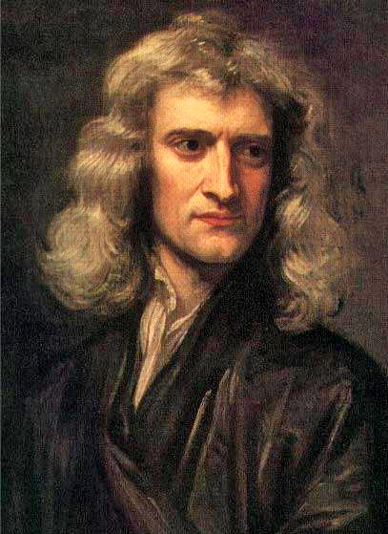
Answer: Isaac Newton

Slide 23
What has held mankind back? Serfdom, slavery, censorship, suppression of religion, aristocratic wars, superstition.

Slide 24
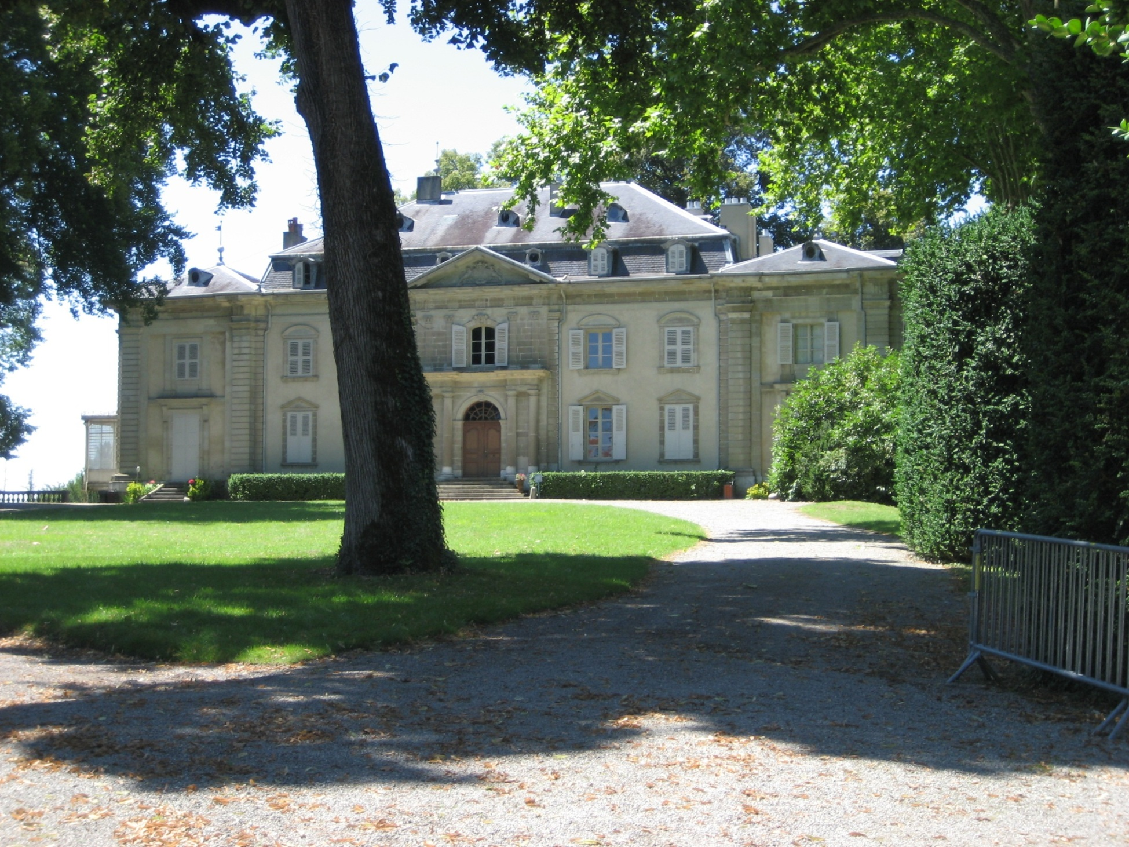
Ferney

Slide 25
The philosophes and the Encyclopédie

Slide 26
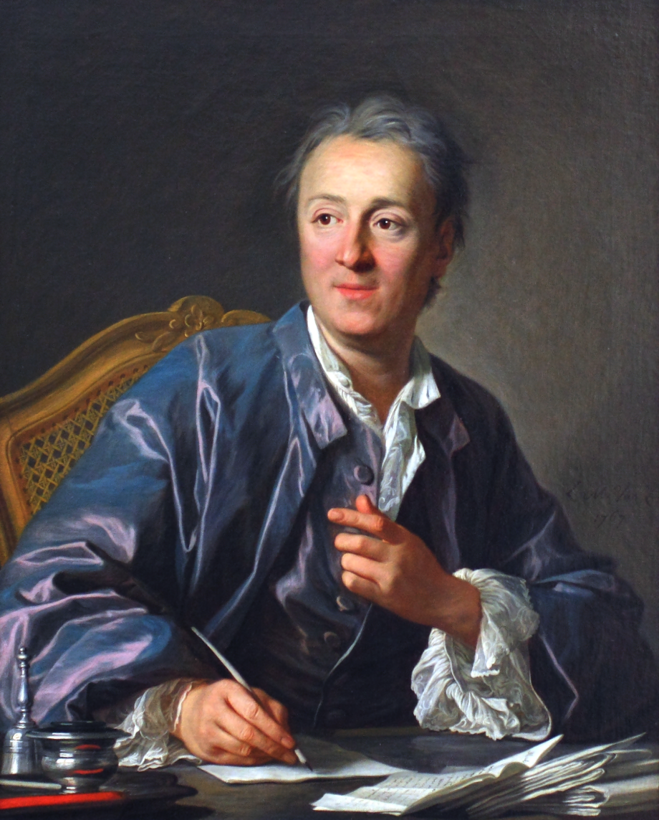
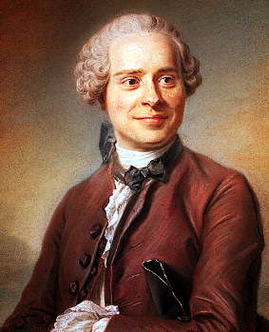
Diderot and D'Alembert

Slide 27
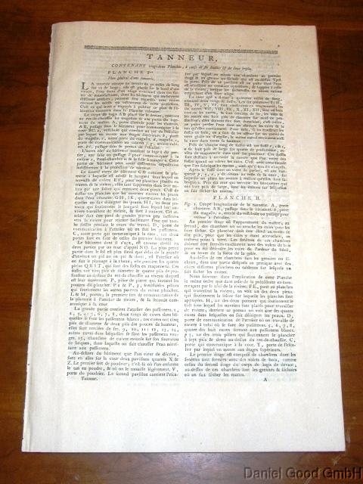
Theory

Slide 28
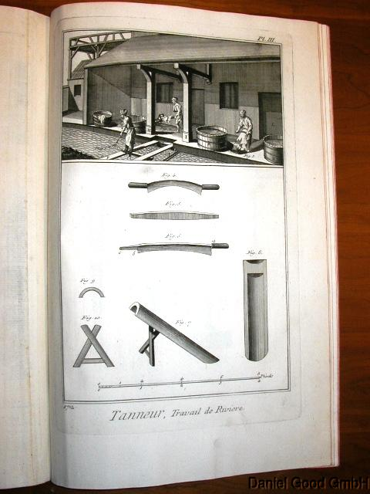
Practice

Slide 29
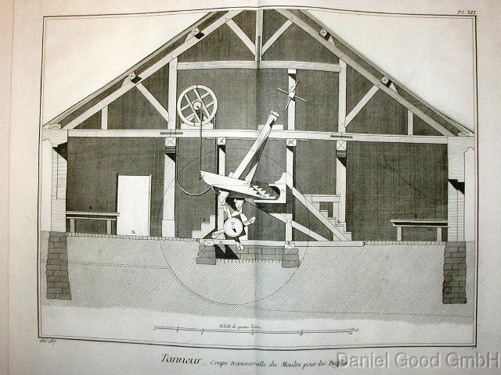

Slide 30
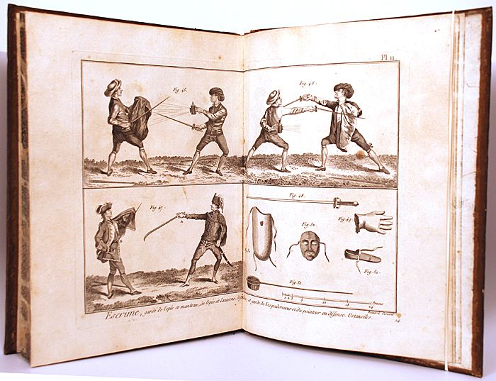
Practice (with an edge)

Slide 31
Dedication to the Encyclopédie: Francis Bacon, John Locke and Isaac Newton

Slide 32
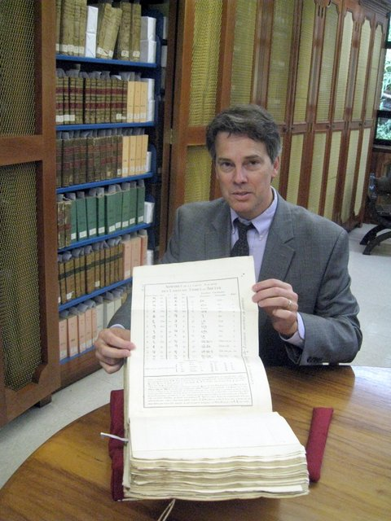
Universidad Francisco Marroquín

Slide 33
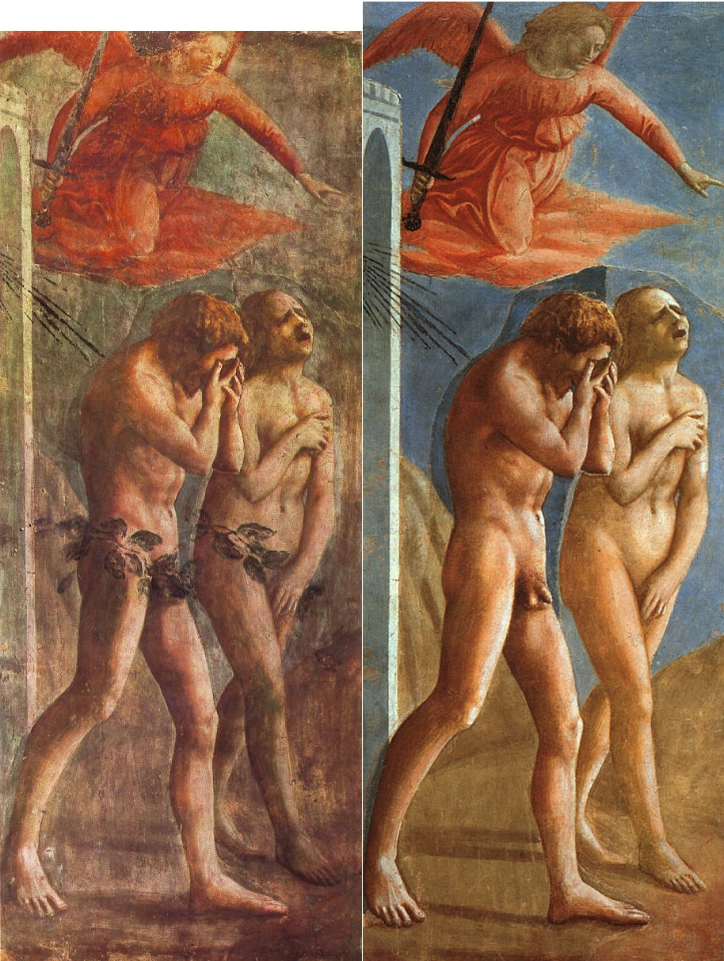
Love and sex?
Guilt, hide, abstain, elaborate courtships, spy, cheat, lie, destroy families, arrange marriages, etc.

Slide 34
Diderot on “Enjoyment”
Pleasure is “the most noble and universal of passions.”

Slide 35
Orou and his wife offer a European visitor their daughter for the night

Slide 36
The European visitor says his religion prohibits him from accepting.
Orou replies:
“I do not know what this thing is that you call ‘religion,’ but I can only think ill of it, since it prevents you from tasting an innocent pleasure to which nature, the sovereign mistress, invites us all; prevents you from giving existence to one of your own kind …”

Slide 37
Diderot’s Orou on marriage:
“A mutual consent to live in the same hut and to lie in the same bed for as long as we find it good to do so.”

Slide 38
“Men will not be free until the last king is strangled with the entrails of the last priest.” (Attributed to Diderot)
Radicalism

Slide 39
Next: Revolution (1789)

