Slide 1
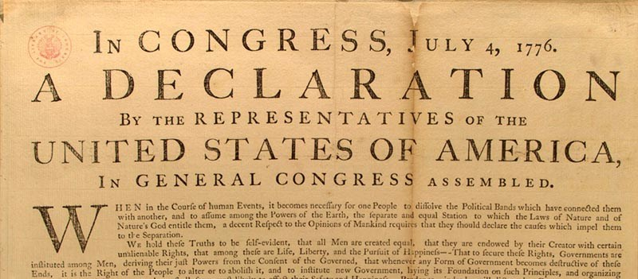
The American Enlightenment

Slide 2
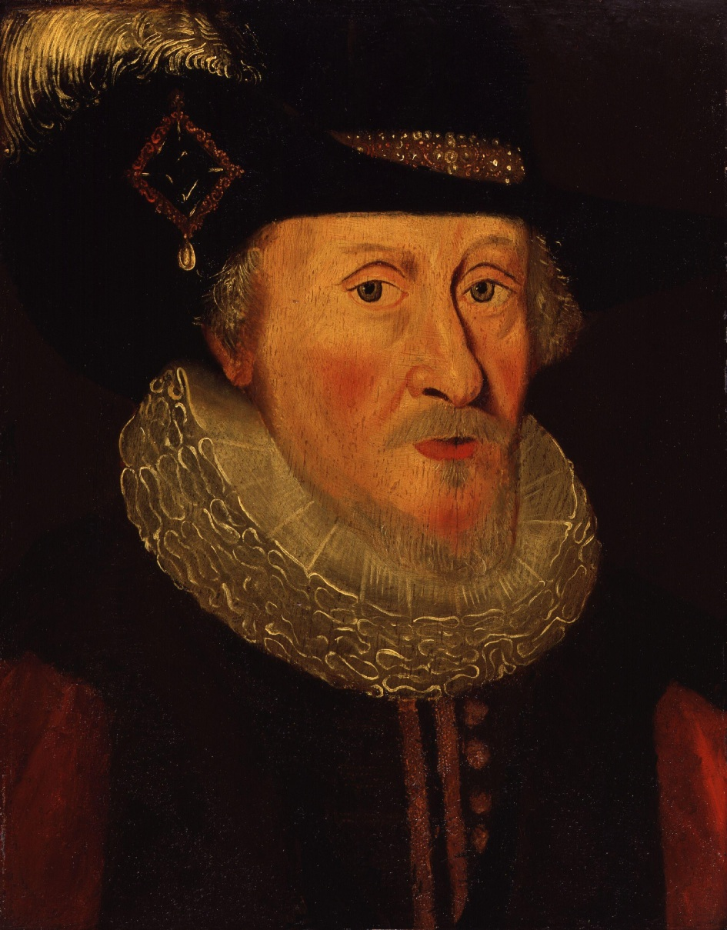
Back in England:
"I will make them conform, or I will harry them out of the land."
King James, 1604

Slide 3
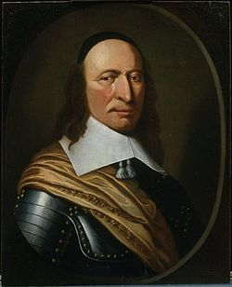
Peter Stuyvesant, Governor of New Netherlands. Some Jews arrive in 1654 ...

Slide 4
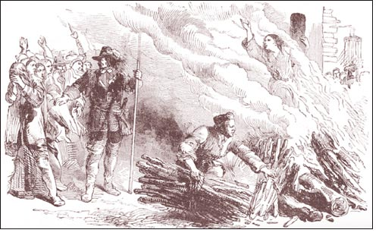
Witchcraft trials in Salem, Mass., 1692-1693

Slide 5
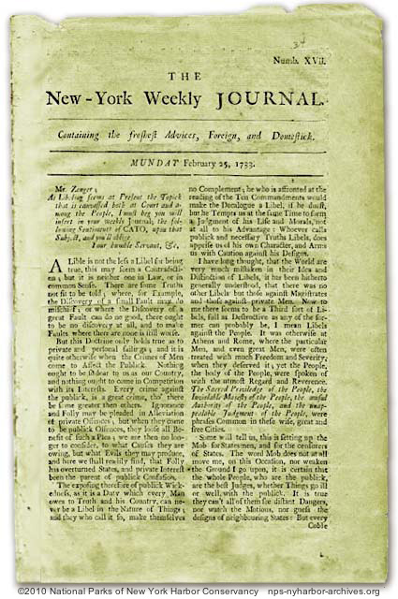
John Zenger’s trial, 1733
“A statement, even if defamatory, is not libelous if it can be proved.” The verdict affirmed freedom of the press in America.

Slide 6
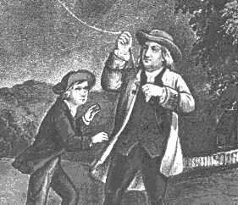
Benjamin Franklin as scientist

Slide 7
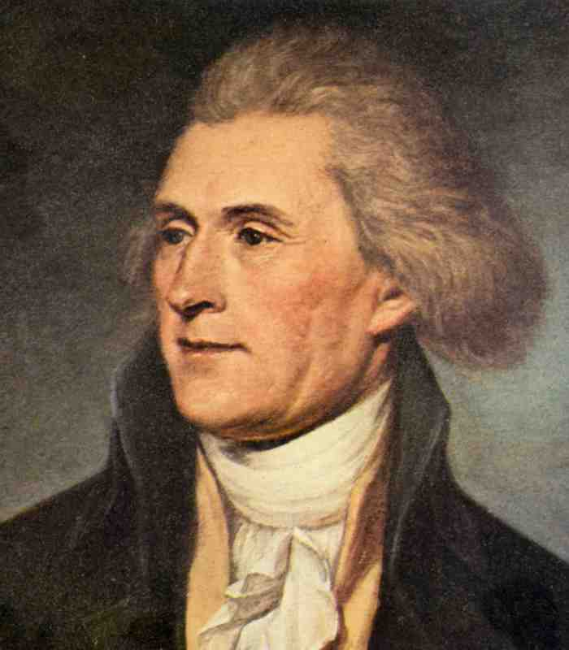
The status of women?
Jefferson on the Indian tribes:
“The women are submitted to unjust drudgery. This I believe is the case with every barbarous people. With such, force is law. The stronger sex therefore imposes on the weaker. It is civilization alone which replaces women in the enjoyment of their natural equality.”

Slide 8
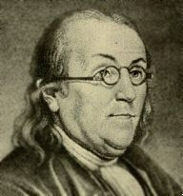
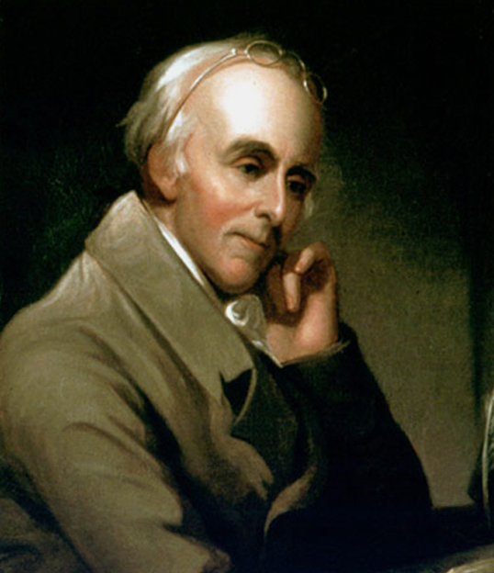
The first antislavery society in America: Pennsylvania Society for Promoting the Abolition of Slavery and the Relief of Free Negroes Unlawfully Held in Bondage [1774]

Slide 9
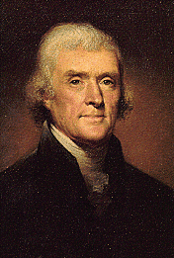
Thomas Jefferson and Cesare Beccaria
“Laws that forbid the carrying of arms ... disarm only those who are neither inclined nor determined to commit crimes .... Such laws make things worse for the assaulted and better for the assailants; they serve rather to encourage than to prevent homicides, for an unarmed man may be attacked with greater confidence than an armed man.”
(Jefferson’s "Commonplace Book," 1774-1776, quoting Beccaria’s On Crimes and Punishment, 1764)

Slide 10
John Locke on the Right of Revolution
“Whensoever therefore the Legislative shall transgress this fundamental Rule of Society; and either by Ambition, Fear, Folly or Corruption, endeavour to grasp themselves, or put into the hands of any other an Absolute Power over the Lives, Liberties, and Estates of the People; By this breach of Trust they forfeit the Power, the People had put into their hands, for quite contrary ends, and it devolves to the People, who have a Right to resume their original Liberty, and, by the Establishment of a new Legislative (such as they shall think fit) provide for their own Safety and Security, which is the end for which they are in Society.”
Second Treatise of Government (1690), §§149, 155, 168, 207-10, 220-31, 240-43

Slide 11
Fourteen Guiding Principles of the American Revolution 1. Individuals have FREE WILL. 2. Individuals possess and live by REASON. 3. We are, and need to be, governed by the RULE OF LAW. 4. We should seek HAPPINESS. 5. We should seek our own PROSPERITY. 6. Men are created EQUAL. 7. The INDIVIDUAL is SOVEREIGN. 8. Men should CONSENT to be governed. 9. Self-preservation means produce PROPERTY. 10. Men must live in LIBERTY. 11. Individuals have RIGHTS to freedom from force. 12. There must be SEPARATION OF CHURCH AND STATE. 13. There must be SEPARATION OF POWERS of government. 14. Men have the RIGHT TO RESIST tyranny. [Source: The Blackwell Encyclopedia of the American Revolution, 1991.]

Slide 12
