Slide 1
From Feudal to Modern Business and Economics

Slide 2
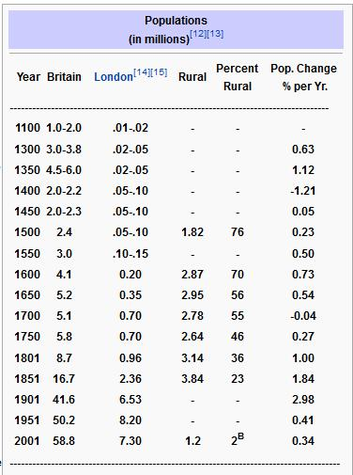
British population increases

Slide 3
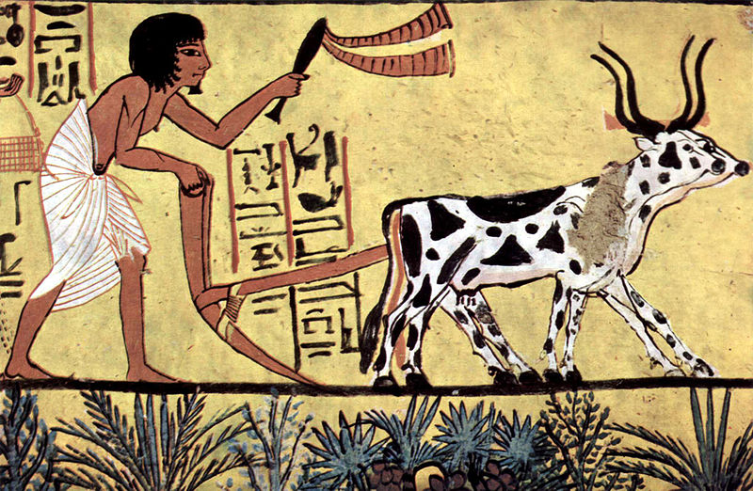

Slide 4
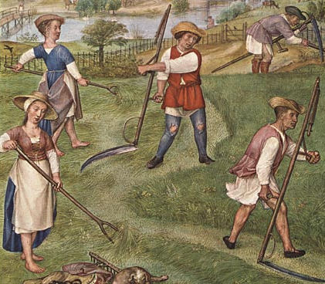

Slide 5
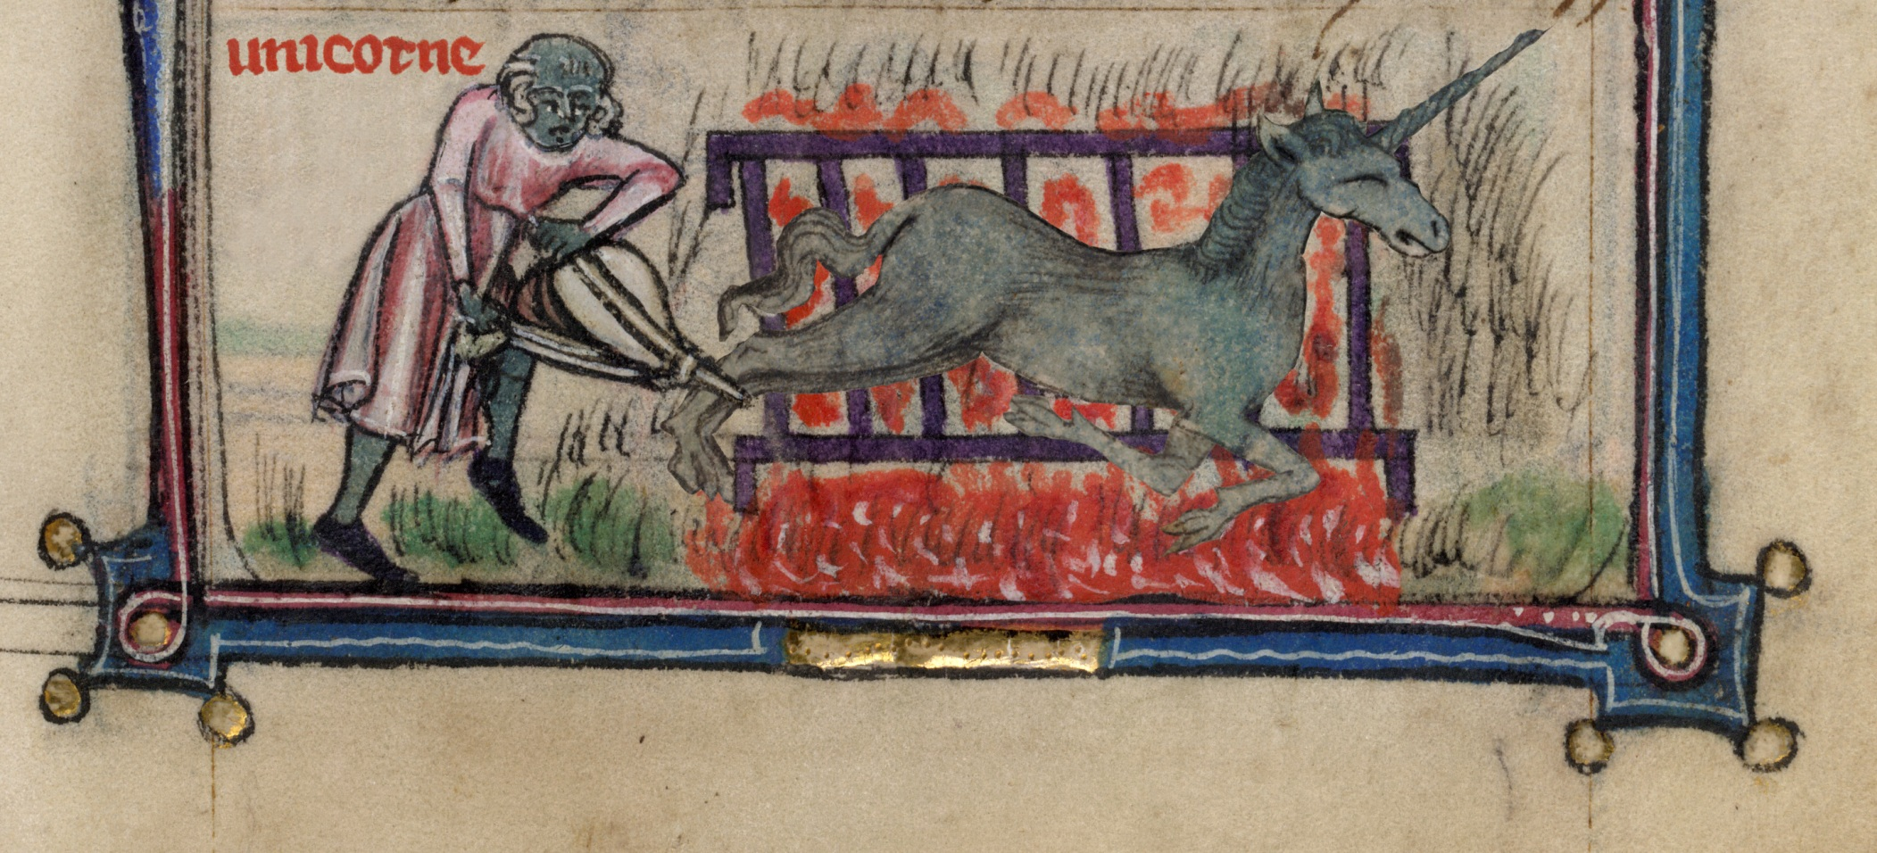

Slide 6
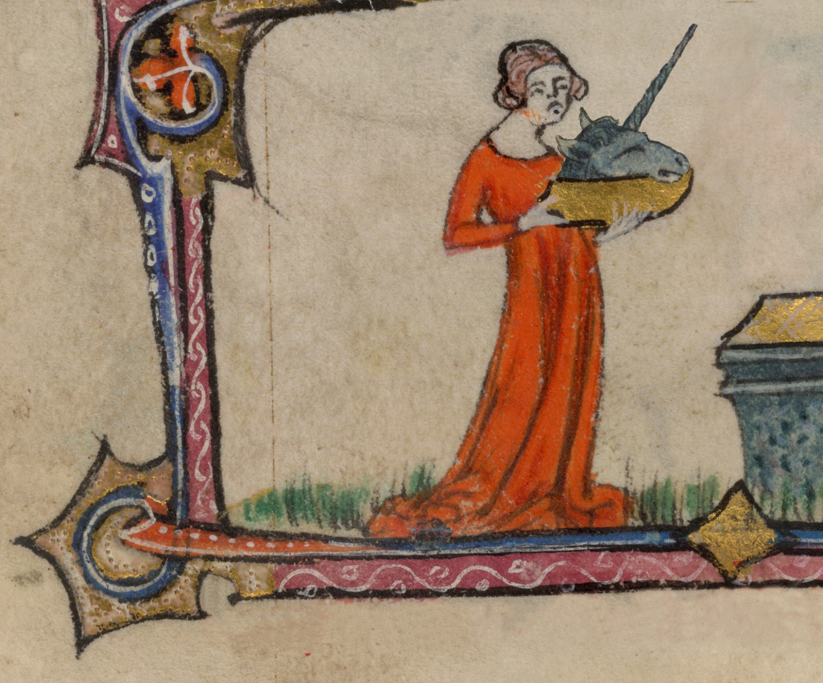

Slide 7
Feudalism
Class-based.
Property ownership severely restricted.
Serfdom and slavery.
Aristocracy’s attitudes toward work and business.
Clergy’s attitudes toward work and business.

Slide 8
Jesus: “one thing you still lack. Sell all that you have and distribute to the poor, and you will have treasure in heaven; and come, follow me.” (Luke 18:22) St. Paul: “Keep your life free from love of money, and be content with what you have…” (Hebrew 13:5) St. Augustine: “Business is in itself an evil.” St. Jerome: “A man who is a merchant can seldom if ever please God.”

Slide 9
Philosophical Revolution: Mind/body integration. Moral/practical integration. Business becomes a worthy profession.

Slide 10
Agricultural revolution
Science applied to agriculture
Soil maintenance: fertilizers and manure
Maximizing crops: fallow, turnips and clover, rotation,
Selective breeding
Fences and enclosures
Transportation: specialization and trade across wider distances
Preservation methods
More crops so can keep animals alive during winter

Slide 11
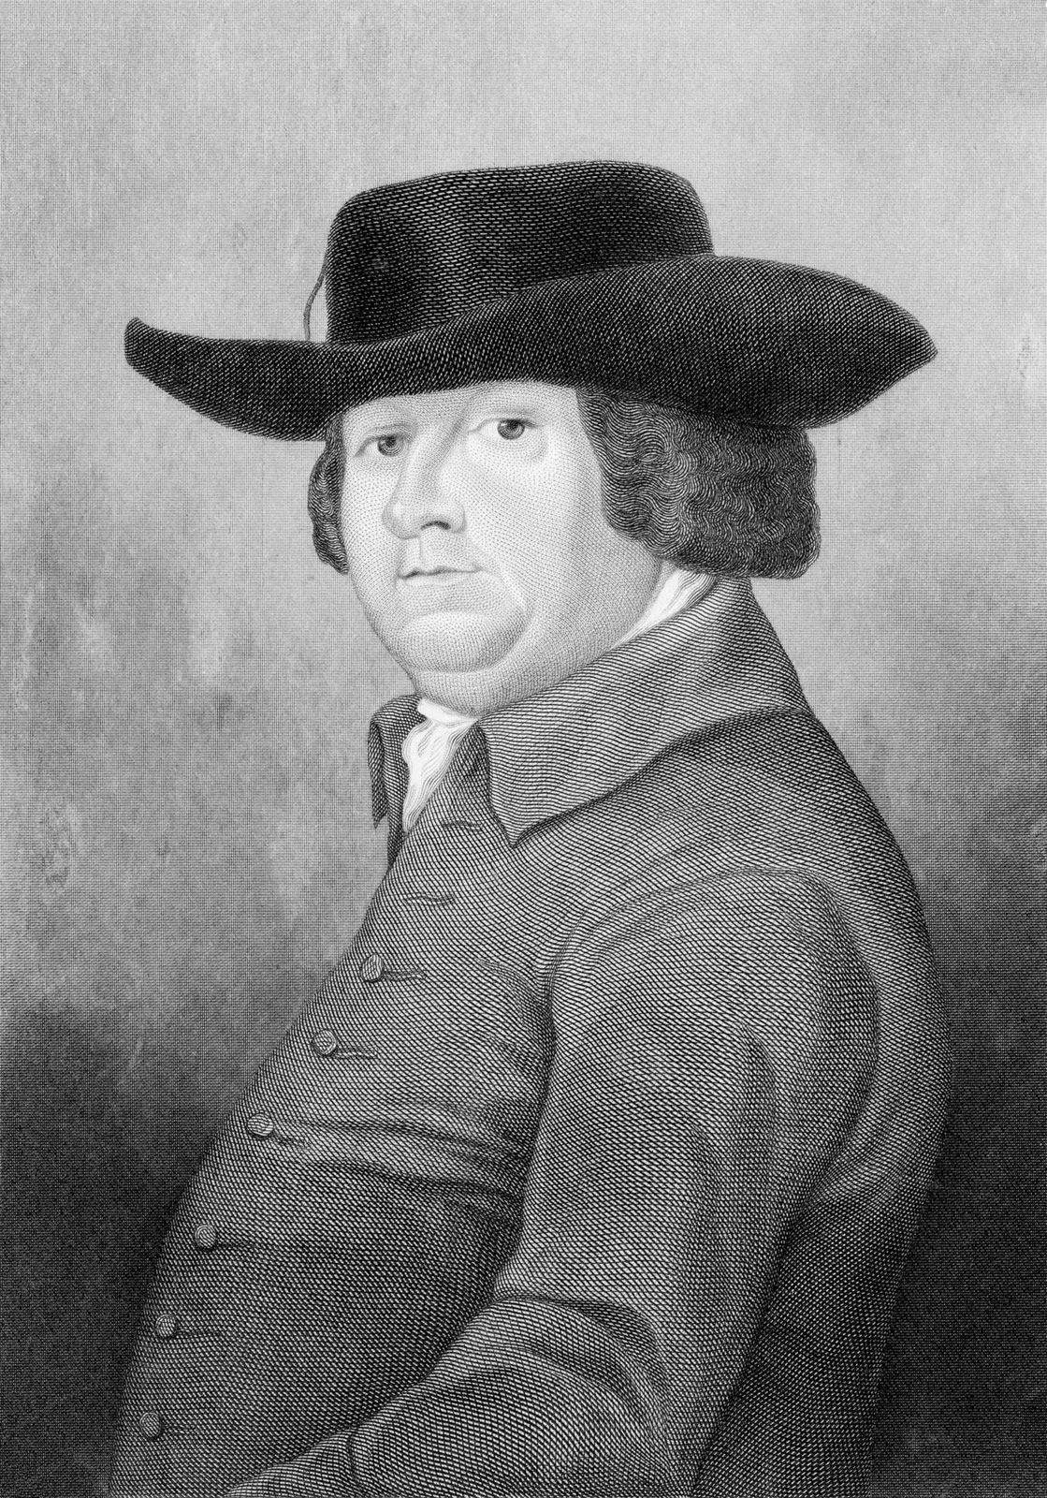
Robert Bakewell (1725–1795)
Selective breeding

Slide 12
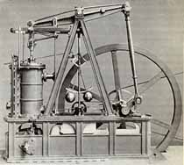
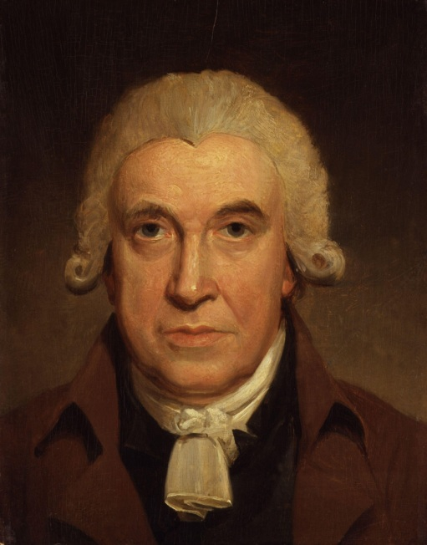
James Watt

Slide 13
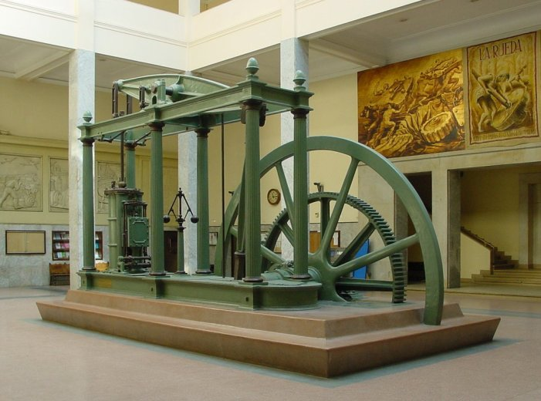

Slide 14
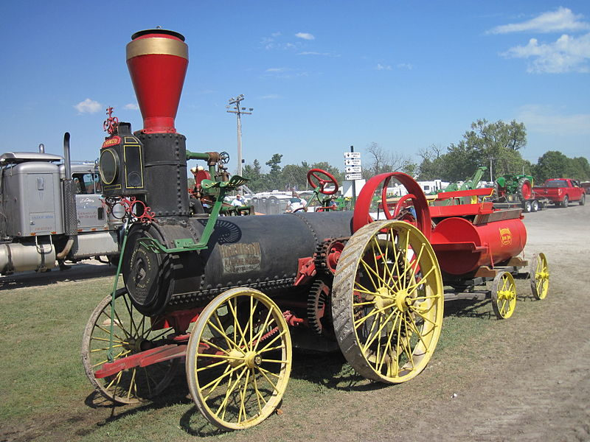
1880 tractor
Food production

Slide 15
Transportation: “In pre-steam days it had cost $5 to carry 100 pounds up to Louisville [from New Orleans]. It had dropped to $2 by 1830, and soon fell to 25 cents.” (Paul Johnson, The Birth of the Modern, HarperCollins 1991, p. 196)

Slide 16
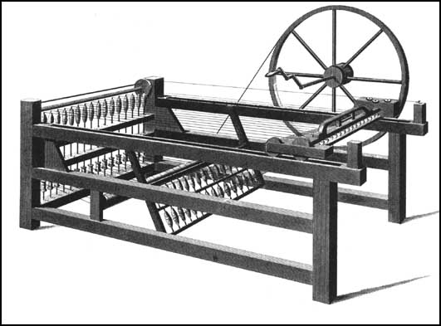
Hargreave's spinning-jenny (1770)

Slide 17
Food, clothing, transportation: Costs down Quantity up Quality up

Slide 18
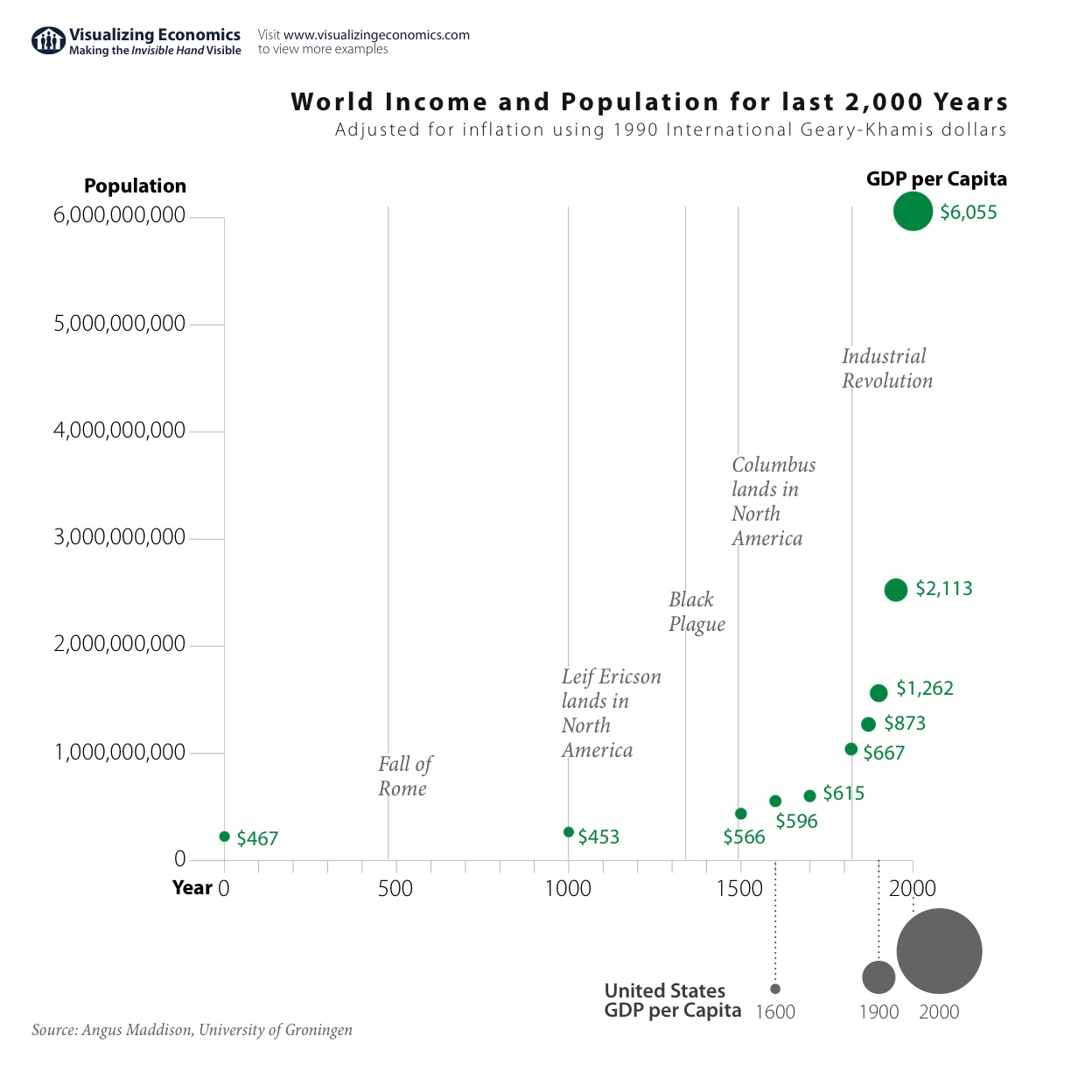

Slide 19
Infant death rates
London, England
1730-49: 74.5%
1810-29: 31.8%

Slide 20
Philosophical revolution: Attitudes toward work and business Agricultural revolution: Scientific farming Industrial revolution: Engineering and machines Financial revolution: Money, banking, capital Political-economy revolution: Free trade

Slide 21
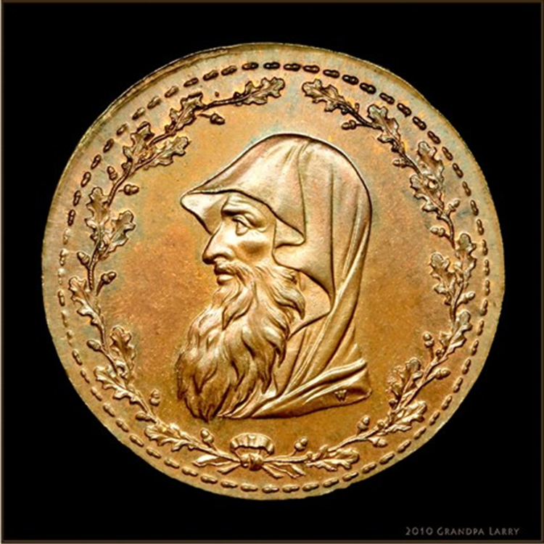
Financial revolution

Slide 22
Traditional attitudes: Ezekiel 18: He who “lends at interest, and takes increases; shall he then live? He shall not live … he shall surely die.” Deuteronomy 23:19-20: “You shall not lend upon interest to your brother … to a foreigner you may lend upon interest …” Jesus versus the moneylenders Shylock and The Merchant of Venice

Slide 23
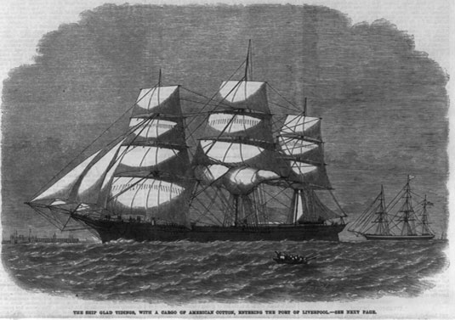
Mercantilism versus proto-free-markets
Licenses.
Tariffs.
Currency controls.

Slide 24
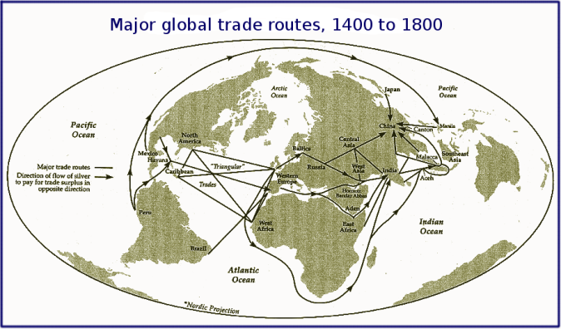

Slide 25
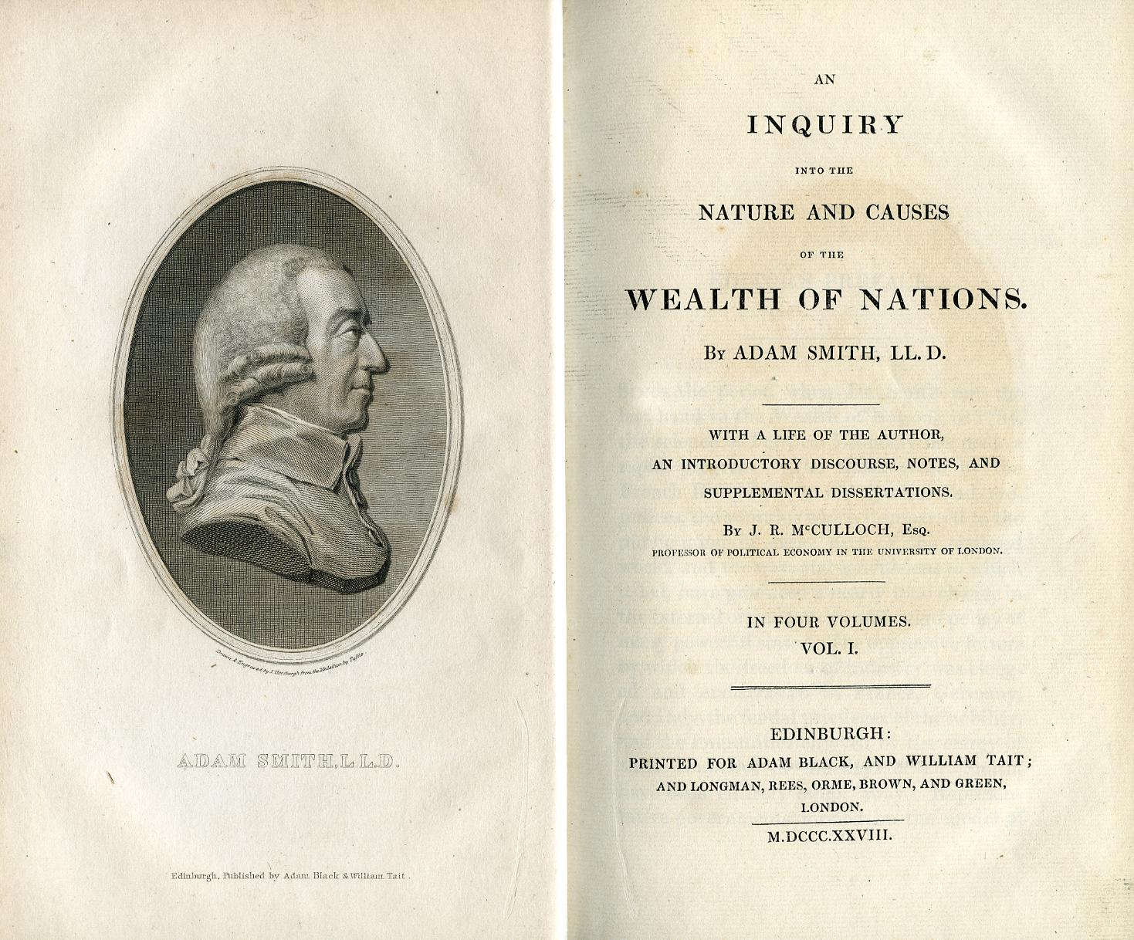
Adam Smith, On the Wealth of Nations (1776)

