Slide 1
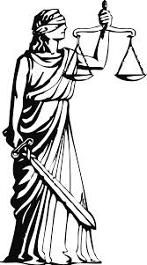
Justice and Modernizing the Law

Slide 2
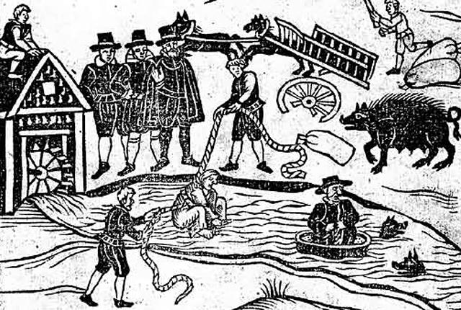

Slide 3
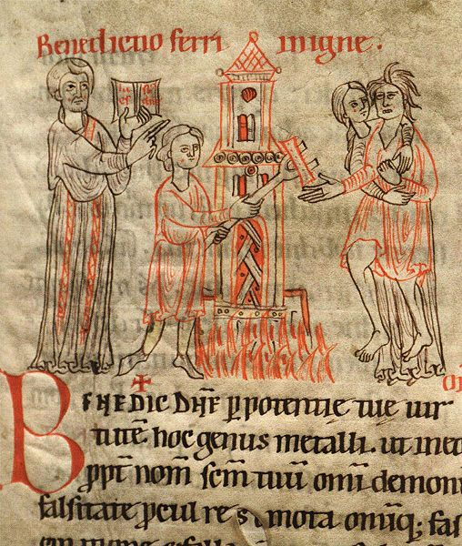

Slide 4
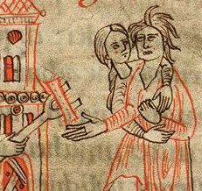

Slide 5
God as the source of justice
“But if there is any further injury, then you shall appoint as a penalty life for life, eye for eye, tooth for tooth, hand for hand, foot for foot, burn for burn, wound for wound, bruise for bruise.” (Exodus 21:23-25)
“Never avenge yourselves, but leave it to the wrath of God, for it is written, ‘Vengeance is mine, I will repay, says the Lord.’” (Romans 12:19)

Slide 6
Trials by Ordeal
Scripture: The bitter water test for an unfaithful wife (Numbers 5:11-31).
Trial by fire: e.g., walk barefoot across red-hot coals.
Trial by water: e.g., dunking.
Remove a stone from pot of boiling water or oil.
Ingesting dry bread (without choking).

Slide 7
Evolution of trial methods
Trials by ordeal discontinued by the 1500s.
Replaced by compurgation: Accused takes an oath of his innocence before 12 of his peers. If peers believe him unanimously , he is considered innocent. If not, he is found guilty of both the crime and lying under oath.
Later by compurgation replaced by inquisition.

Slide 8
Circa 1500: Prisoner tortured by Spanish Inquisition. Monks at rear await his confession.

Slide 9
Torture Theological reasons Secular reasons

Slide 10
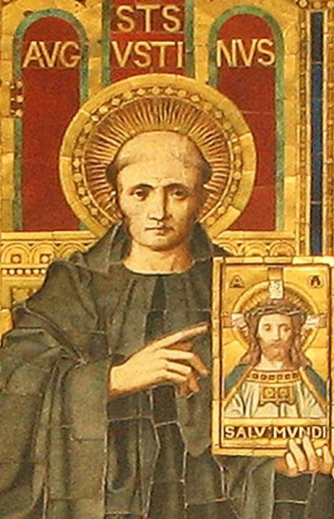
St. Augustine
Benevolent torture

Slide 11
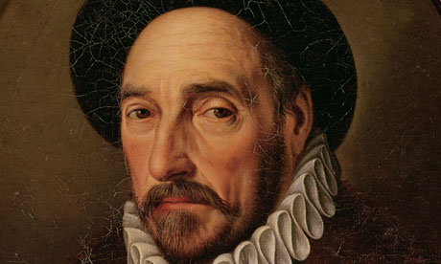
"It is putting a very high price on one's conjectures to have a man roasted alive because of them." [Montaigne (1533-1592), "Of Cripples“]

Slide 12
Presumption of guilt?

Slide 13
Presumption of guilt? Original Sin.

Slide 14
Presumption of innocence? Tabula rasa.

Slide 15
What is the law is based on?
Revelation?
Traditions?
Power?
Reason?

Slide 16
Class-based or Equal Laws?

Slide 17
What is the purpose of punishment?
Justice?
Deterrence?
Rehabilitation?

Slide 18
Proper methods of punishment?

Slide 19
Capital Punishment?
“By the mid-fifteenth century crimes subject to the death penalty … included the following: rebellion, fraud, bigamy, incest, arson, theft, adultery, carrying off a woman against her will, blasphemy, moving signs of property boundaries, attacking someone, high treason, child murder, using dishonest weights and measures, murder, counterfeiting, rape, attempted suicide, striking someone to death, converting to Judaism, treason, having sex with animals, and sorcery.”
Source: Richard Marius, Martin Luther: The Christian between God and Death (Harvard University Press, 1999), pp. 4-5.

Slide 20
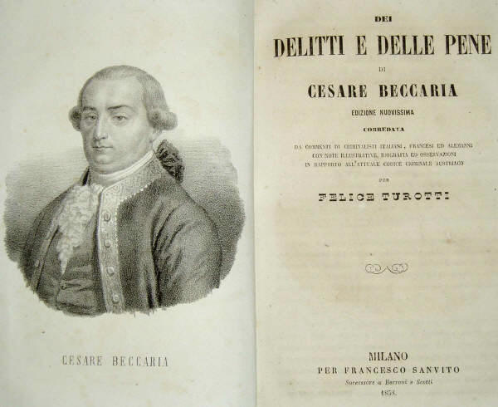
Cesare Beccaria On Crimes and Punishment (1764)

Slide 21
Punishment is preventive not a retributive. Punishment should be proportionate to the crime committed. The probability of punishment, not its severity, will the preventive effect. Procedures of criminal convictions should be public. Punishment should be prompt.
Beccaria on punishment

Slide 22
Beccaria against the death penalty
1. The state does not have the right to take lives.
2. Execution is neither useful nor a necessary form of punishment.

Slide 24
Common law and Civil law systems

Slide 25
