Slide 1
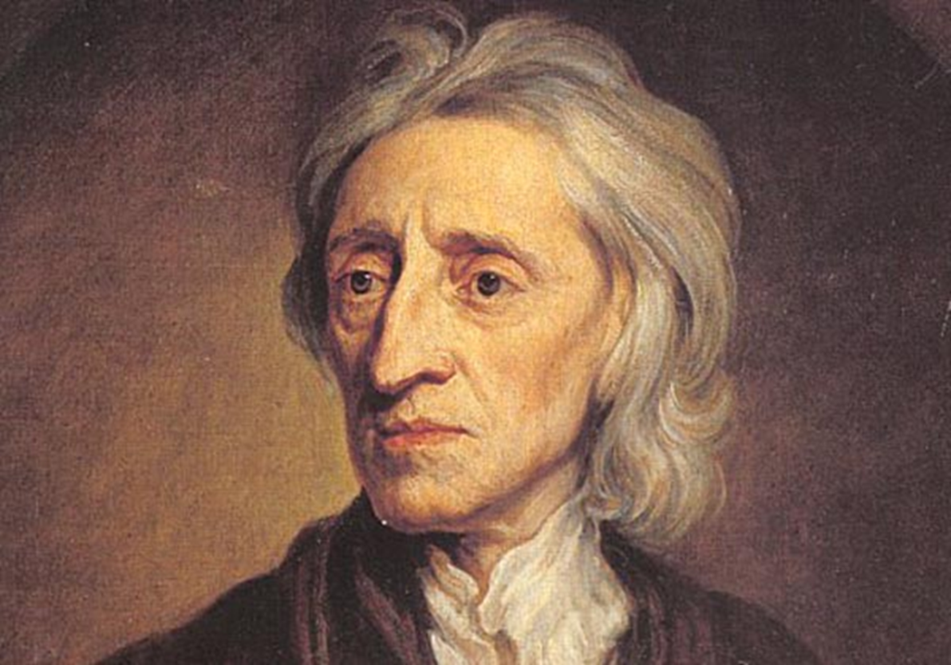
England to the Glorious Revolution

Slide 2
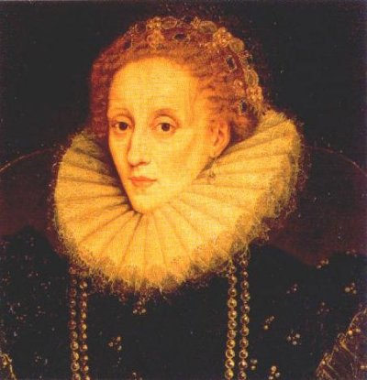
Elizabeth I died in 1603

Slide 3
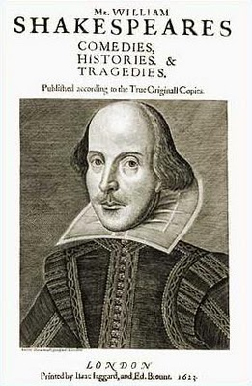

Slide 4
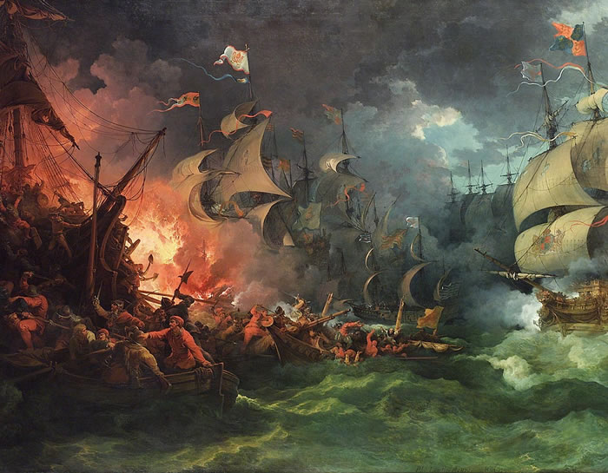
Spanish Armada defeated in 1588.

Slide 5
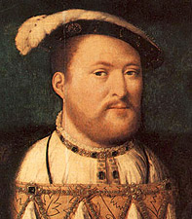
Henry VIII when younger

Slide 6
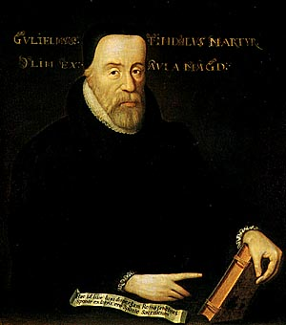
William Tyndale

Slide 7
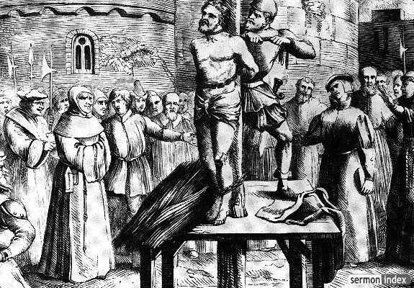
Tyndale’s execution

Slide 8
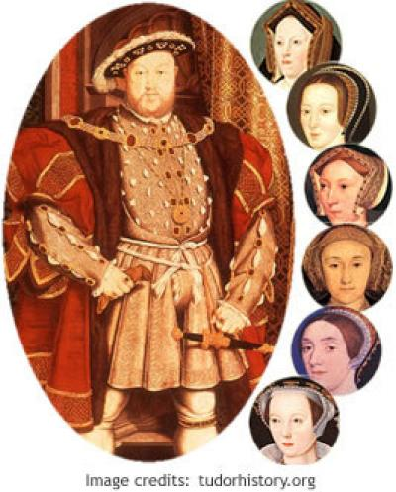
Henry VIII

Slide 9
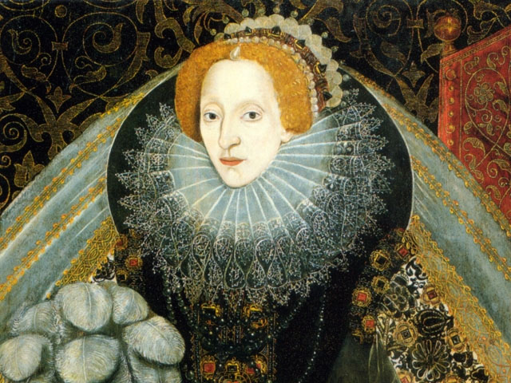

Slide 10
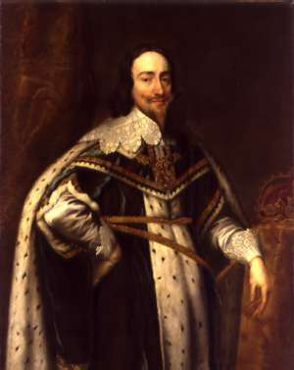
Charles I

Slide 11
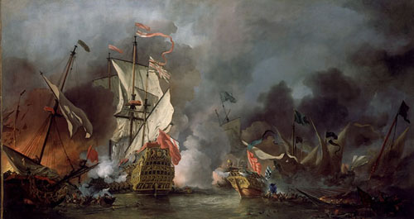
English naval power

Slide 12
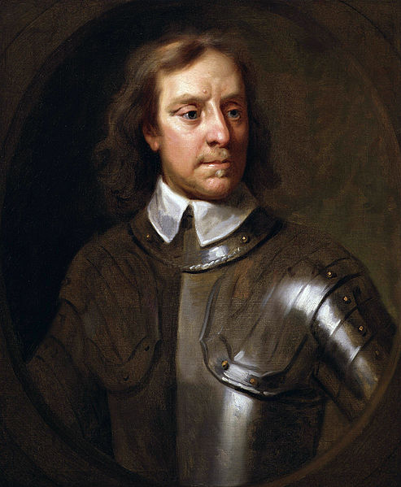
Oliver Cromwell

Slide 13
“Whereas the distracted state of England, threatened with a cloud of blood by a civil war, calls for all possible means to appease and avert the wrath of God, it is therefore thought fit and ordained by the Lords and Commons in this parliament assembled that, while these set causes and set times of humiliation continue, public stage plays shall cease and be forborne.”
(Parliamentary edict, September 2, 1642)

Slide 14
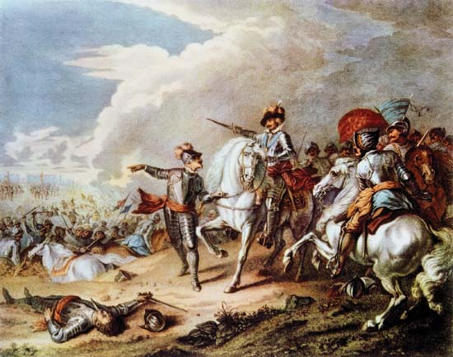
Parliamentary forces victorious

Slide 15
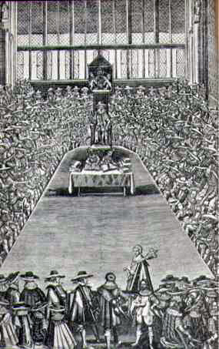
Parliament

Slide 16
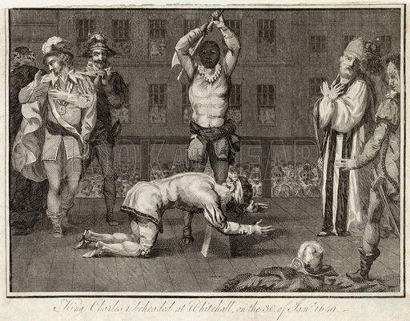
Charles I executed

Slide 17
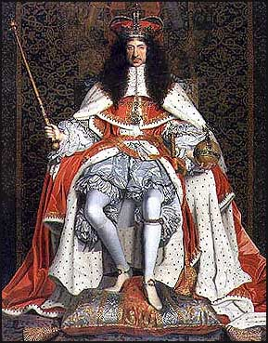
Charles II

Slide 18
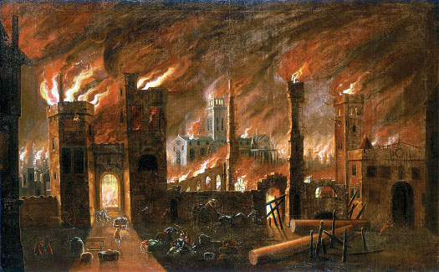
1666 Great Fire of London

Slide 19
John Locke

Slide 20
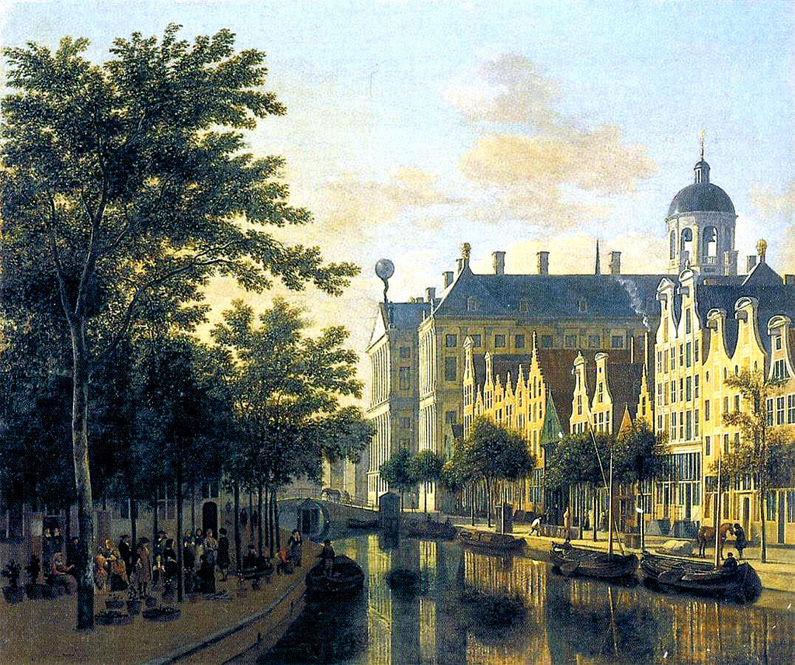
Amsterdam

Slide 21
1688

Slide 22
Politics? Religion?

Slide 23
Anglicans? Catholics? Dissenters? Jews? Moslems?

Slide 24
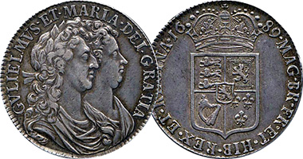
Act of Toleration, 1689

Slide 25
