Slide 1
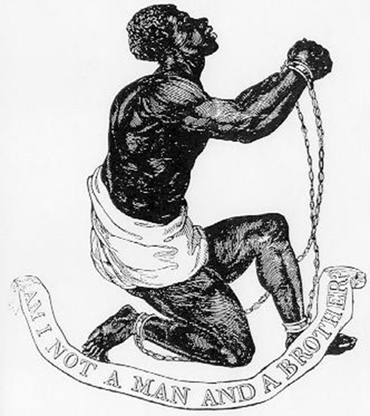
The Battle to End Slavery and Serfdom

Slide 2
By 1500
Slavery had mostly died out in Western Europe.
Elsewhere, still common.

Slide 3
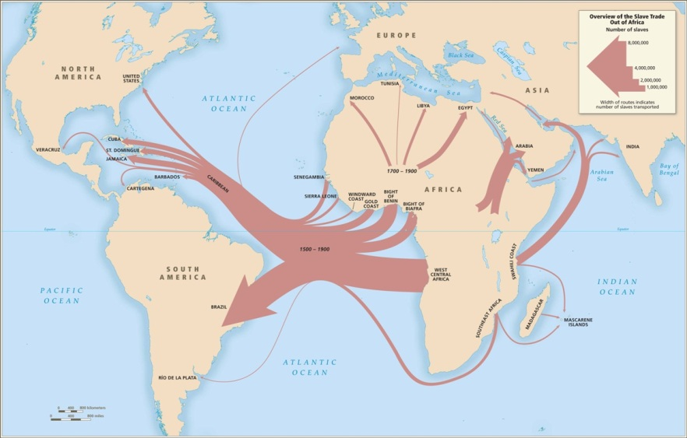

Slide 4
Participation of all races:
African blacks: capturing from other tribes; internal transport; sale at major African slave markets.
North African/Middle Eastern Arabic: some capturing; purchase and Saharan transport.
European/North American whites: some capturing; purchase and Atlantic transport.

Slide 5
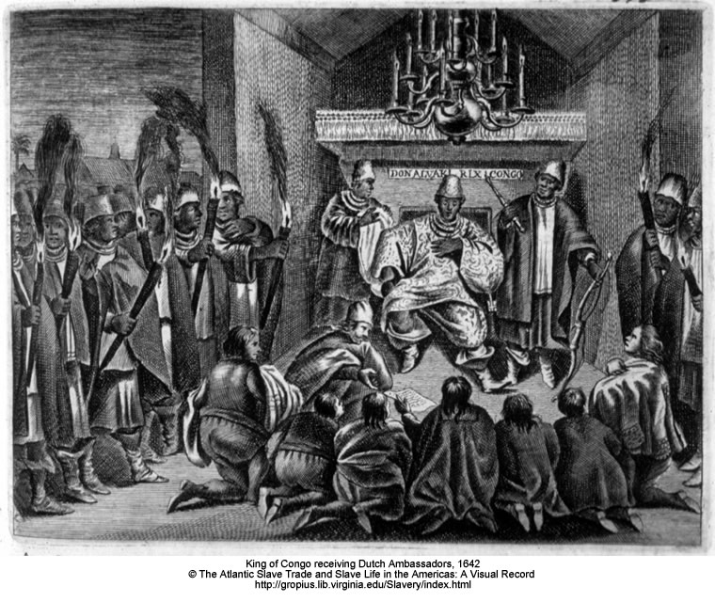
King of Kongo receiving ambassadors

Slide 6
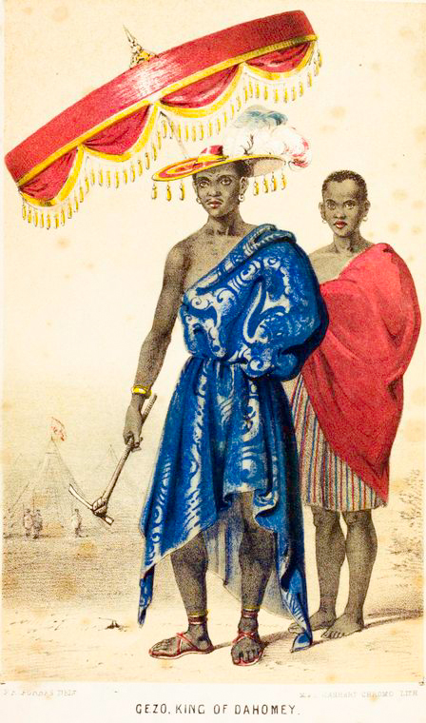
1840s: Dahomey’s King Gezo
“The slave trade is the ruling principle of my people. It is the source and the glory of their wealth … the mother lulls the child to sleep with notes of triumph over an enemy reduced to slavery …”

Slide 7
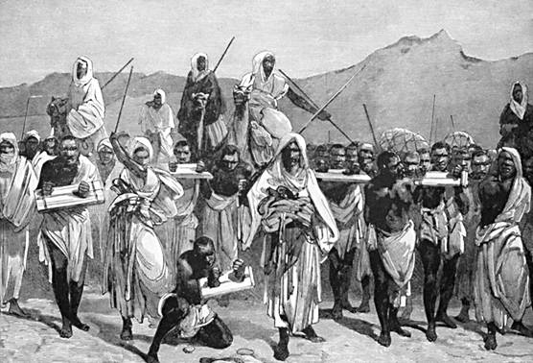
Arab trans-Saharan slave trade

Slide 8
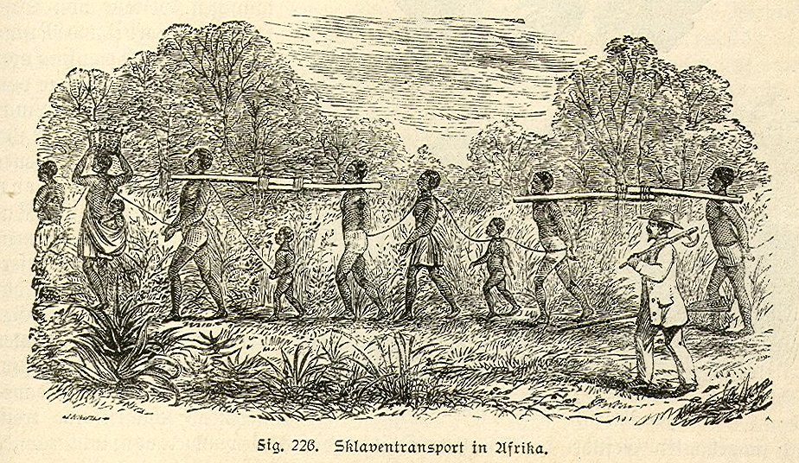

Slide 9
Saharan and Atlantic slave trades compared
Number of Africans enslaved:
Saharan: 28 million.
Atlantic: 11 million.
Duration:
Saharan: 14 centuries
Atlantic: 3 centuries
Principal parties:
Saharan: Middle Eastern/Muslim
Atlantic: European/Christian
Mortality rates during transport:
Trans-Saharan and East African slave trade: between 80 and 90%
Atlantic slave trade: approximately 10%

Slide 10
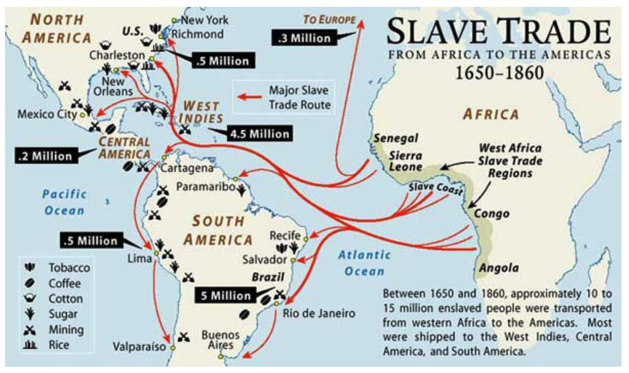

Slide 11
11 million Africans were transported across the Atlantic. 94% went to South and Central America (mainly to Portuguese, Spanish and French possessions). 6% went to colonial America and the USA.

Slide 12
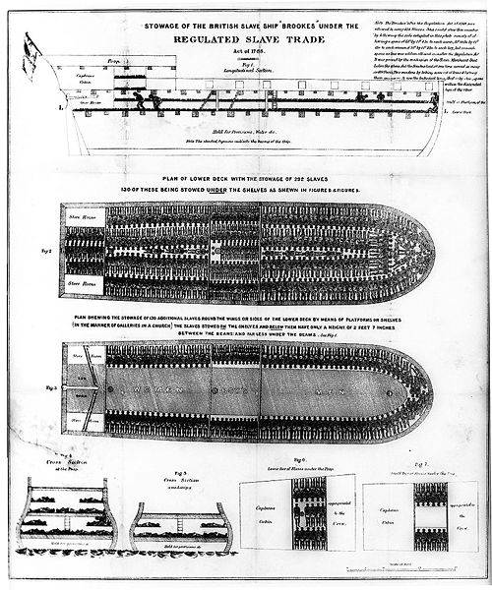

Slide 13
Historical rationales for slavery
Rights of conquest.
The natural inferiority of some.
Religious sanction.

Slide 14
Traditional attitudes: Judeo-Christian West
Exodus 21:20-21: If a man beats his male or female slave with a rod and the slave dies as a direct result, he must be punished; but he is not to be punished if the slave gets up after a day or two, since the slave is his property.
Leviticus 25:44-45: Your male and female slaves are to come from the nations around you; from them you may buy slaves. You may also buy some of the temporary residents living among you and members of their clans born in your country, and they will become your property.

Slide 15
New Testament
1 Peter 2:13: “Submit yourselves for the Lord's sake to every authority instituted among men.”
2:18: “Slaves, submit yourselves to your masters with all respect, not only to those who are good and considerate, but also to those who are harsh.”
Ephesians: “Servants, be obedient to them that are your masters according to the flesh, with fear and trembling, in singleness of your heart, as unto Christ.”

Slide 16
The battle against slavery begins

Slide 17
Progression
Intellectual: Slavery is wrong.
Societies formed: Discussion, activism. E.g., Pennsylvania Society for Promoting the Abolition of Slavery (1774). Society for the Abolition of the Slave Trade (Britain, 1787). Société des Amis des Noirs (France, 1788).
Legislation: (a) Prohibit in the home country, (b) Prohibit the international trade (Britain and the USA, 1807), (c) Prohibit in the colonies (e.g., French 1794). (d) Children born of slaves are not slaves.
War: E.g., British Naval patrols, US Civil War (1861-1865).

Slide 18
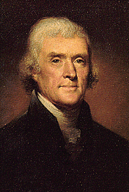
Thomas Jefferson on slavery
Draft of Constitution for the State of Virginia (1776):
“No person hereafter coming into this county shall be held within the same in slavery under any pretext whatever.”

Slide 19
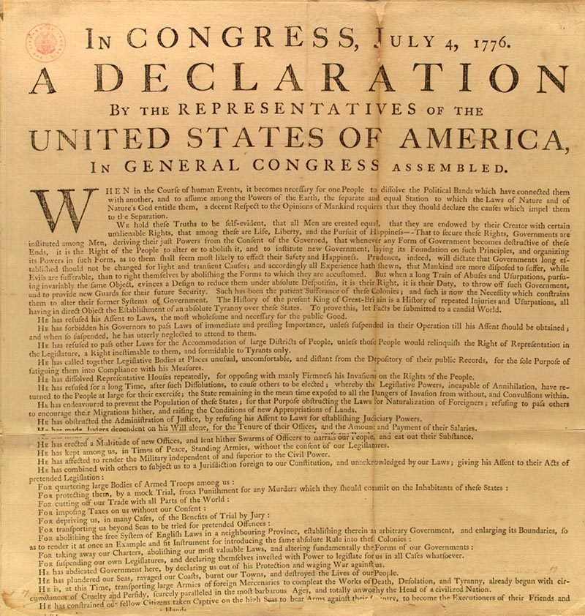

Slide 20
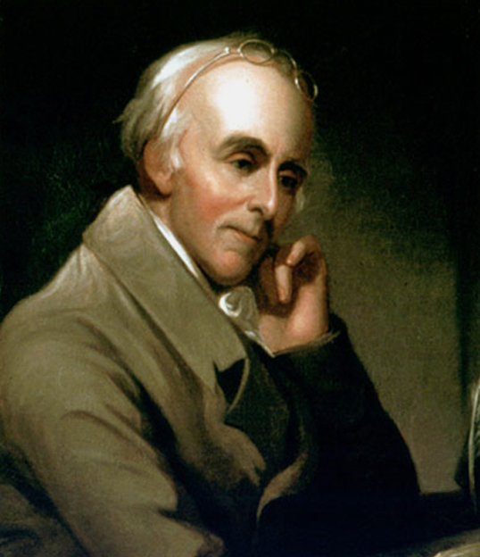
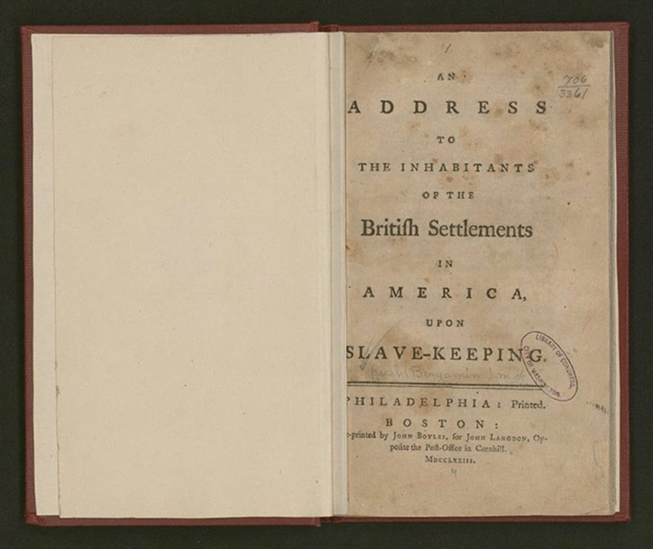
Benjamin Rush: Co-founder with Benjamin Franklin of Pennsylvania Society for Promoting the Abolition of Slavery (1774)

Slide 21
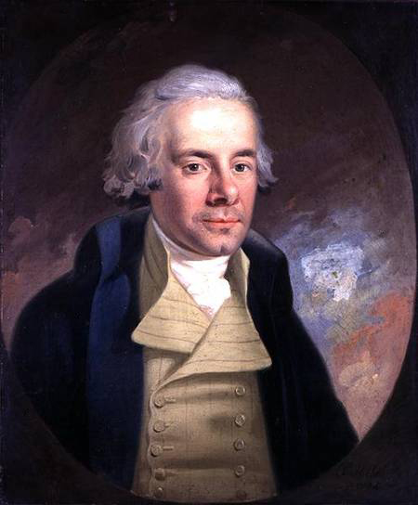
William Wilberforce: 1789 speech before British Parliament.

Slide 22
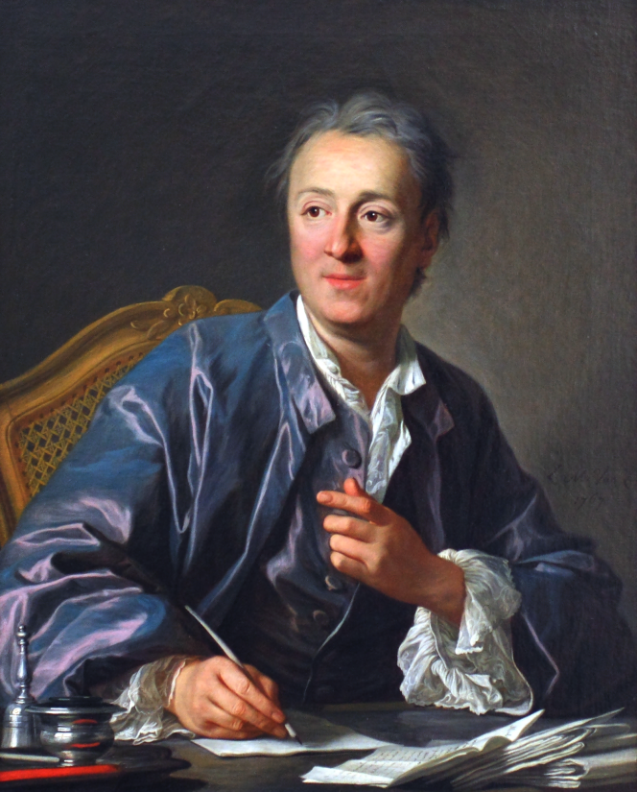
Denis Diderot on the slave trade:
The Africans “are tyrannized, mutilated, burnt and put to death, and yet we listen to these accounts coolly and without emotion. The torments of a people to whom we owe our luxuries are never able to reach our hearts.”

Slide 23
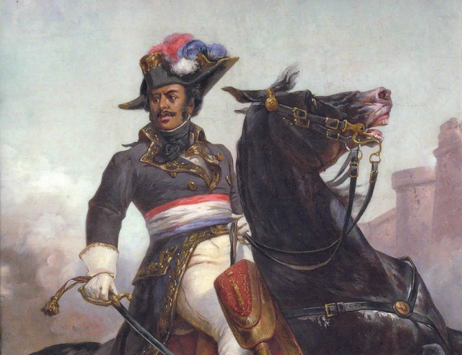
Thomas-Alexander Dumas

Slide 24
Gannibal

Slide 25
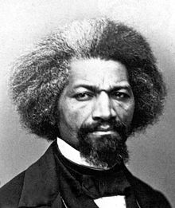
Frederick Douglass

Slide 26
In a letter to his former master (1848), Douglass explains why he escaped from slavery:
“The morality of the act, I dispose as follows: I am myself; you are yourself; we are two distinct persons, equal persons. What you are, I am. You are a man, and so am I. God created both, and made us separate beings. I am not by nature bound to you, or you to me. Nature does not make your existence depend upon me, or mine to depend upon yours. I cannot walk upon your legs, or you upon mine. I cannot breathe for you, or you for me; I must breathe for myself, and you for yourself. We are distinct persons, and are each equally provided with faculties necessary to our individual existence.”

Slide 27
The contribution of the Industrial Revolution:
“Western technology made slavery unnecessary; Western ideas made it intolerable.”
(Bernard Lewis, "Eurocentrism Revisited," Commentary, December 1994)
Josiah Wedgwood, anti-slavery medallion

Slide 28
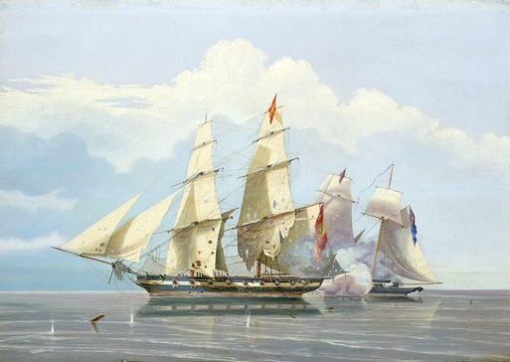
1841
Treaty makes slave-trading an act of piracy.
Signed by Britain, France, Austria, Prussia, and Russia.
British anti-slave patrols off West Africa.

Slide 29
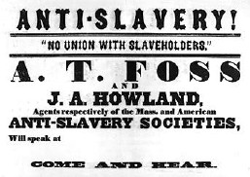
1850s:

Slide 30
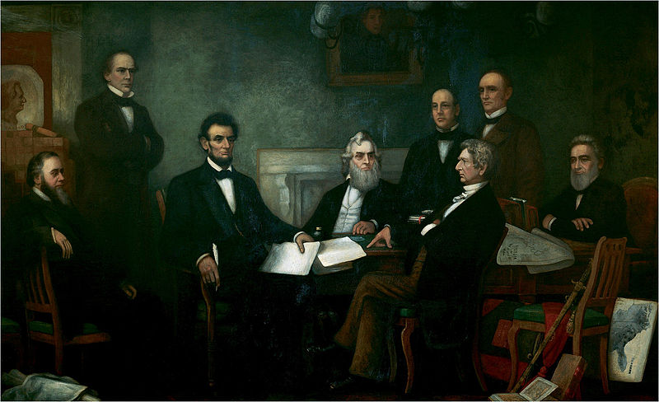
Emancipation Proclamation, 1863

Slide 31
Slavery not yet eliminated everywhere

Slide 32
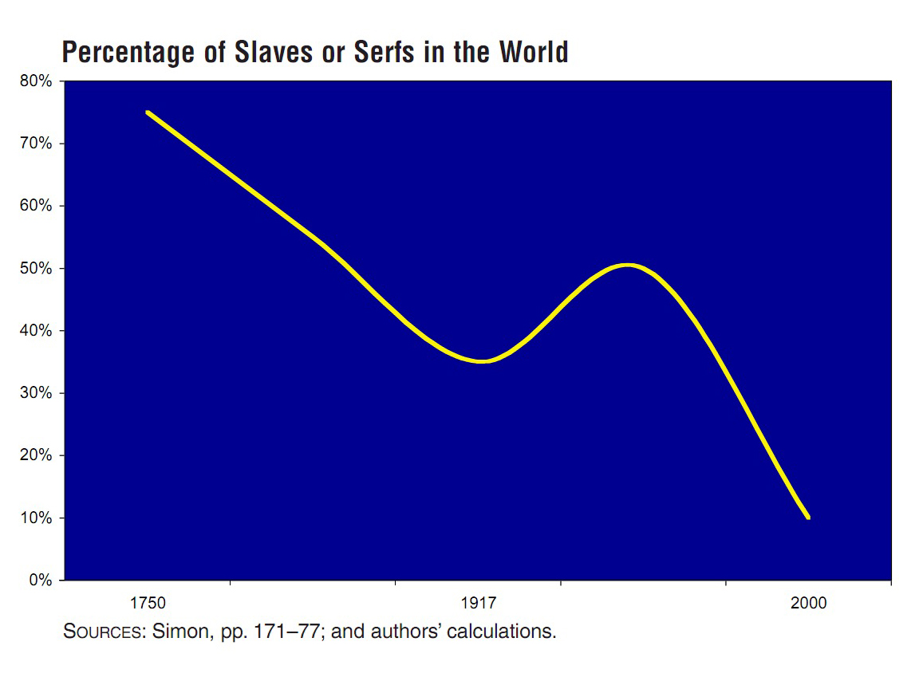

Slide 33
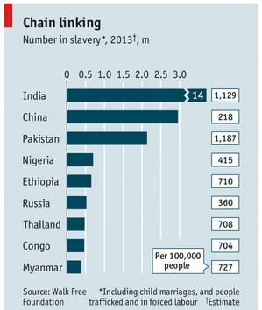
Source: The Economist (http://tinyurl.com/opd7koj)

Slide 34
Abolishing serfdom

Slide 35
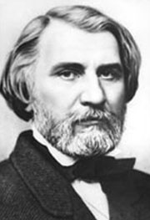
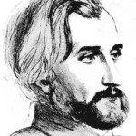
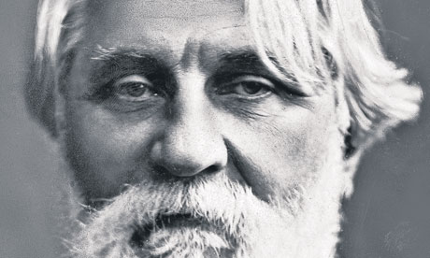
Ivan Turgenev

