Slide 1
What is a civilization?

Slide 2
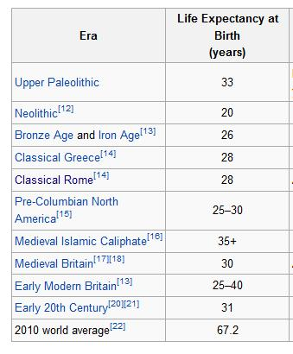
http://en.wikipedia.org/wiki/Life_expectancy

Slide 3
Infant mortality
The percentage of children born in London who died before the age of five:
Years 1730-1749: 74.5%
Years 1810-1829: 31.8%
Sources:
Mabel C. Buer, Health, Wealth and Population in the Early Days of the Industrial Revolution, London: George Routledge & Sons, 1926, p. 30.
BBC—History—The Foundling Hospital. Published: 2001-05-01.

Slide 4
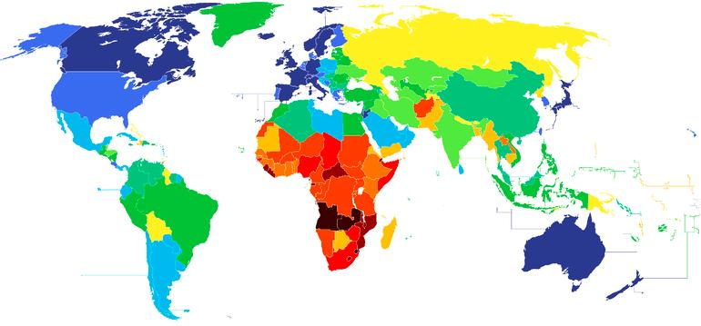
Life expectancy at birth, 2012

Slide 5
The role of:
Economics?
Politics?
Religion?
Science?
Technology?
Philosophy?
Etc.?

Slide 6
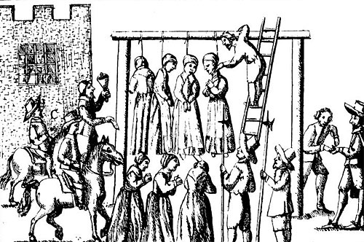
Witches hanged

Slide 7
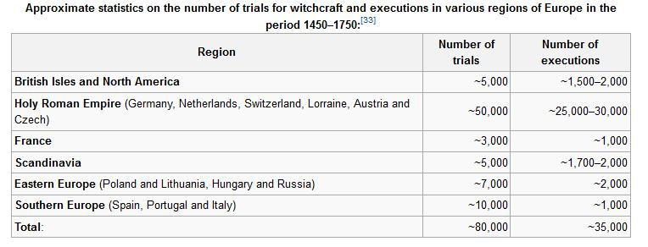

Slide 8
What is Western civilization?

Slide 9
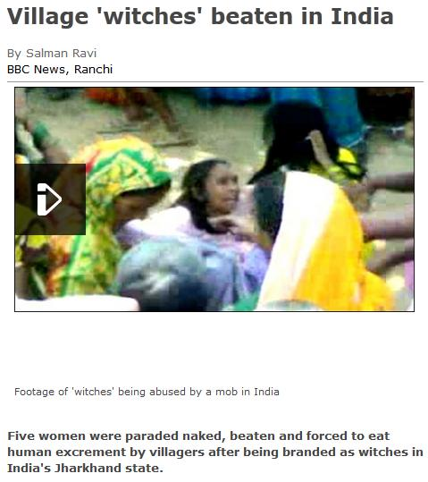

Slide 13
