Slide 2
Velázquez
Las Meninas
Art begins in the mind of a creative individual. The artist takes his significant experiences and thoughts as raw material and creates a perceptual embodiment for them. Each artist makes independent judgments about which of his experiences and thoughts are significant. And to the best of his ability and with his unique style, each artist employs the techniques of his perceptual medium of choice. The result is an object that, at its best, has an awesome power to exalt the senses, the intellects, and the passions of those who experience it.

Slide 3
Michelangelo
Creation of the Sun and Moon
Those individuals who over the centuries accepted art’s calling developed it into a vehicle that called upon the highest insights of the human creative vision and demanded exacting skill. The names that evoke in us a sense of greatness — Leonardo, Michelangelo, Raphael, Rembrandt, Vermeer — stand for those individuals who expanded the range of themes and subjects and developed the repertoire of techniques available to the next generation of artists. Their achieve-ments created the status of the artist as not merely a visionary or a craftsman, but as a special individual in whom both vision and craft are integrated and heightened.

Slide 4
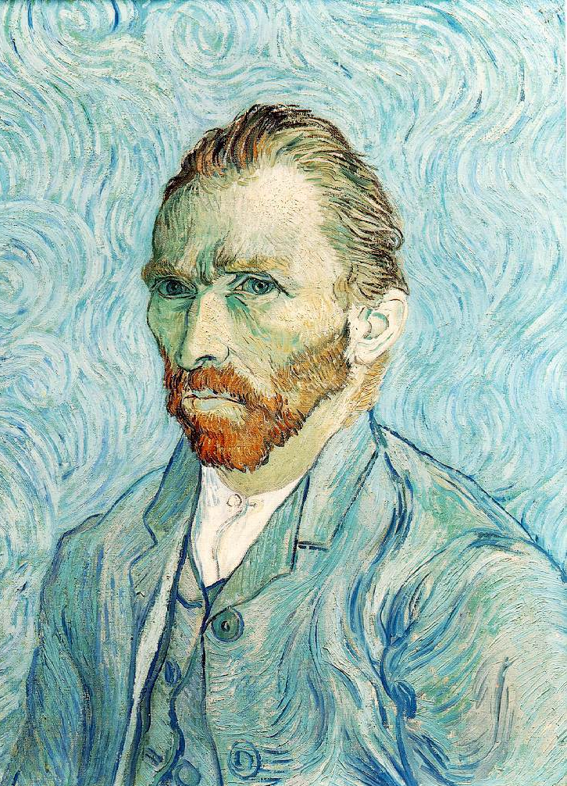
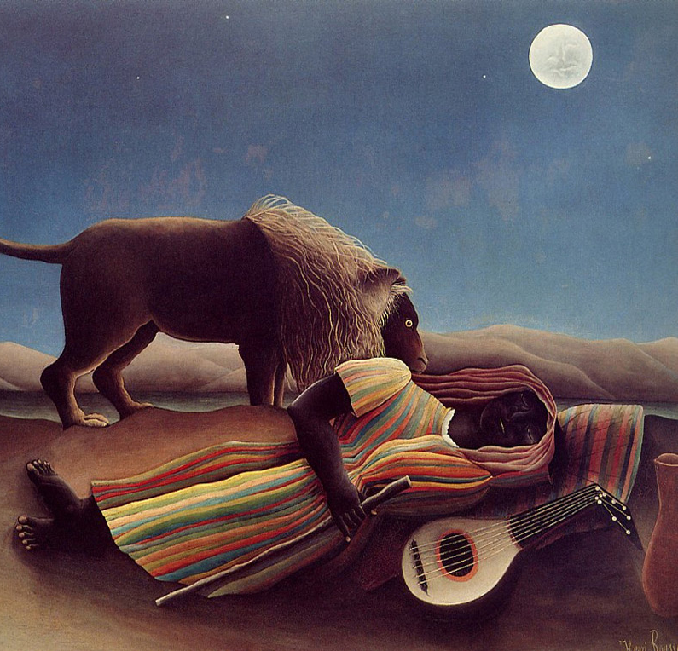
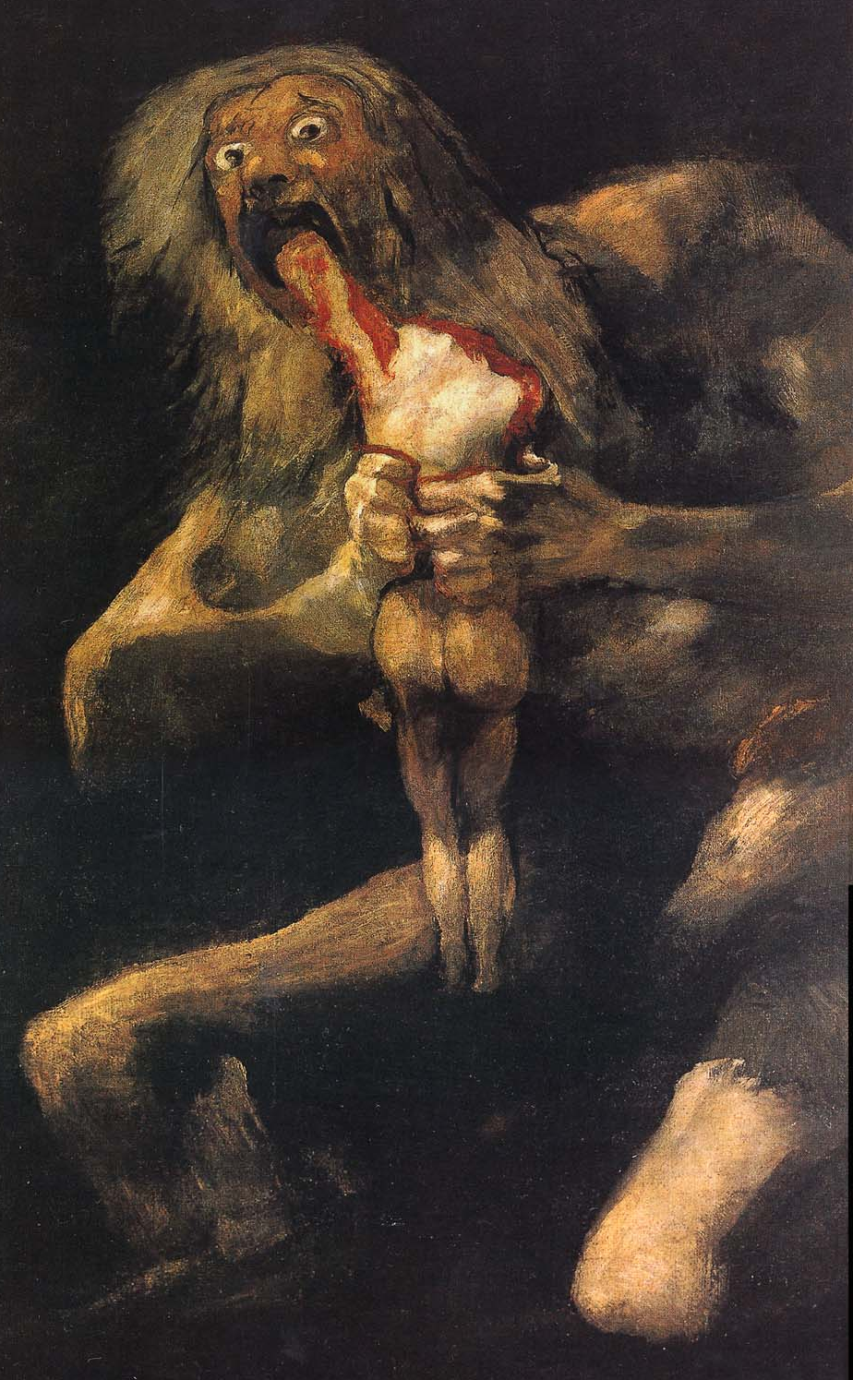
Van Gogh
Self Portrait
Rousseau
The Sleeping Gypsy
Goya
Saturn Devouring His Son
But by about the middle of the nineteenth century, the art world began to lose its confidence. The art world’s symptoms of decline were part of the broader intellectual world’s slipping into a sense that progress, beauty, optimism, and genuine originality were no longer possible.

Slide 5
Hans Olde
Portrait of Friedrich Nietzsche
The causes of the sense of decline were many. The increasing naturalism of the nineteenth century led, for those who had not shaken off their religious heritage, to a feeling of being alone and without guidance in a vast, empty universe. The rise of philosophical theories of skepticism and irrationalism led many to distrust their cognitive faculties of perception and reason. The development of scientific theories such as evolution and entropy brought with them pessimistic accounts of human nature and the destiny of the world.

Slide 6
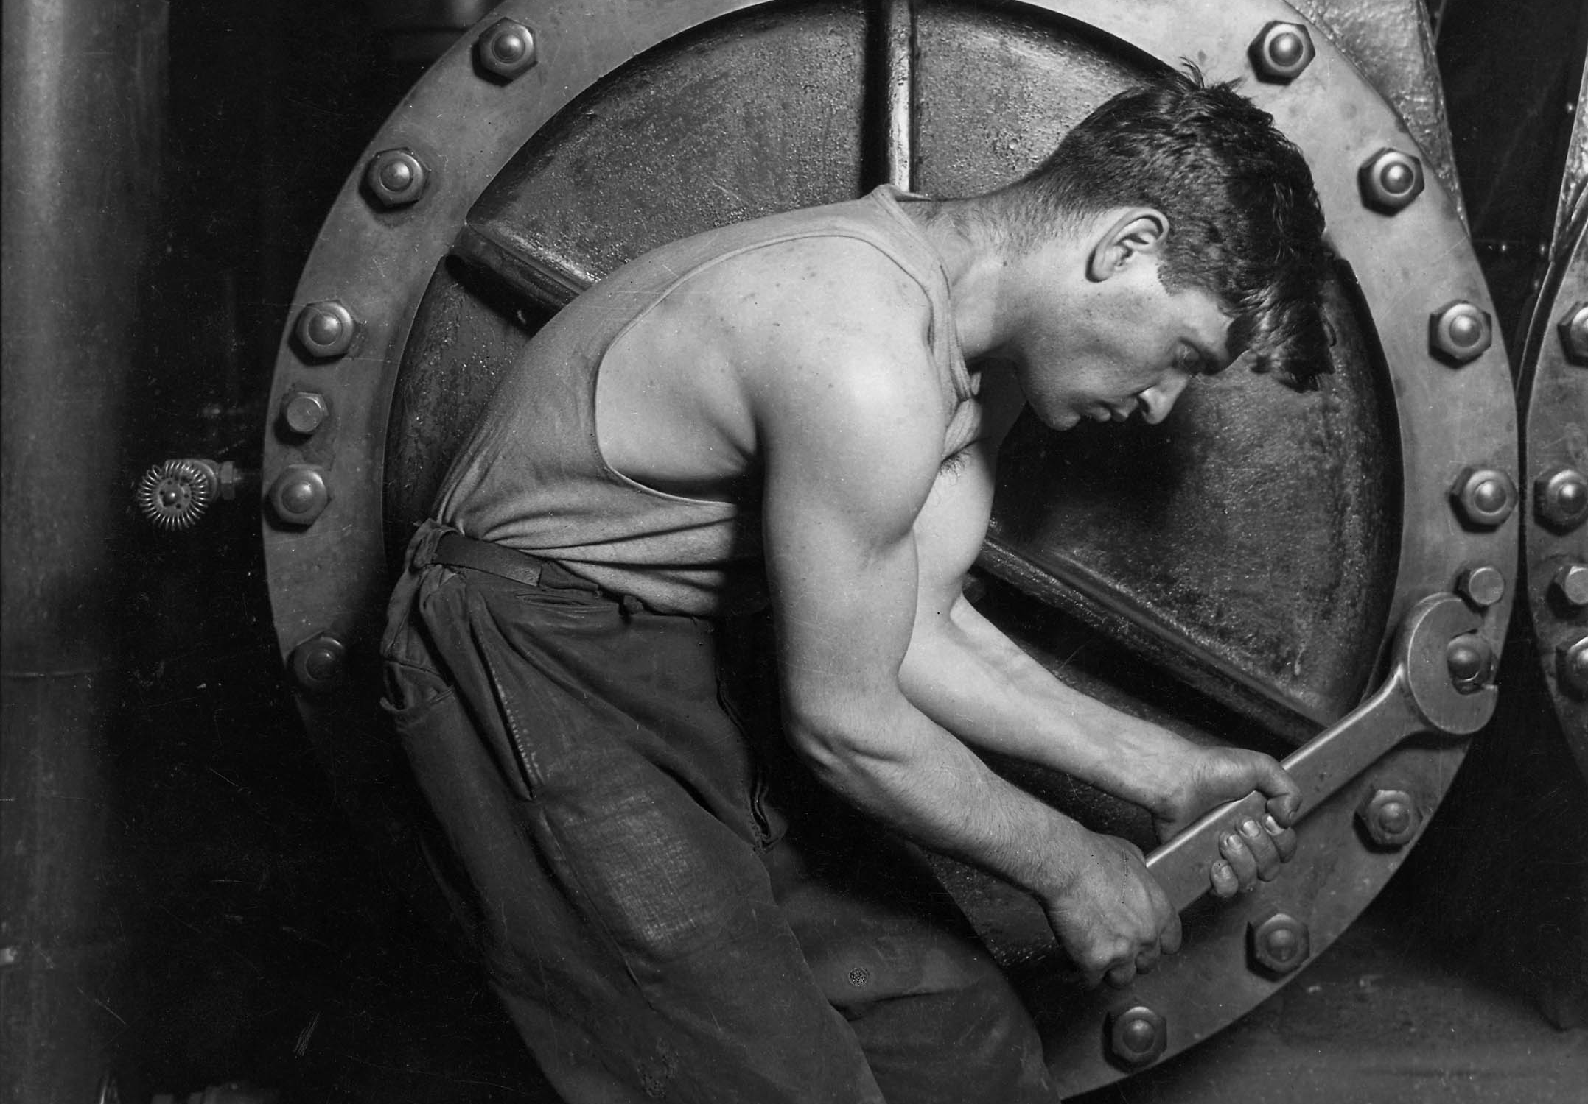
Hine
Power house mechanic working on steam pump
The spread of liberalism and free markets caused their opponents on the political left, many of whom were members of the artistic avant garde, to see political developments as a series of deep disappointments. And the tech-nological revolutions spurred by the combination of science and capitalism led many to project a future in which mankind would be dehumanized or destroyed by the very machines that were supposed to improve their lot.

Slide 7
Munch
Vampire
By the turn of the twentieth century, the nineteenth-century intellectual world’s sense of disquiet had become a full-blown anxiety. The artists responded, exploring in their works the implications of a world in which reason, order, certainty, dignity, and optimism seemed to have disappeared.
The works that are the iconic pieces of twentieth century art express the minds of the great names that created them.

Slide 8
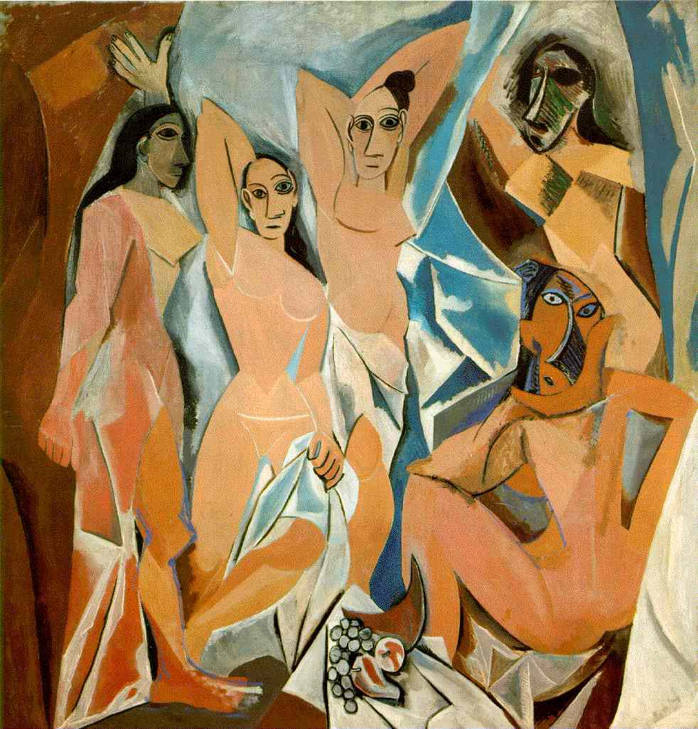
Picasso
Les Demoiselles d'Avignon
Twentieth-century art is Pablo Picasso’s fractured world populated by vacant-eyed, disjointed beings.

Slide 9
Hopper
Summer Interior
It is Edward Hopper’s emotionally out-of-tune men and women in bland, worn settings.

Slide 10
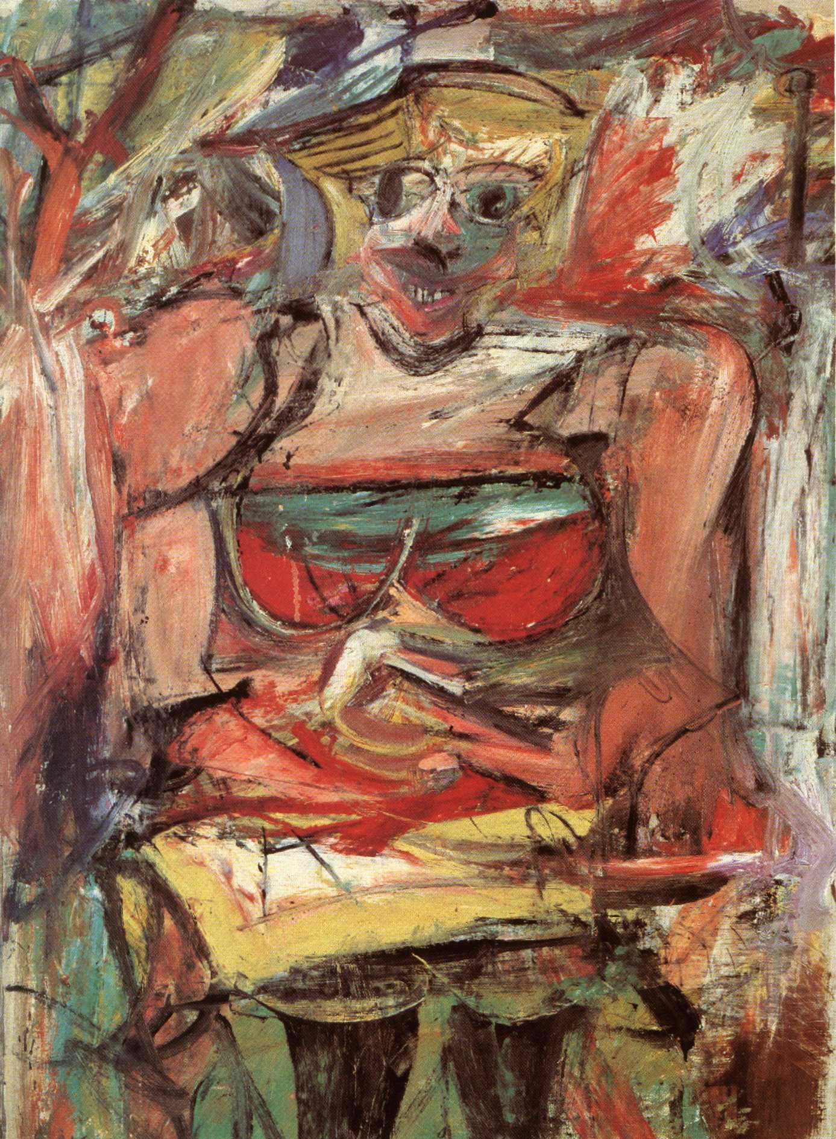
de Kooning
Woman V
It is the predatory horror of Willem de Kooning’s Woman series.

Slide 11
Dalí
Ascension
It is Salvador Dali’s surreal world in which the distinction between subjective dream states and objective reality is obliterated.

Slide 12
Warhol
Marilyn
It is Andy Warhol’s smirking trivialization and mechanical reproductions.

Slide 13
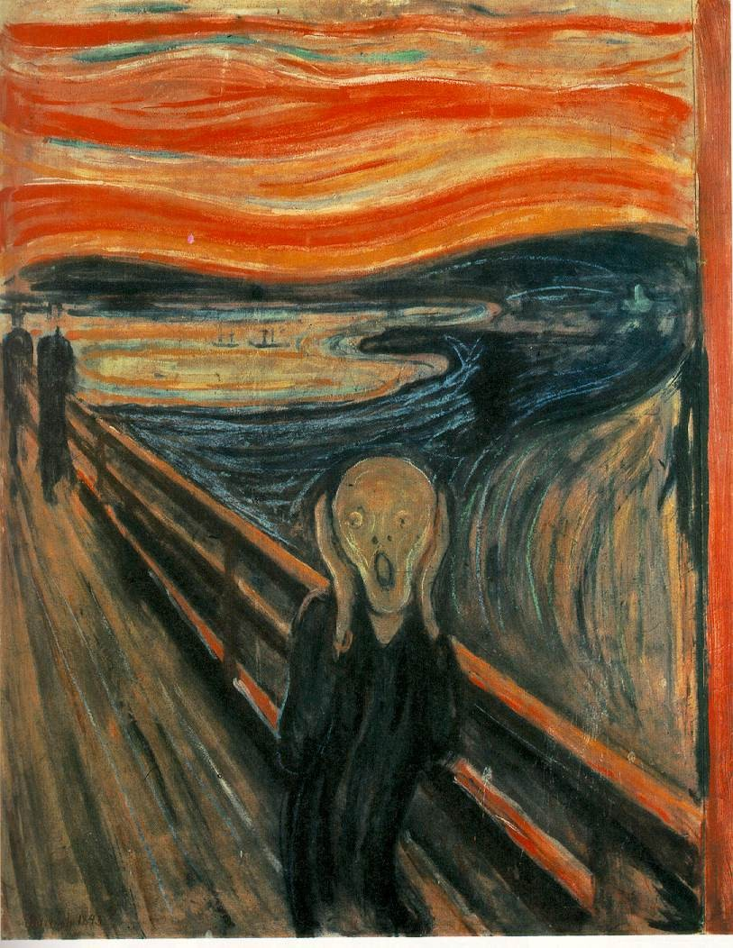
Munch
The Scream
It is a reality that is captured presciently in Edvard Munch’s The Scream, the horror of being a cypher in a world of hideously swirling near-formless forms.

Slide 14
Dalí
Galatea of the Spheres
The twentieth-century world is also the story of its own self-elimination. While Picasso and Munch looked at reality and reported their depressed observ-ations, others retreated from the world and proceeded to strip away from art anything that they could. On the grounds that other media such as photography and literature reproduced reality and told stories, many eliminated as much content as they could from their works. Art came to be a self-contained study of dimension, color, and composition. But the reductionist, stripping-away game led quickly to challenges even to those features.

Slide 15
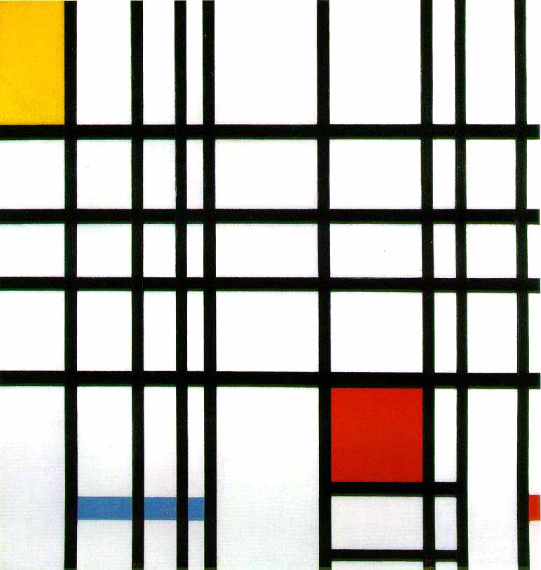
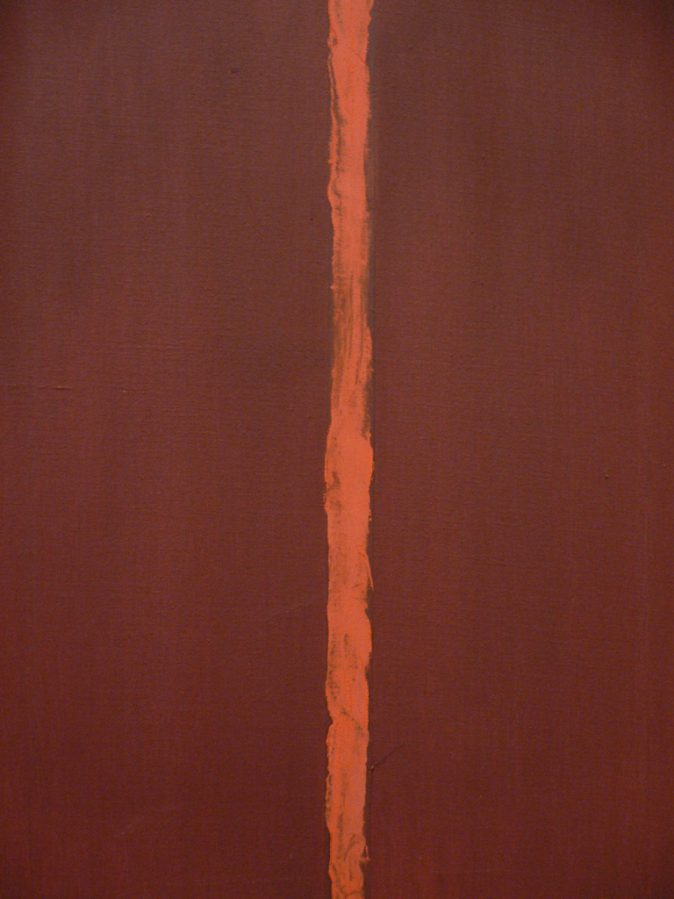
Mondrian
Composition with Yellow, Blue, and Red
Newman
Onement 1
In the sterile color studies of Piet Mondrian and Barnett Newman, any sense of a third dimension disappeared.

Slide 16
Malevich
White on White
In Kasimir Malevich’s near-monochrome White on White, color differentiation was abandoned.

Slide 17
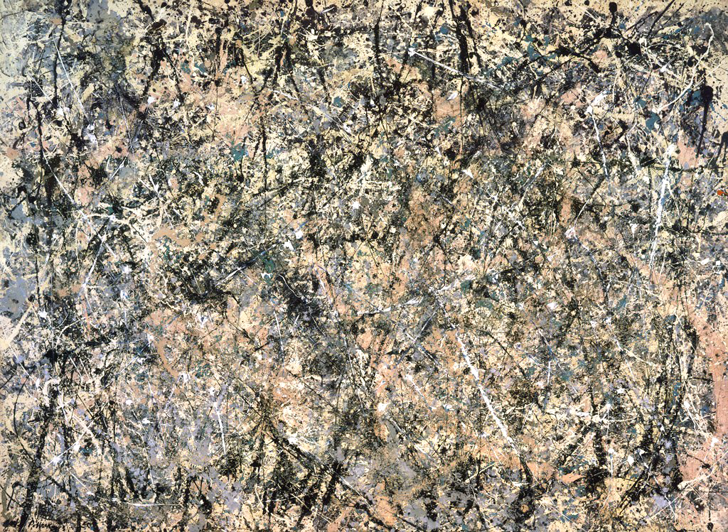
Pollock
Number 1, (Lavender Mist)
And with Jackson Pollock’s erratic paint drips and splatters, any role of artistic composition was eliminated.

Slide 18
Malevich
Black Square
The art world had reached a dead end. When it looked out at the world through the eyes of Picasso and Munch, it saw nothing of value. When it looked at what the reductionists had produced, it saw that nothing uniquely artistic had survived. Collectively, the leading members of the art world had decided that art has no content, that it has no special media or techniques, and that the artist has no crucial role in the process. Art became nothing—or a statement of nothingness.
The summary conclusion was announced, infamously, by Marcel Duchamp.

Slide 19
Duchamp
Fountain
Asked to submit something for display in 1917, Duchamp sent a urinal.

Slide 20
Julian Wasser
Marcel Duchamp and Eve Babitz
Duchamp of course knew the history of art. He knew what had been achieved—how over the centuries art had been a powerful vehicle that called upon the highest development of the human creative vision and demanded exacting technical skill; and he knew that art had an awesome power to exalt the senses, the minds, and the passions of those who experience it. Duchamp reflected on the history of art and decided to make a statement. The artist is not a great creator—Duchamp went shopping at a plumbing store. The artwork is not a special object—it was mass-produced in a factory. The experience of art is not exciting and ennobling—at best it is puzzling and mostly leaves one with a sense of distaste. But over and above that, Duchamp did not select just any ready-made object to display. In selecting the urinal, his message was clear: Art is something you piss on.

Slide 21
da Vinci
Lady with an Ermine
Art by its nature is about the significant. To the extent that art is an expression of the artist’s being, it expresses what the artist thinks and feels to be significant. To the extent that art is an act of communication, it is a statement to an audience of what the artist thinks and feels to be important. When an artist decides to devote a week, a month, or a year or more of his life to creating This rather than That—he is saying that This is worth his time and effort. When the artist presents the results of his efforts to an audience, he is telling them that his creation is worthy of the time and effort of their contemplation. We do not waste our time on the insignificant or ask others to waste theirs—unless we wish to express the significant belief that nothing is significant.

Slide 22
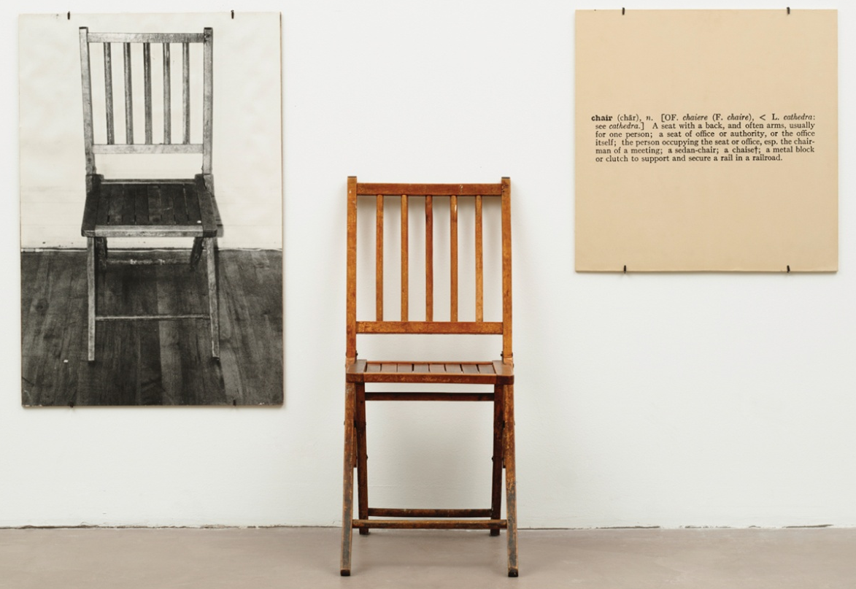
Kosuth
One and Three Chairs
Duchamp and the others have become the iconic figures of recent art history. Through them, the story of the art world is a story of self-conscious dis-integration.
Once, however, everything has been disintegrated, every artist has a choice. He can choose to play the current game of cynicism and despair, hoping, at best, to introduce a minor variation here and there. Or he can look afresh at the world and rediscover in it the potential that earlier great artists pointed us toward.

Slide 23
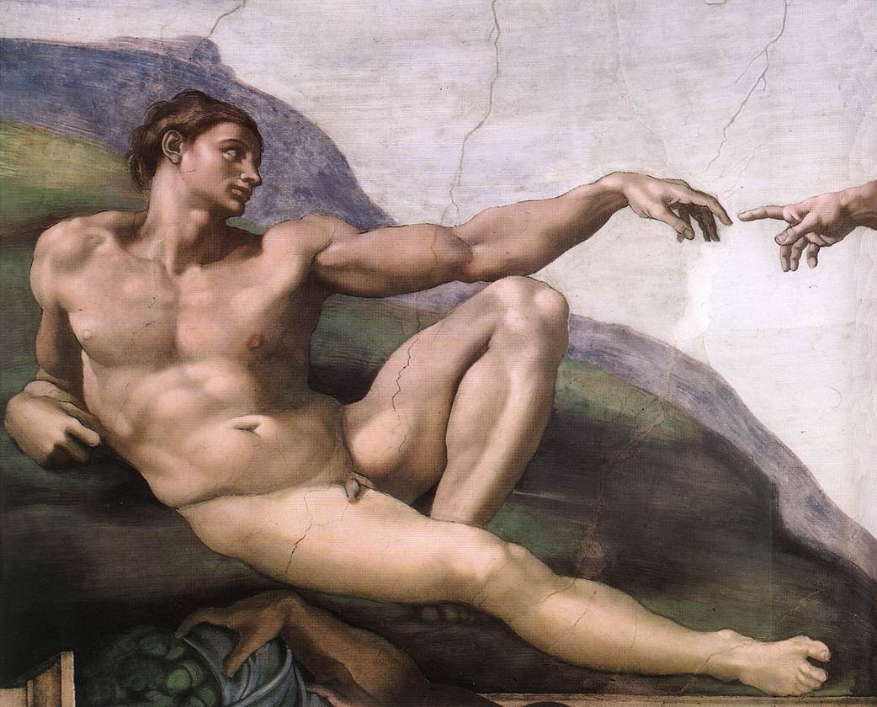
Michelangelo
Creation of Adam
Much of the art world is currently a long way from building upon Michelangelo’s powerfully stylized human forms …

Slide 24
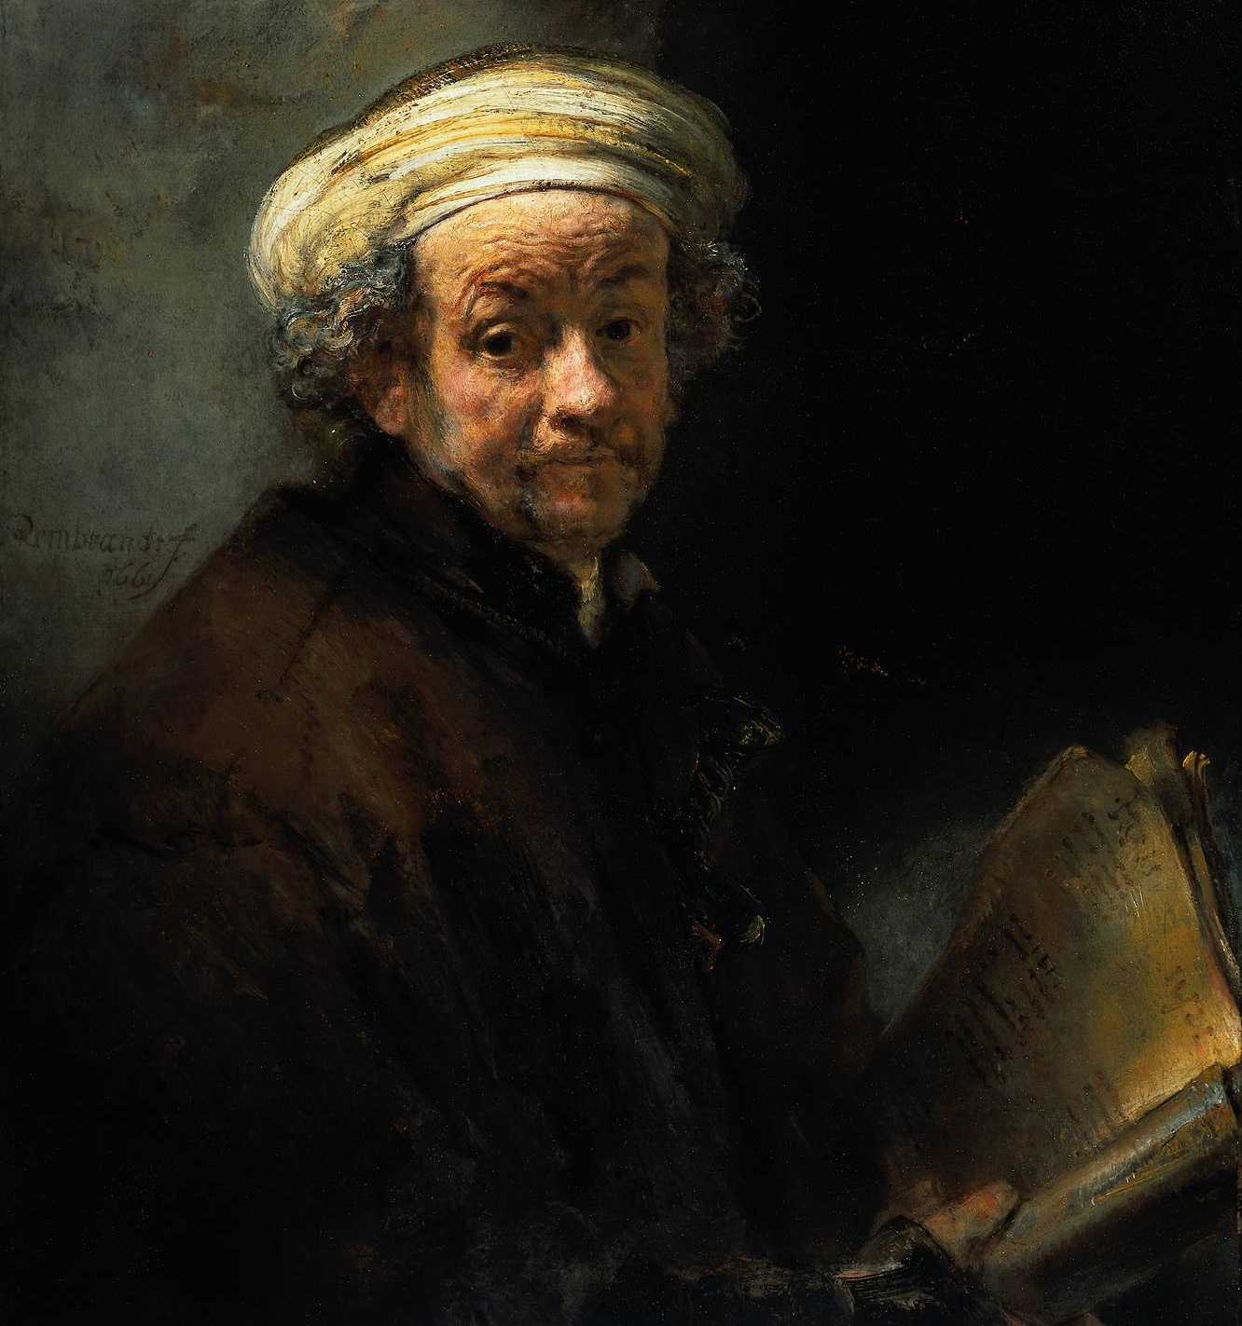
Rembrandt
Self Portrait
… Rembrandt’s skill of characterization …

Slide 25
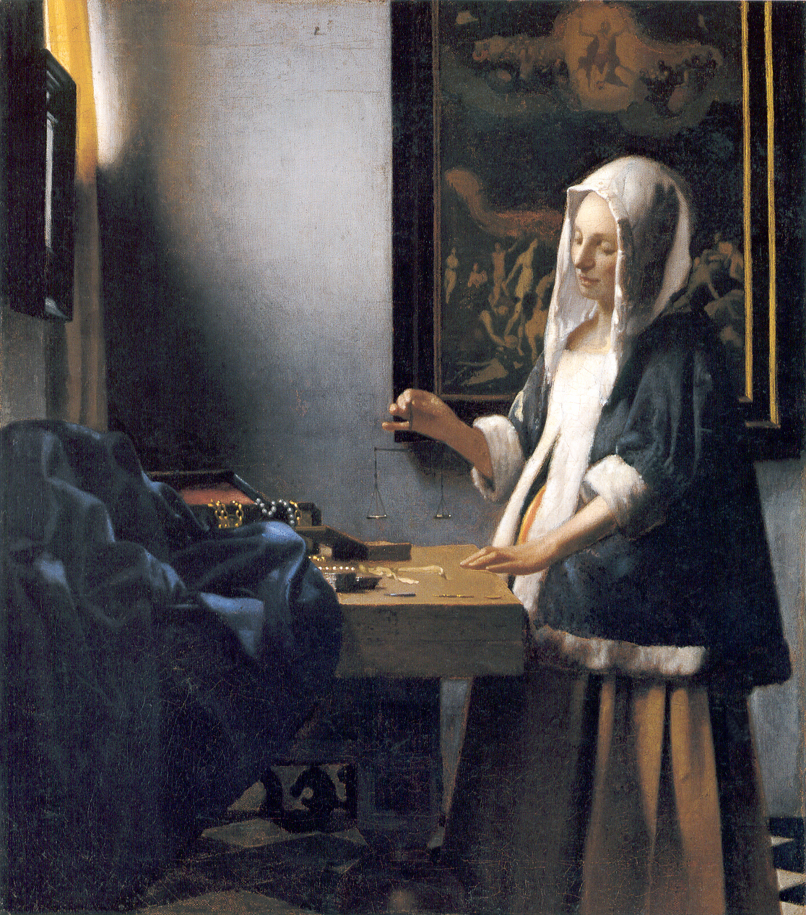
Vermeer
Woman Holding a Balance
… Vermeer’s exquisite use of light.

Slide 26
Bierstadt
Among the Sierra Nevada Mountains
Though closer in time, much of it is also a long way from the majesty in the works of Albert Bierstadt …

Slide 27
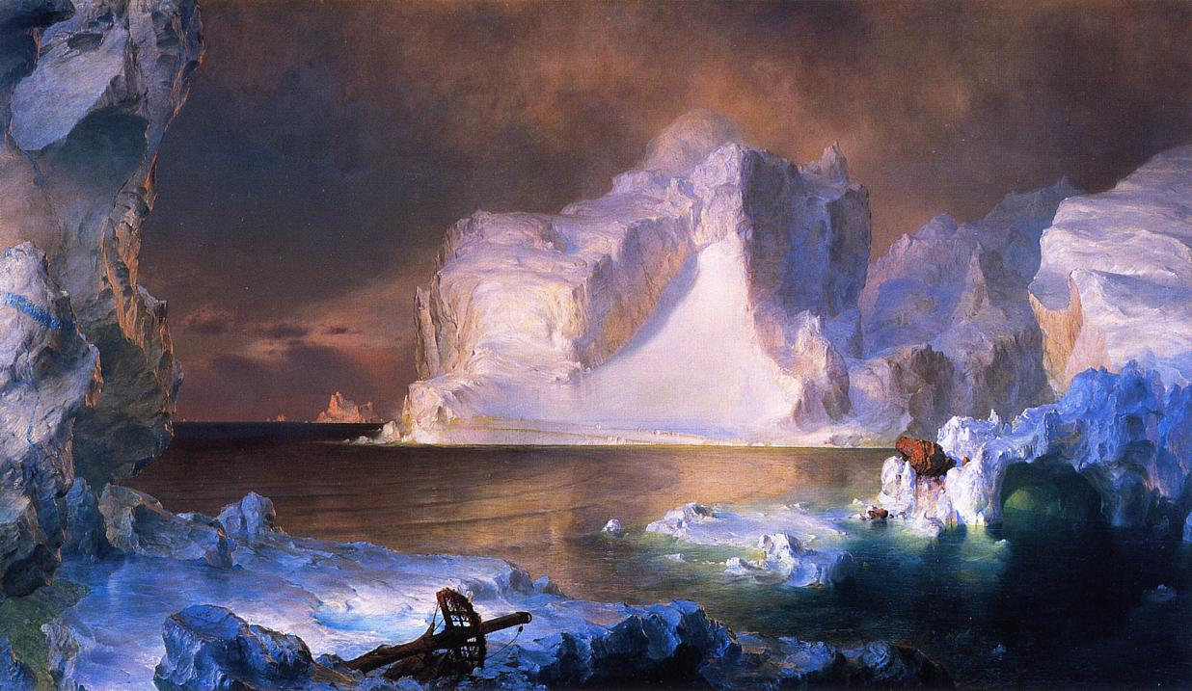
Church
The Icebergs
… and Frederick Church …

Slide 28
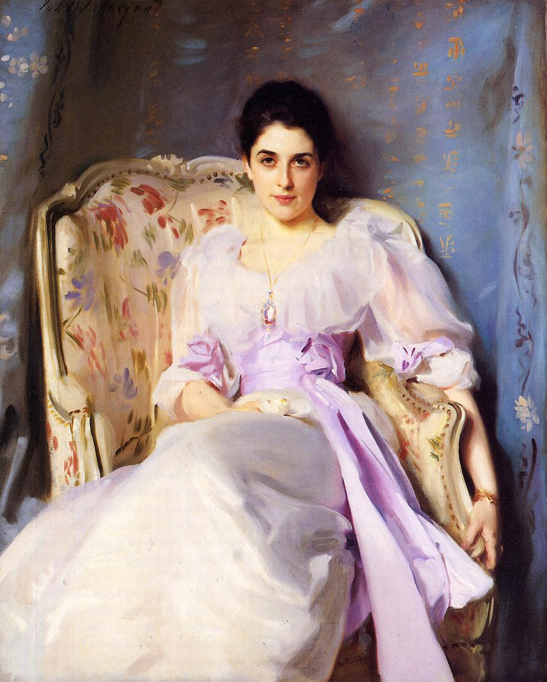
Sargent
Lady Agnew of Lochnaw
… the elegance of John Singer Sargent’s paintings …

Slide 29
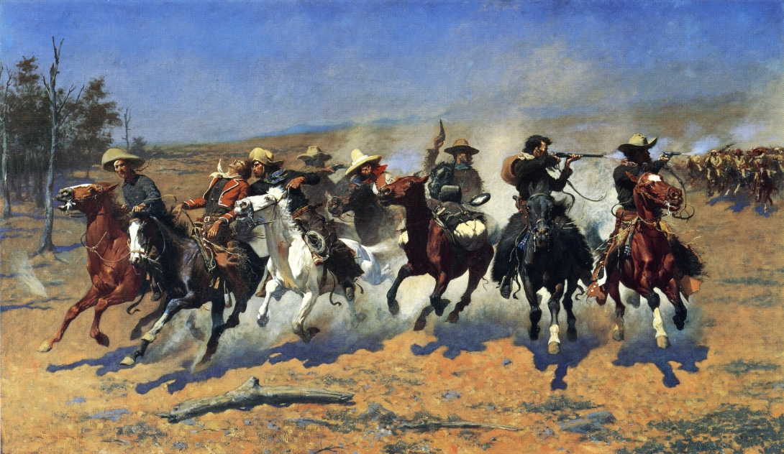
Remington
A Dash for the Timber
… or the exuberance of Frederic Remington’s.

Slide 30
Friedrich
Wanderer Above the Sea of Fog
The artist is not an archaeologist, and the point is not to resurrect and imitate the past. The point is that the world they saw and a whole lot more is still out there.
The artist, like every thinking and passionate human being, has the power to decide whether to accept the assumptions of the recent past and work within them, or whether to strike out on his own, questioning those assumptions and actively seeking alternatives to them. Every artist, in his work, expresses the deepest choices he has made. That power of expression is what compels some of us to be artists in the best sense, and it is what attracts those of us who are not artists to their creations. The strategic choice of what to express and how, accordingly, is everything.

Slide 31
Stephen R. C. Hicks, Ph.D.
Professor of Philosophy
Executive Director, Center for Ethics and Entrepreneurship
Rockford College
www.StephenHicks.org
Slide show design by Christopher Vaughan
cvaughan@rockford.edu

